Slide 1
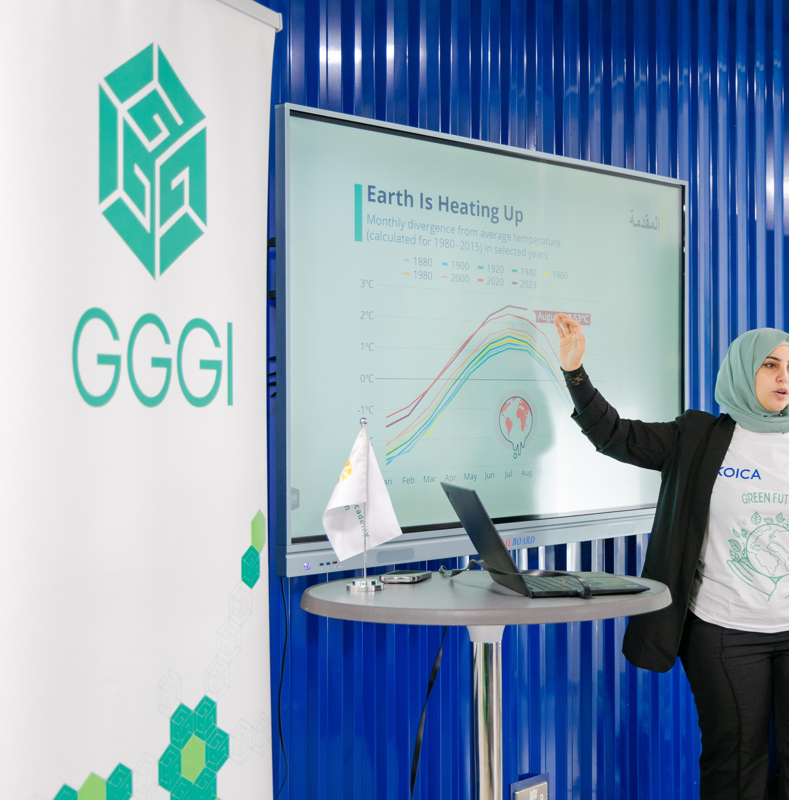

Results-Based
Gender Just
Energy Transitions
EEAP Conference

Slide 2
What is Results Based Management?

Slide 3
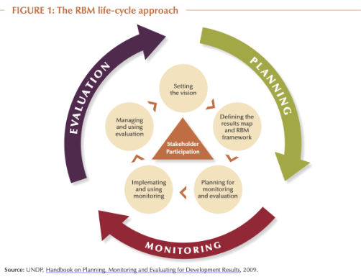
Result Based Management(RBM)
RBM
RBM is a management strategy focusing on performance and achievement of outputs, outcomes and impacts.
This management approach provides the framework, tools and guidance for strategic planning, risk management, performance monitoring, evaluation and knowledge management. It serves four complementary purposes: decision-making, learning, accountability and communication
(OECD – Glossary)

Slide 4
How is it Applied at GGGI?

Slide 5
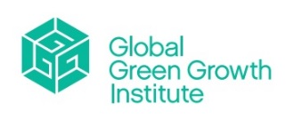
What is RBM at GGGI??
RBM is an overarching management strategy that integrates and drives GGGI’s Value Chain and business process in the production of core goods and services that will deliver quality and higher-level outcomes and impact, which align with partner countries NDC and SDG commitments and national development priorities.
It integrates and connects the components of strategy/budgeting, HR, finance, technology and project management through the various steps in the project cycle management (PCM 1-5) that form its established value chain into causal relationships, utilizing a feedback loop that facilitates the necessary adjustments and improvements to the results delivery and monitoring process. The RBM process points to quality of design, implementation and reporting of results generated by our support to the partner countries in the transition to a model of green growth.
Strategy 2030 adopted six SOs for GGGI’s operations. These SOs form the core of GGGI’s RBM system and focus its operations on measurable impacts that anchor in-country and global programmatic activities to partner countries NDC and SDG commitments. This shift from a traditional, input-based approach, to a results-based approach challenges GGGI to define its contributions to the six SOs against partner countries’ official targets. These changes have redefined GGGI’s long-term goals and results framework and will set the organization’s ambitions high in ensuring its organizational relevance and value addition in the context of the global compacts.

Slide 6
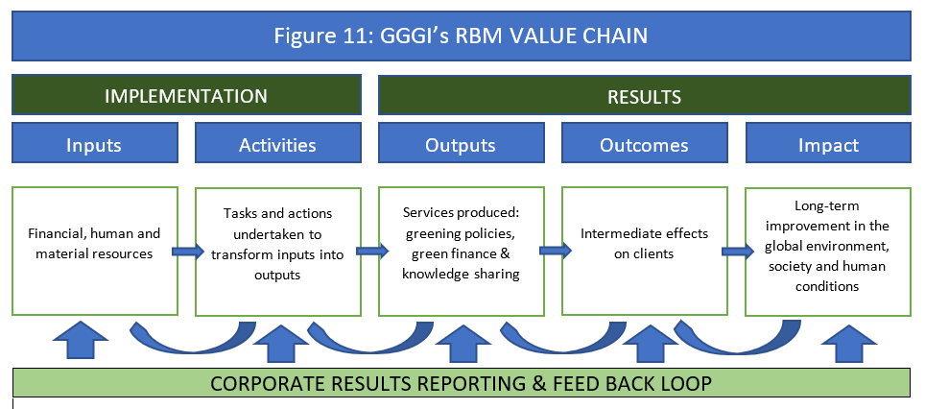
GGGI’s RBM Value Chain

Slide 7
How GESI interacts with RBM?
GESI is a cross-cutting component of the overall RBM process, functioning as a lens applied across all levels of the results chain. GESI analysis informs the baseline and provides a reference point at each level.
RBM
GESI
Disaggregated indicators and feedback loops help monitor the direction of GESI implementation and generate lessons that refine subsequent GESI analysis.

Slide 8
Case Study (1): Nepal
: Building Climate Resilience and Reintegrating Economically Displace Workers through Climate Smart Agriculture in the Terai Flood Plain

Slide 9
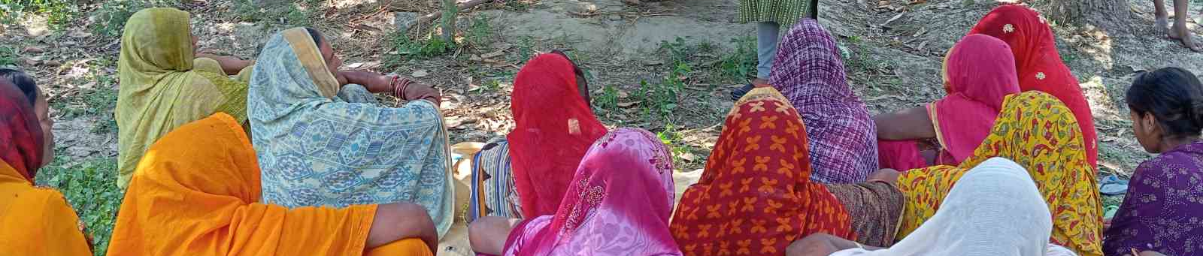
Project Summary
Case Study: Jordan
Climate Smart Agriculture Project designed to support widespread adoption of Climate-Smart Agriculture (CSA) to reduce vulnerability and improve food and job security, especially for women, youth, and returned migrant workers. Specifically, this project improves emergency management in the agriculture sector to protect lives and livelihoods; strengthen resilient agriculture planning and implementation; build and finance climate-smart agriculture businesses for job creation and long-term resilient green growth.

Slide 10
GESI Integration in Project Design
Case Studyn
The Project recognizes the role of women in food security and agriculture and will ensure that women are duly consulted and included in all activities.
Quantitative targets
The capacity building activities target 40 per cent of its activities addressing women, and 40 per cent participation by women headed groups and cooperatives.
The Project includes participation of economically displaced returned migrant workers (or youth), with the aim to have 30 per cent of its total participants in agribusiness incubation
The Project aims to create 750 new green jobs for women, returned migrant workers and youth.

Slide 11
Evaluation Through a GESI Lens
1) Key Evaluation Question
2) Data collection
KEQ2.
To what extent has the Project been gender responsive and climate adaptive in its design, implementation, and results?
Qualitative research
: Key Informant Interviews (KII) and focus group discussions (FGD) with local NGOs, stakeholders, government representatives, women representatives, returnee migrants, youth, project participants, etceters.,
together with other GESI-related secondary resources.
2.1. Was a gender analysis with climate vulnerability conducted during project design, and how was it used to shape objectives, activities, and indicators?
2.2. To what extent have project activities been tailored to address the distinct needs, priorities, and constraints of women, men, and gender-diverse groups in the context of climate change?
2.3 How have Project implementation strategies and resource allocation promoted both gender equality and women's empowerment and equitable climate adaptation outcomes?
2.4 What measurable changes - intended or unintended - have occurred in gender relations, roles, or outcomes, particularly in terms of resilience, access to climate-related resources, and decision-making
3) Team capacity requirement
Consultant/team members who participate ,design, or evaluate the project should have awareness-level knowledge of gender equality and social inclusion.

Slide 12
Case Study (2) : Vanuatu
Ex-Post Evaluation of Solar Power-Driven Access to Water Projects in Vanuatu

Slide 13
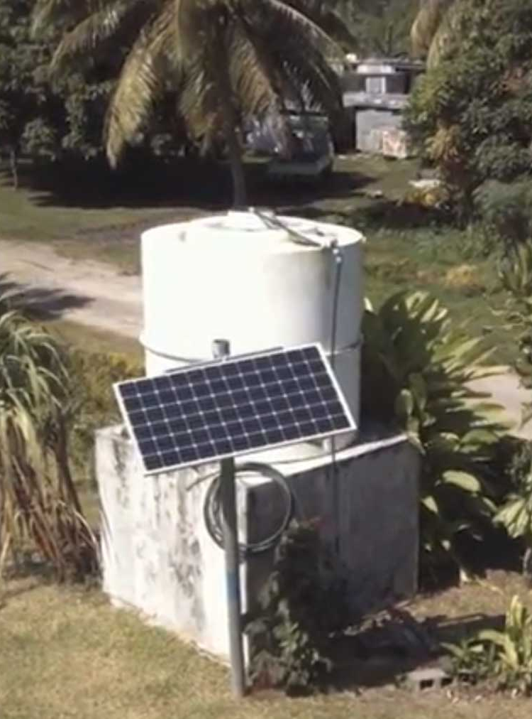
Case Study: Jordan
Project Summary
This project supported improving household access to water in rural areas far from power grids and established national guidelines for Solar Powered Water Systems (SPWS), integrating them into Vanuatu’s water policies.

Slide 14
GESI-Integration in Project Design
Case Studyn
Safeguards-level design
The intervention was designed with explicit integration of GESI considerations.
ESS
Identified women, female-headed households, and low-income community members as disproportionately affected by unreliable water access and associated time burdens.
Emphasized ensuring equitable benefit distribution and enabling women's participation in water governance
*ESS: Environmental and Social Standards

Slide 15
Evaluation Through a GESI Lens
1) Key Evaluation Question (KEQ2)
2) Data collection
Quantitative
gender- and vulnerability-disaggregated data on water access and reliability, system functionality, women's participation in water committees, and changes in health, livelihoods, and time savings, compared with baseline and End-of-Project Evaluation data where possible.
Qualitative
KIIs with local government representatives, project staff, community leaders, and water committee members. FGDs organized separately for women, men, and vulnerable groups, including the continued application of women's skills developed during the project. In-depth case studies in selected communities.
2A. To what extent did women's technical, operational, and management skills improve as a result of the Project's capacity-building activities?
2B. To what extent did these increased capacities translate into women's active participation and influence in water committees or local water governance structures?
2C. Did the Project contribute to greater gender balance in decision-making related to water resource allocation, operations, or maintenance?
3) Team capacity requirement
All team members should have at least awareness-level knowledge of GESI. Fair recruitment of participants, including women and socially excluded groups

Slide 16
Case Study (3) : Jordan
Creating Sustainable Green Jobs for Refugees and Host Communities through the Green Economy in Jordan

Slide 17
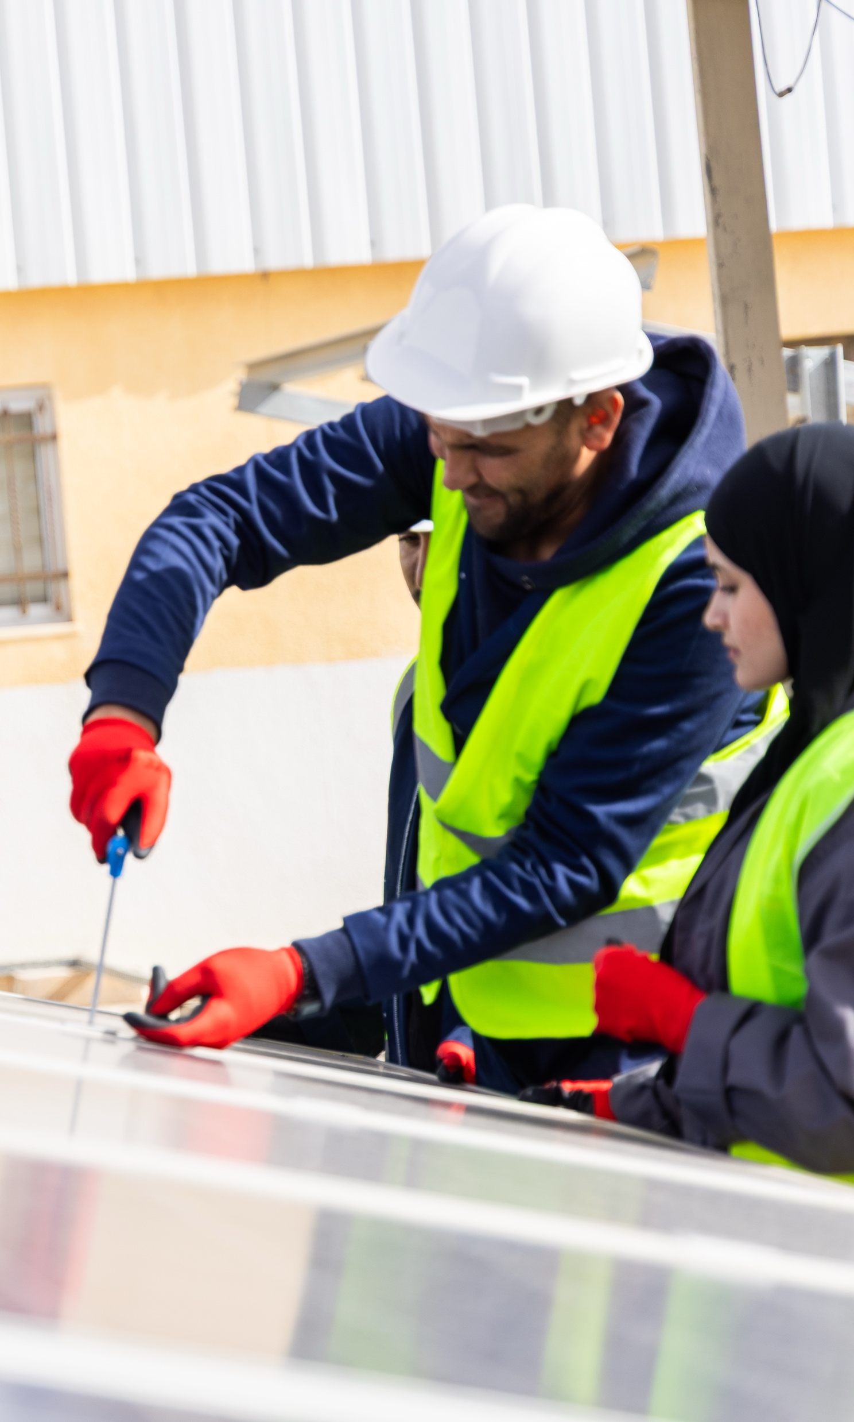
Case Study: Jordan
Project Summary
Creating Sustainable Green Jobs for Refugees and Host Communities through the Green Economy focusing on the creation of an inclusive green employment ecosystem, helping to boost the green entrepreneurship environment and support a just green transition with the inclusion of the most marginalized and vulnerable communities – including both refugees and host communities.

Slide 18
GESI integration in Project Design
Case Studyn
1) Output-level design
Output 2.1: Integrated skill development program delivered for Refugees and Jordanians, especially women and youth. Social vulnerables directly targeted as the main beneficiaries of the project.
2) Quantitative target
The project will equip 1,000 jobseekers (50% refugees, 50% women, and 25% youth) with demand-driven green skills to enhance their employability in emerging green sectors.
Evaluation Through a GESI Lens
GESI Strategy embedded across all phases of the endline evaluation.
Quantitative
Minimum quota of women/refugees
Qualitative
FGI sessions conducted, where logistically feasible, in gender-segregated and nationality-segregated configurations, grounded in the recognition that mixed-group settings may suppress disclosure among participants whose voices are subordinated by prevailing power dynamics.
Difference-in-difference (DiD) framework comparing changes among beneficiaries with those observed in the control group to estimate the net effect of the Project, disaggregated by women and youth.
1) Data collection
2) Analysis

Slide 19
Project Result
Case Studyn
1
2
3
1) Overall reach
1,649 individuals trained (165% of the target), with especially strong participation among women (60%), youth (70%), and refugees (49%).
2) Green skills training
As of February 2025, 323 trainees (249 women, 146 refugees, and 255 youth) participated in a variety of green skills training programs.
3) Green entrepreneurship training
540 prospective green entrepreneurs (327 women, 109 refugees, and 417 youth) completed specialized green entrepreneurship training.

Slide 20
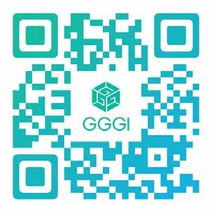
Thank You!
The Global Green Growth Institute
19F Jeongdong Building, 21-15, Jeongdong-gil,
Jung-gu, Seoul, Korea 04518
Follow our activities on LinkedIn, YouTube, Instagram, Facebook, and X.
www.gggi.org

