Slide 1
Beyond the average: What disaggregated data reveals about India’s clean energy livelihood transition
Divya Gaur
Priyatam Yasaswi
Evaluation for Just and Inclusive Energy Transitions, EEAP Virtual Conference
01 October 2026
© Council on Energy, Environment and Water, 2026

Slide 2
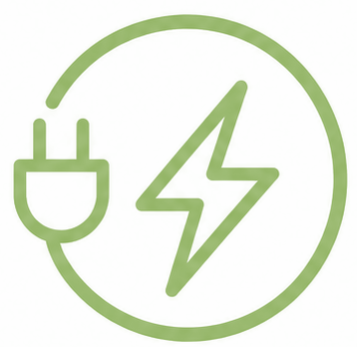
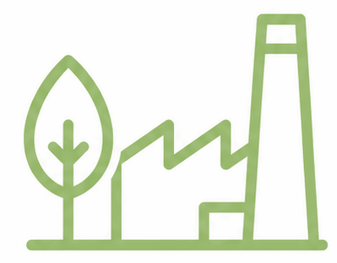


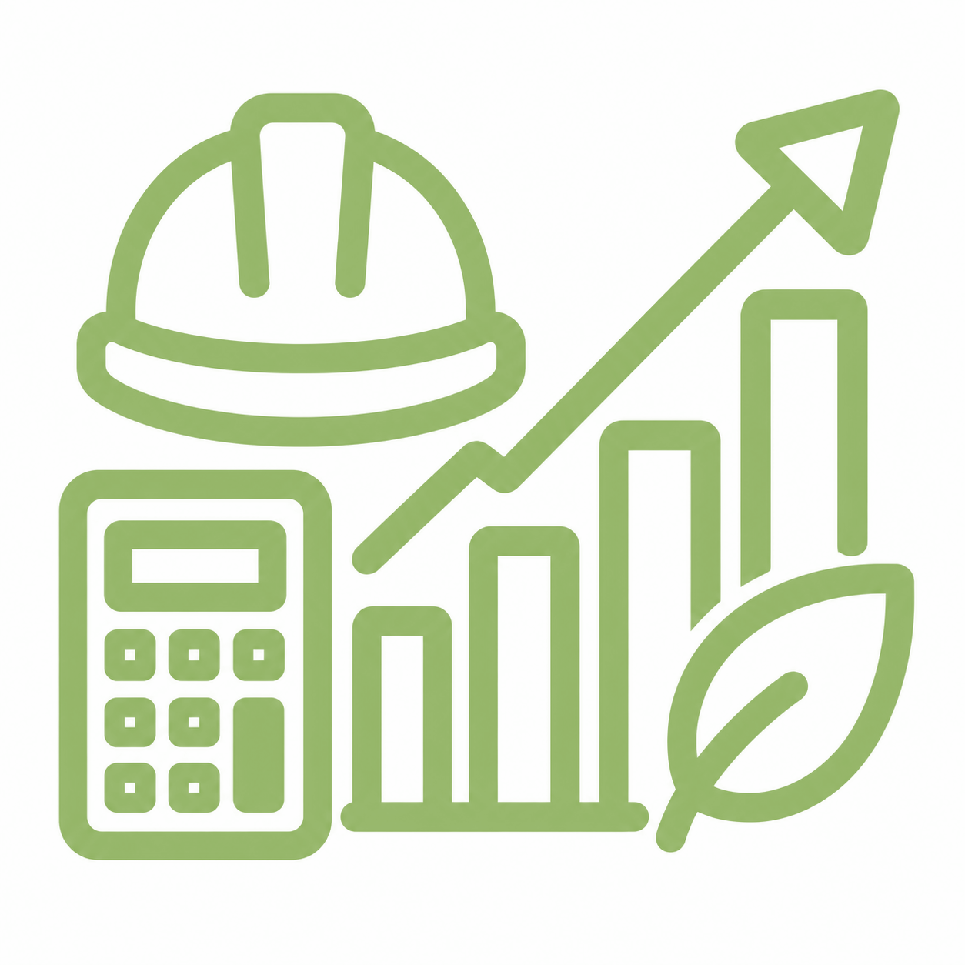

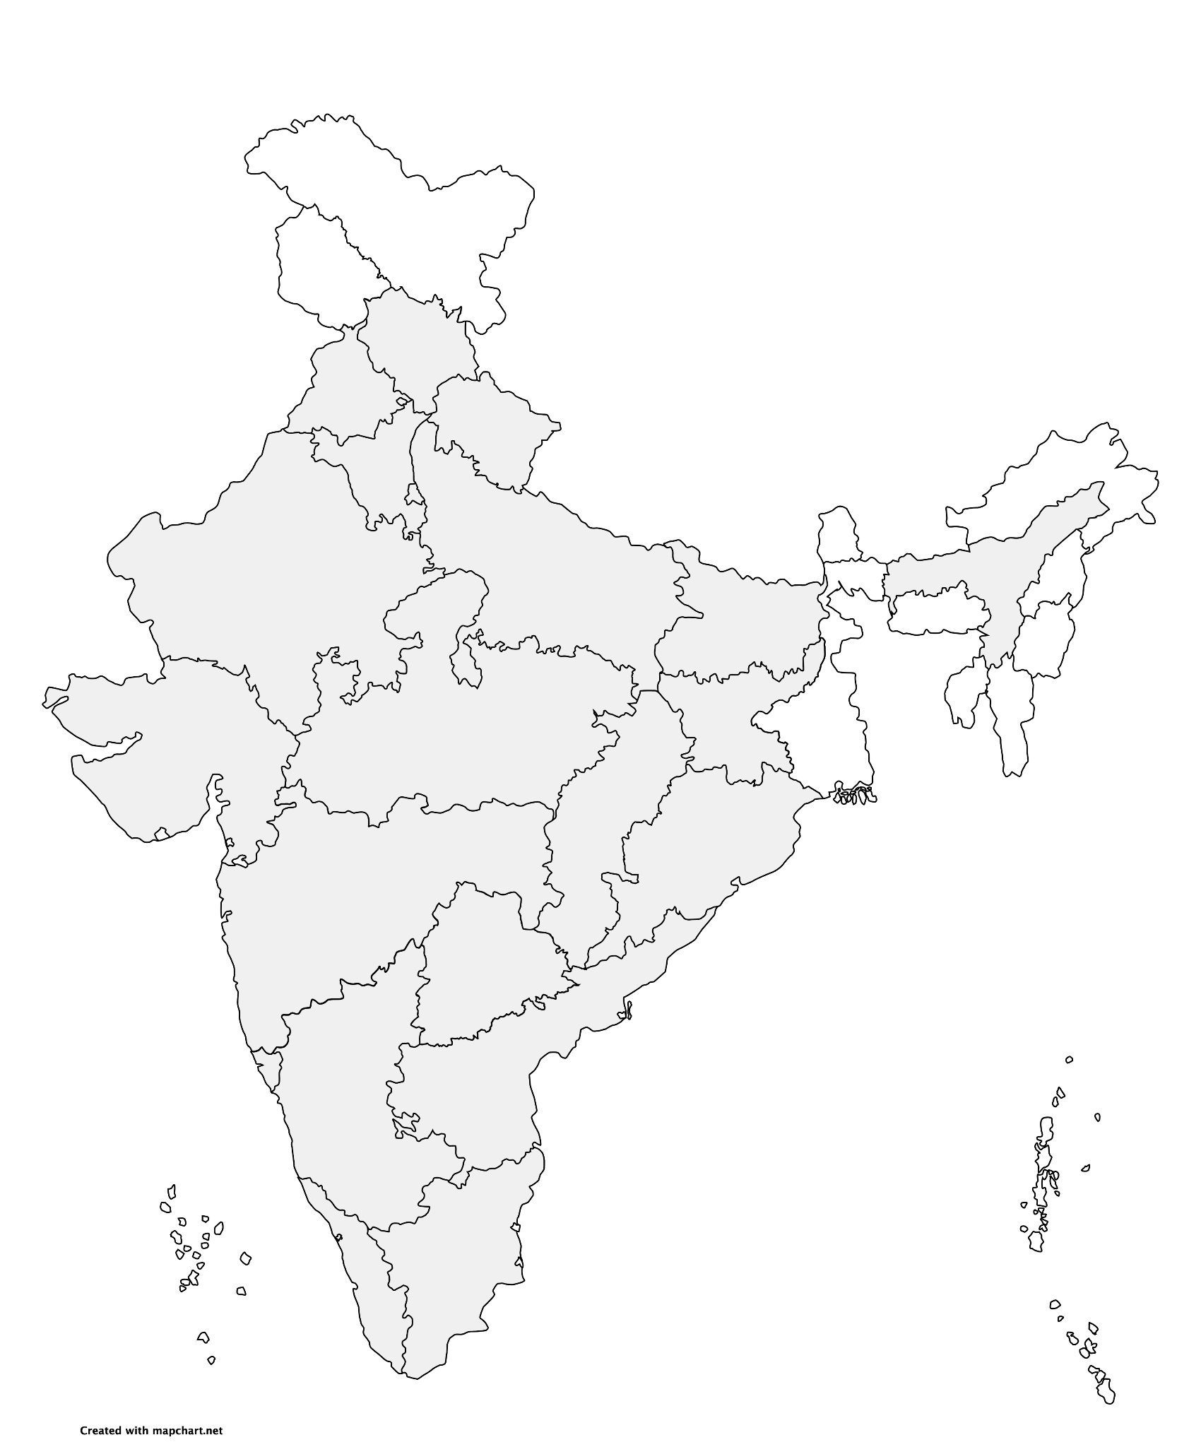
Impacting sustainable development at scale with data, integrated analysis, and strategic outreach
STRATEGIC PILLARS
Clean electricity
Low-carbon
industrialisation
Fuels of the future
Improving quality of life
Green economy & livelihoods
Sharing lessons from India
Himachal Pradesh
Resilience
Uttarakhand
Energy, Resilience
16 years
16 research teams
400+ team members
680+ peer-reviewed studies
240+ policies & plans informed
80,000+ livelihoods enabled
770+ convenings
800+ opinion pieces
52 mn reached via films & documentaries
Punjab
Air, Mobility
Assam
Energy, Livelihoods
Haryana
Air, Energy
Uttar Pradesh
Energy, Mobility, Water
Delhi
Air, Energy, Mobility
Bihar
Air, Livelihoods
Rajasthan
Air, Energy, Food, Industry, Water
Gujarat
Air, Energy, Industry, Resilience, Water
Jharkhand
Energy
Chhattisgarh
Energy, Mobility
Madhya Pradesh
Air, Energy, Food
Odisha
Energy, Livelihoods, Resilience
Maharashtra
Air, Energy, Resilience, Water
Telangana
Mobility
Goa
Resilience, Water
Karnataka
Energy
Andhra Pradesh
Resilience, Food
Kerala
Energy, Mobility
Tamil Nadu
Air, Energy, Resilience,
Water
Notes:
18 states, 52 ongoing engagements.

Slide 3
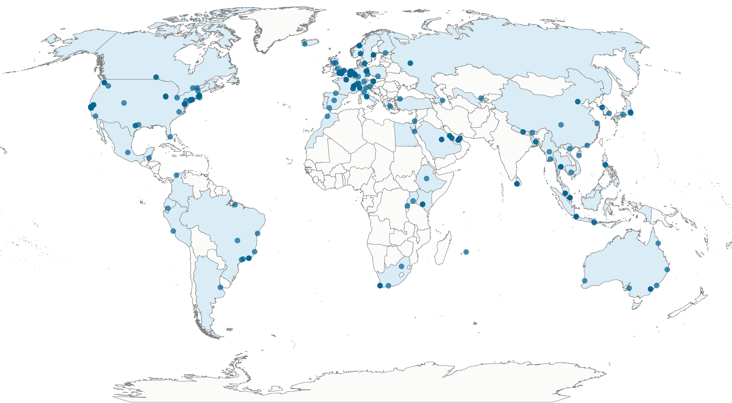
Global collaborations since 2010
60+ countries
230+ institutions
3|

Slide 4






Community-centered Energy Transition
Policy
Technology
Instruments that enable access to innovations that can increase the uptake.
Reliable means to harness natural sources of energy into electricity.
People
Skills, decent jobs and community engagement key to building sustainable and just transitions.

Slide 5
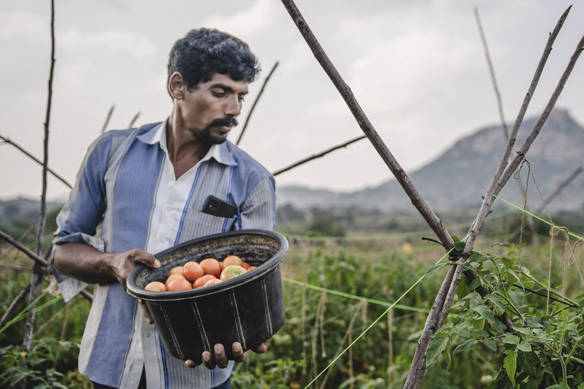
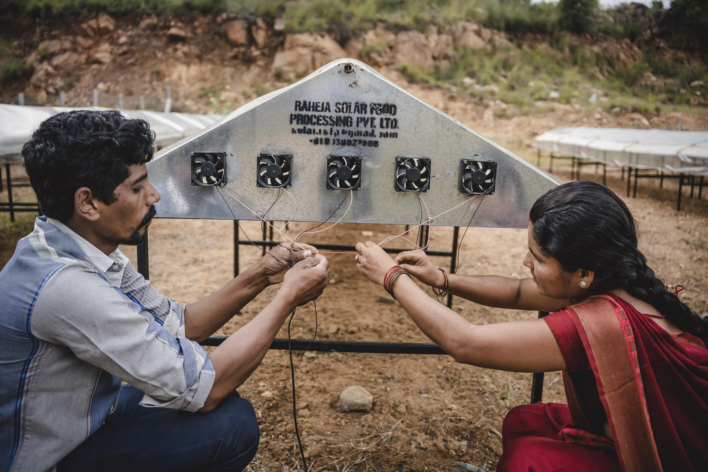
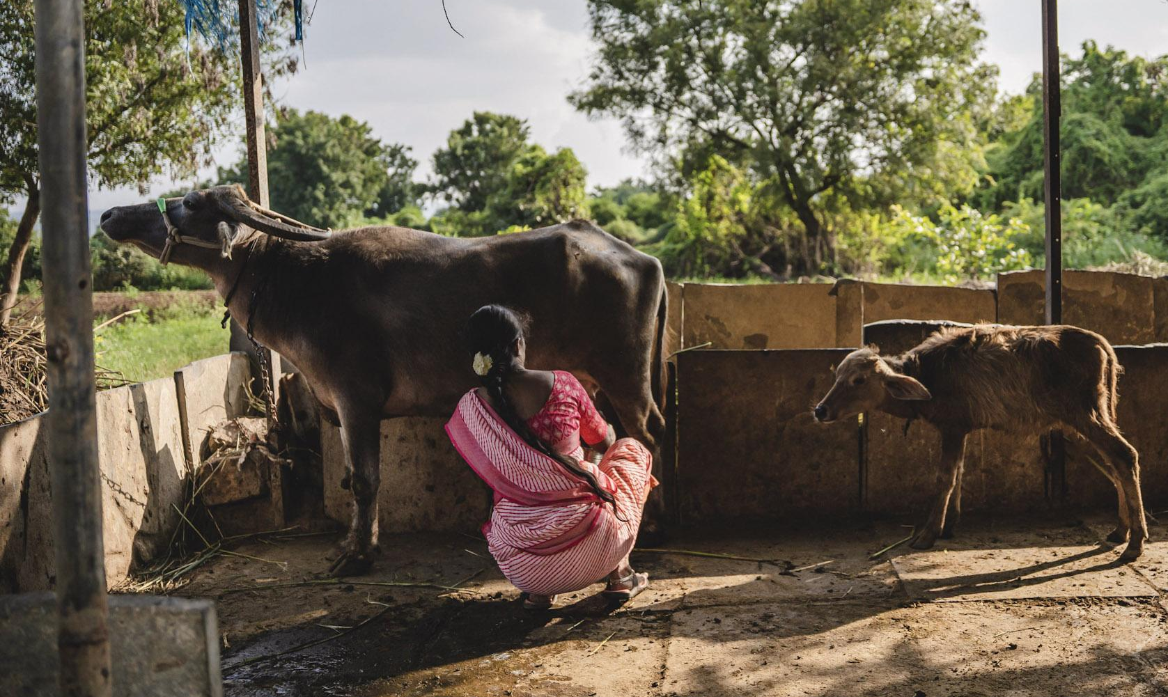
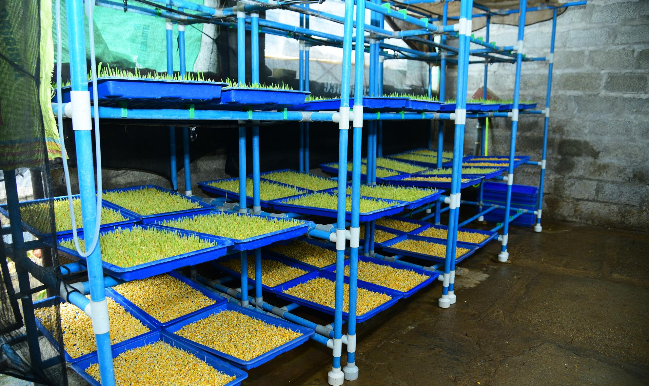
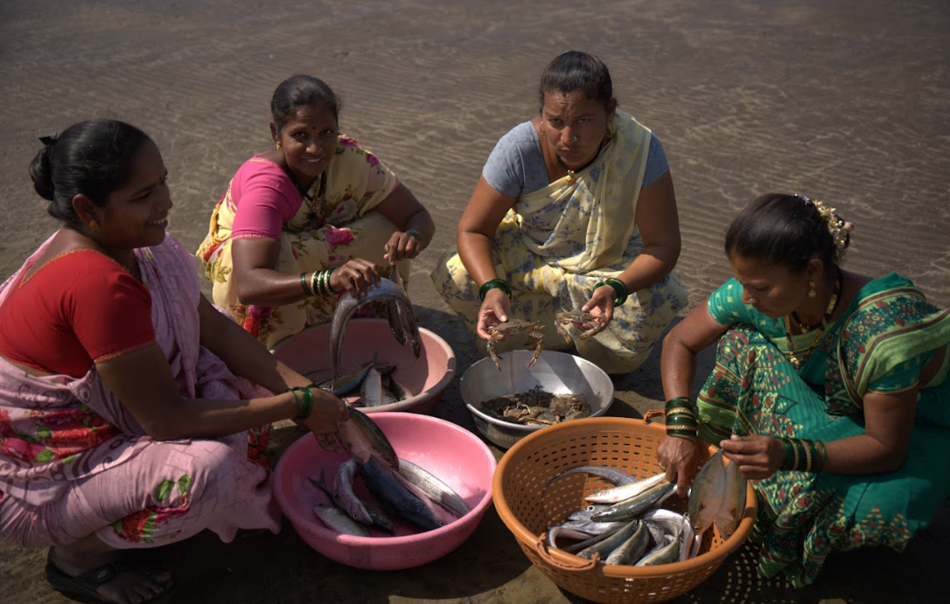
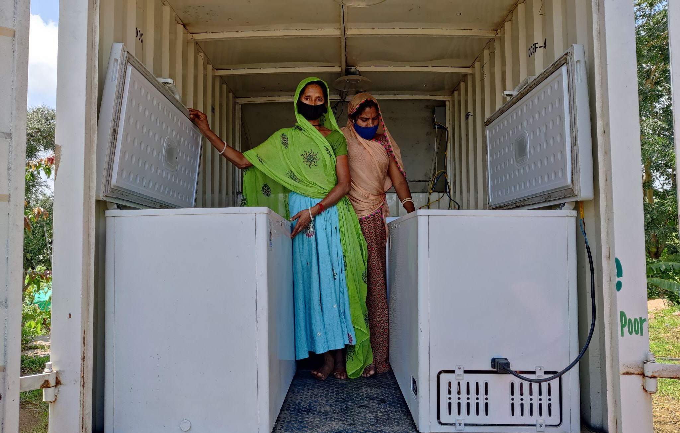
PURE presents a massive opportunity “Beyond Access”
USD 50+ billion | Market opportunity for PURE solutions to power 37 million livelihoods in India alone.
1/2 of Global Food Loss | To be reduced by 2030$
Unreliable access leads to energy poverty leading to loss of livelihoods
PURE technologies ensure energy access + multiple advantages
5|
Images: CEEW/Emotive Lens

Slide 6
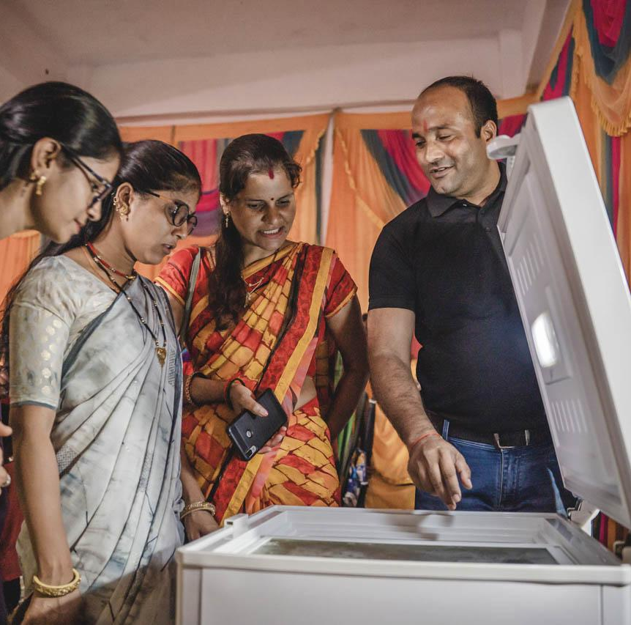
Powering Livelihoods Story
How can we scale these solutions across Global South?
Image: CEEW/Emotive Lens

Slide 7









Clean energy innovations present a ~$50 billion market opportunity to support 37 million livelihoods in India
A joint initiative by CEEW and Villgro to mainstream DRE livelihood tech by enabling an inclusive end-to-end ecosystem
Capital support
Evidence generation and dissemination
Leverage enterprise growth towards ecosystem acceleration
Partnerships with ecosystem players (20+)
Technical assistance
Market linkages
Market advisory & policy support
‘ENTERPRISE ACCELERATOR’
(Enterprise-focused engagement)
‘ECOSYSTEM ACCELERATOR’
(Sector-wide engagement)
Explicit focus on gender inclusion
Impact through programme supported enterprises
53,500+ livelihoods (~45% women)
33,000+ new technology deployments
Dedicated DRE-livelihoods (PURE) government framework - 1st in the world

Slide 8

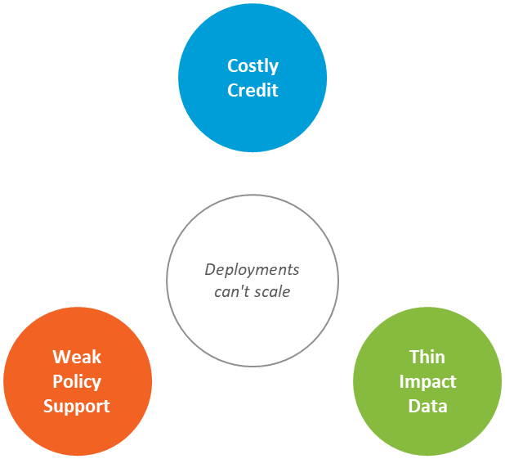
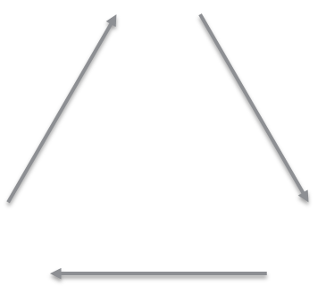
Role of Evidence in DRE
Evaluation design & insights
Limitations
Way Forward
Evidence for Enabling Ecosystem | 360 degree and Disaggregated
  Unbiased: credible enough for lenders to extend affordable credit
  Nuanced: granular enough to see who's left behind
  360 degree: systemic enough to inform sectoral stakeholders
Ecosystem

Slide 9
Role of Evidence in DRE
Evaluation design & insights
Limitations
Way Forward
Partner data and user evidence feed one another
Enterprises
Generates
Sales, revenue, livelihoods, customer KYC
Generates
New funders, new deals, new financing opened, new channel partners
Ecosystem
Channel partners
User impact evidence
Income, usage, social and environmental change
Generates
Leads, customer types, outreach turnout
Policymakers
Financiers
Generates
Insights from stakeholder interactions and engagement
Generates
Loans disbursed, down payments, repayments
Notes:
Hub: user impact evidence from impact assessments, disaggregated by gender, caste, ownership and source of income. Data per partner follows the monitoring slide in the main deck and the ecosystem tracker. Connectors show that each data stream informs the others.

Slide 10
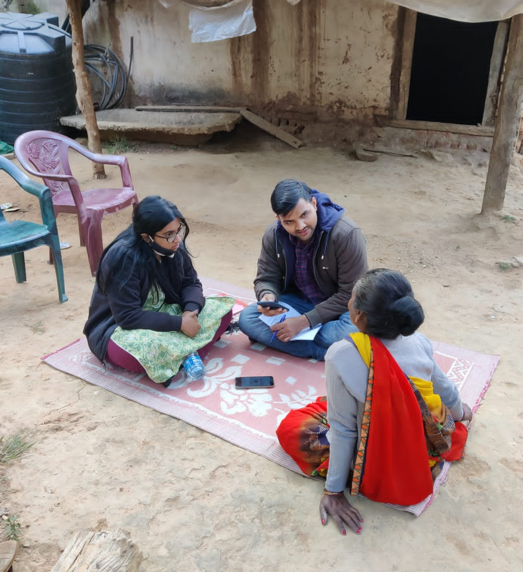
End-user Impact Evaluation Design & Insights

Slide 11
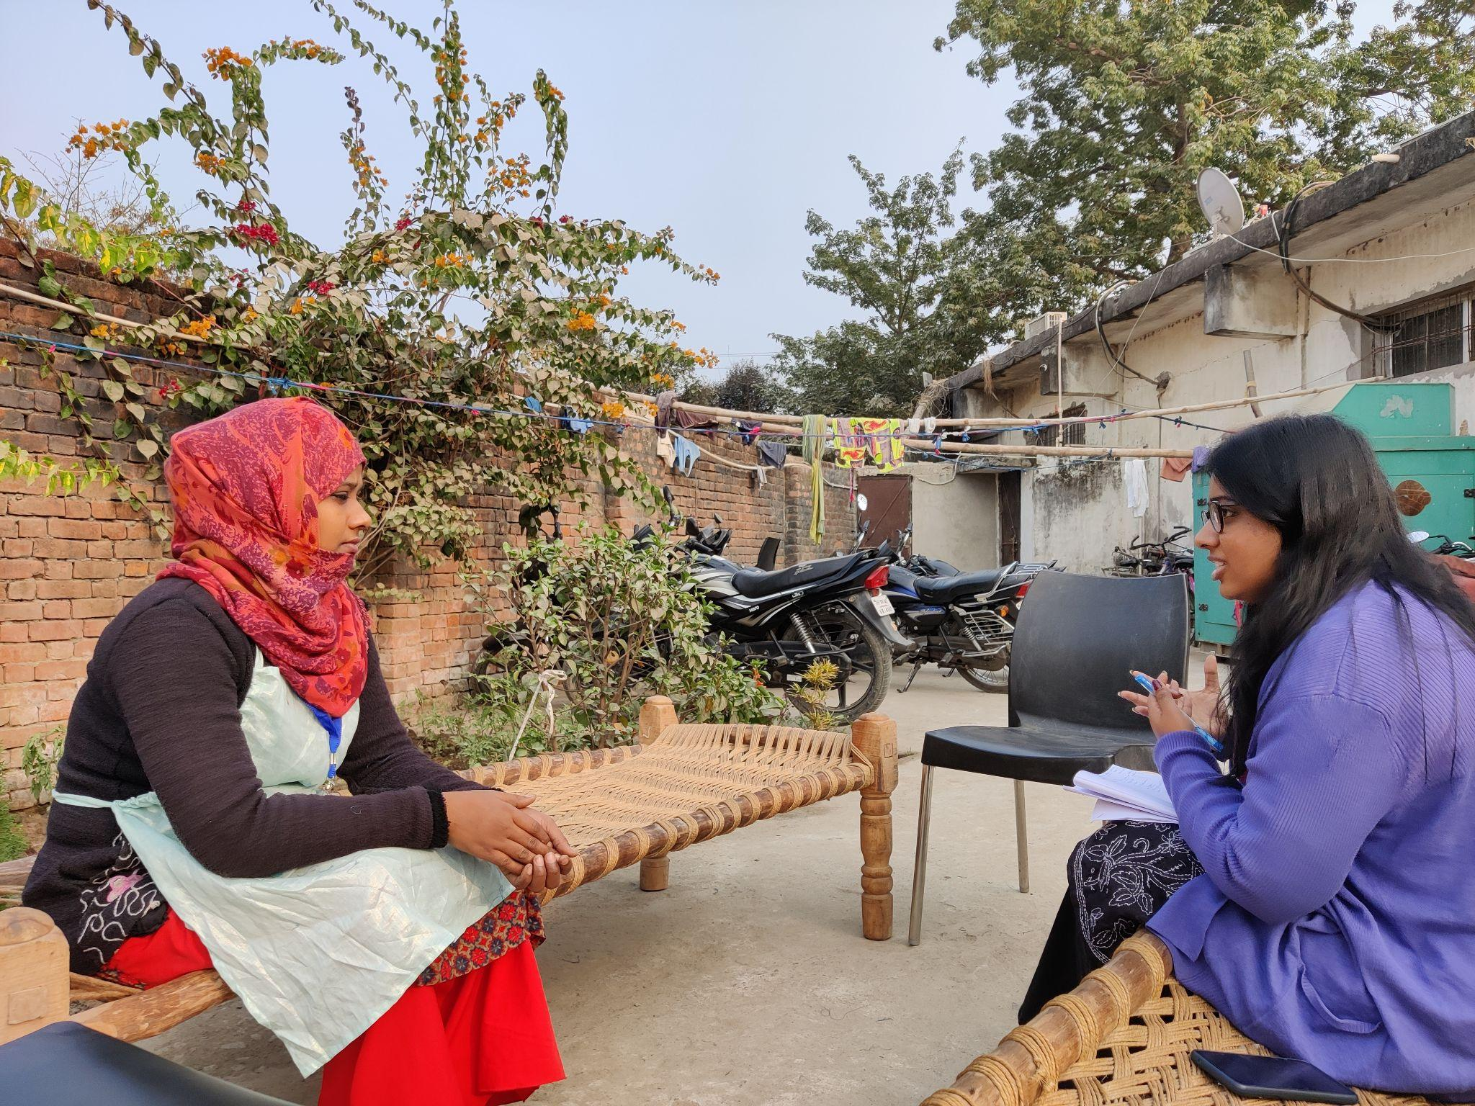
End user Impact Evaluation for Self-selection Cases | Study Design
Role of Evidence in DRE
Evaluation design & insights
Limitations
Way Forward
Methodology | Multiple rounds of cross-sectional study (no. of users covered) and longitudinal study (no. of users covered)
Approach | mixed-method approach
Approach:Pre and post (retrospective method); Descriptive analysis & along with multivariable logistic regression analysis.
Rationale - Programme takes a market driven approach and technologies are self-selected. Collecting baseline data a challenge.

Slide 12
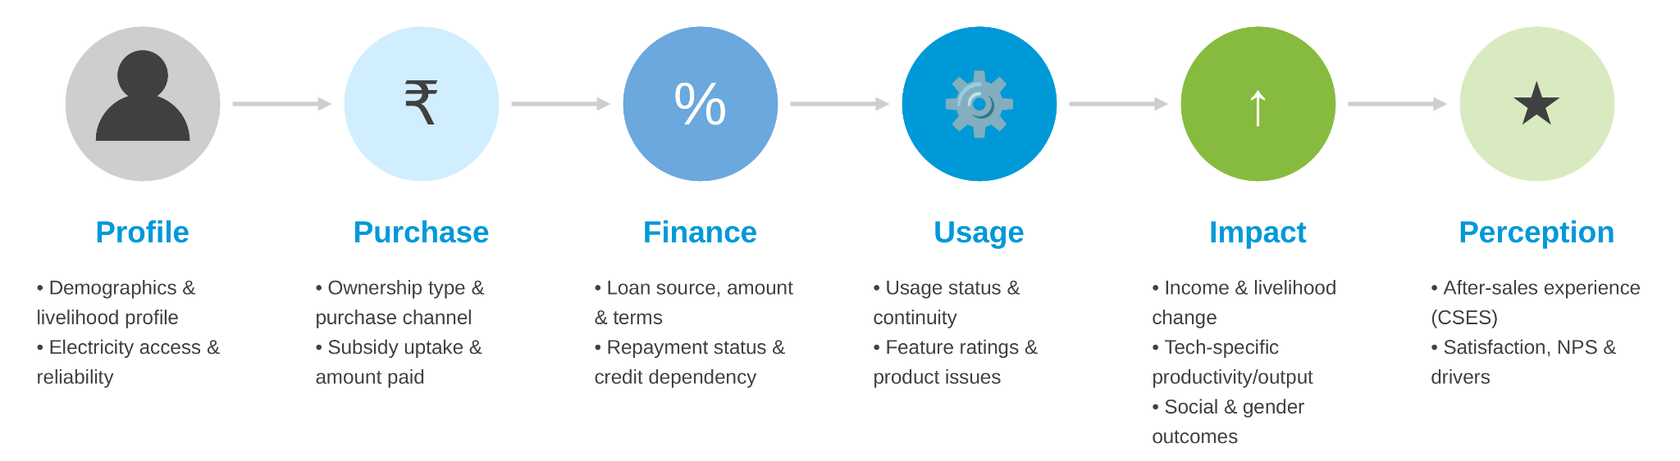
From purchase to perception: The user journey this study measures
Role of Evidence in DRE
Evaluation design & insights
Limitations
Way Forward
Each stage below corresponds to a section of the Round 3 quantitative survey instrument, in the order a respondent experiences it

Slide 13
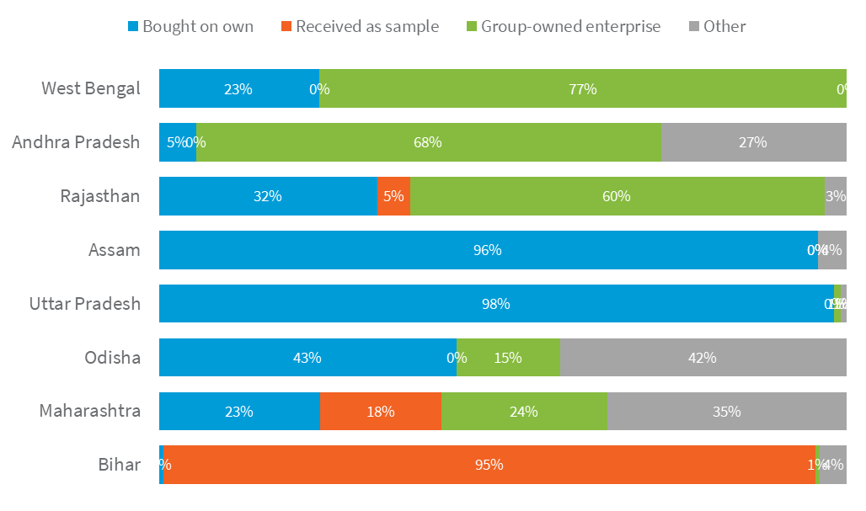
Only 36% users bought the product on their own; the rest depended on samples, groups or partnerships
Role of Evidence in DRE
Evaluation design & insights
Limitations
Way Forward
Purchase mode by state (selected states)
36%
GENDER
Men: 52%
Women: 34%
Men buy outright far more; women more often receive a free sample (25-pt gap)
n = 889
bought the product outright, paying for it themselves
CASTE
General: 52%
OBC: 21%
OBC relies most on free samples (47%)
Rest of the breakdown:
GROUP AFFILIATION
25%
Received as sample
Business: 74%
22%
Group-owned enterprise
Unaffiliated: 35%
18%
Partnership / other
FPO members mostly buy via the group enterprise (50%)
Purchase mode reflects each state's distribution model (direct sale, sample seeding, or group-enterprise route) more than individual characteristics.
Beyond solution cost, factors like users’ income, linkages, and ecosystem maturity impact users’ upfront contribution.
Higher user contribution enhances commitment, drives behavior change, and ensures sustained usage of tech.

Slide 14
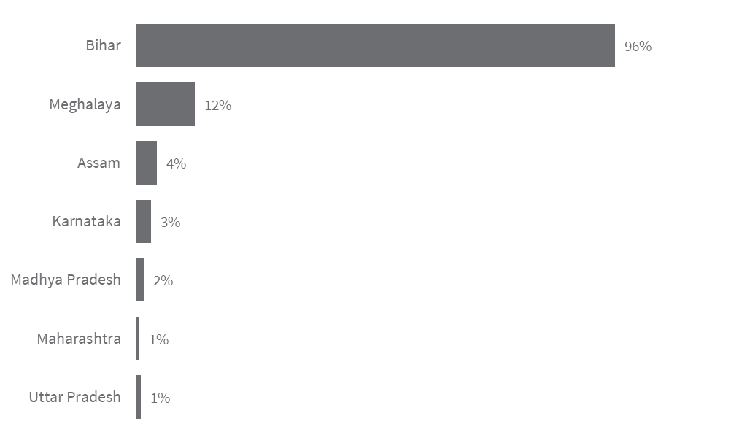
61% of all 889 respondents were actively using the product at the time of the survey
Role of Evidence in DRE
Evaluation design & insights
Limitations
Way Forward
% of respondents who have “never used” the product, by state
CASTE (NEVER USED)
61%
OBC: 44%
Others: <8%
The single largest gap in this dataset, on the largest caste group (n=342)
n = 889
GROUP AFFILIATION
were using the product at the time of the survey (“Yes” to usage status)
Unaffiliated: 42%
Business: 81%
SHG/FPO/enterprise ties strongly predict active use
Full usage status breakdown:
61%
Active (“Yes”)
GENDER (ACTIVE)
15%
Seasonal pause
18%
Never used
Women: 57%
5%
Stopped using it
An 11-point gap — smaller than caste or group effects
Bihar's 96% “never used” rate lines up with its sample-based distribution model: free samples without a purchase decision rarely convert to actual use.
82% of users who cite seasonal challenges for non-usage use solutions like micro solar pump, solar dryer and milk processing.

Slide 15
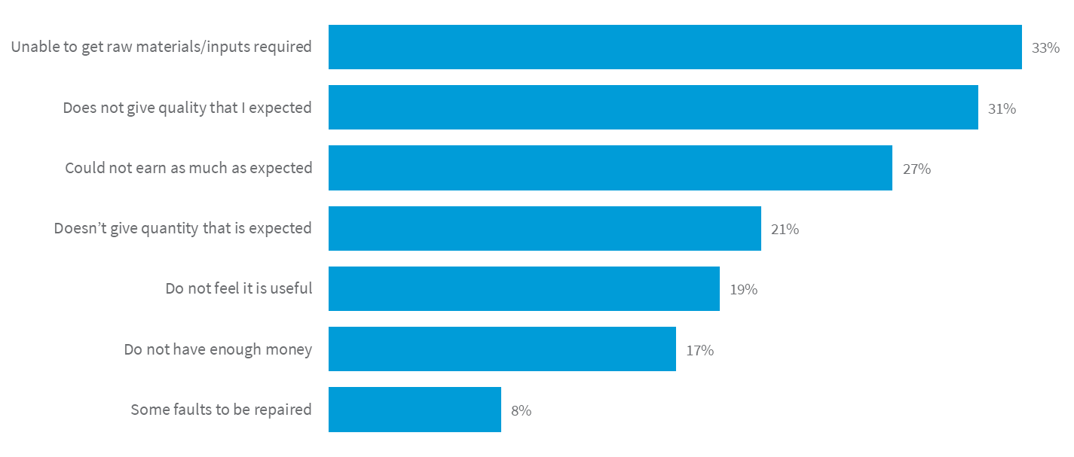
Input access and quality gaps are the top reasons people stop using it
Role of Evidence in DRE
Evaluation design & insights
Limitations
Way Forward
% of non-users citing each reason (multi-select))
33%
n = 48
of non-users cite lack of raw materials/inputs
This is the single most-cited reason among all non-users surveyed.
Affordability (17%) ranks well below input access (33%) and quality gaps (31%) — after-sales and supply-chain support may sustain usage more than financing alone.
Users (86%) cite not having enough money for never using the solution, majorly for the silk reeling solution.

Slide 16
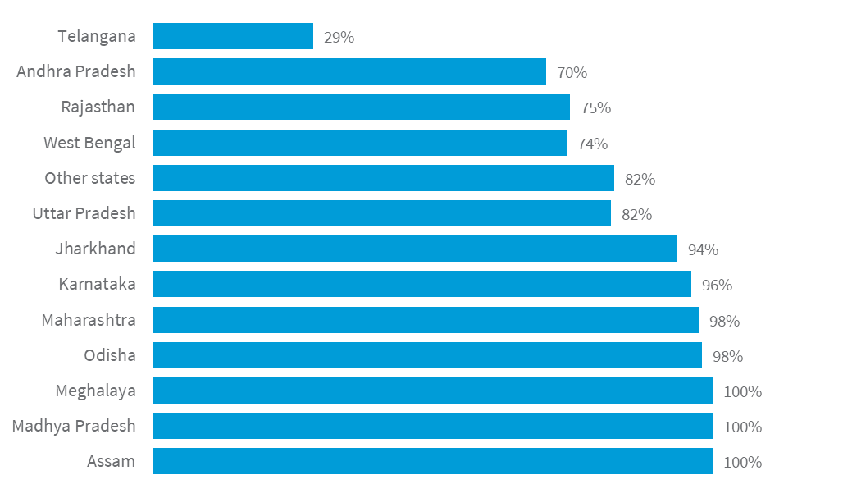
87% of ever-used respondents saw their income increase
Role of Evidence in DRE
Evaluation design & insights
Limitations
Way Forward
% of ever-used respondents reporting an income increase, by state
87%
GENDER, CASTE & GROUP
All: 80–90%
Female 88.5% vs. Male 85.7%; castes 82–95%; group types 80–90%
n = 661
of ever-used respondents report an income increase
OUTLIER TO FLAG
Telangana: 29%
Additional incomes from DRE tech enabled users’ income slab progression.
Geography shows far wider variation in whether income increased at all than gender, caste or group affiliation do.

Slide 17
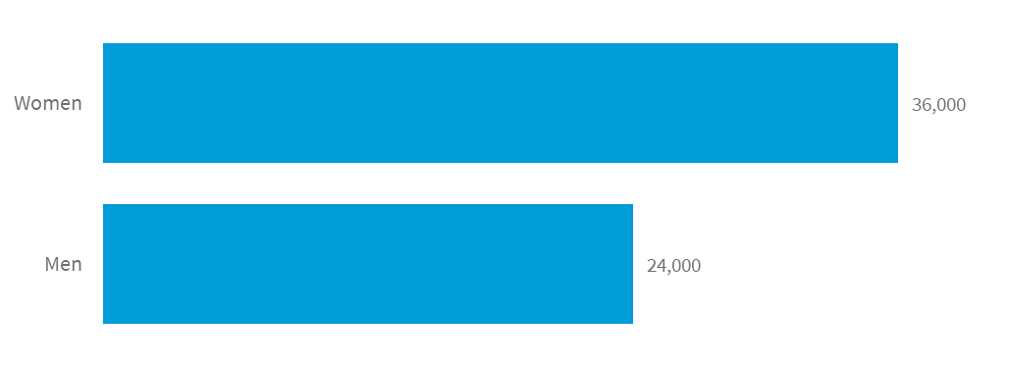
The typical income gain is INR 40,000/year — with a 5.5x range observed across states
Role of Evidence in DRE
Evaluation design & insights
Limitations
Way Forward
Median annual income increase (Rs), by gender
INR 40k
CASTE (MEDIAN)
General: 50k
OBC: 20k
A 2.5x gap, highest vs. lowest caste group (Rs)
n = 576
Mean annual income increase, among those reporting an increase
GROUP AFFILIATION
FPO: 39k
Unaffiliated: 20k
Group-affiliated respondents gain roughly double (Rs)
Women's typical gain is 50% higher than men's.
Geography (median): highest in Maharashtra (Rs 55,000), lowest in Uttar Pradesh (Rs 10,000) — a 5.5x range across states.
Unlike income status (where geography shows the widest variation), the size of the gain is also associated with gender, caste and group ties.
~50% can repay loans for DRE tech through increased incomes. Extending loan tenures takes it ~70%.

Slide 18

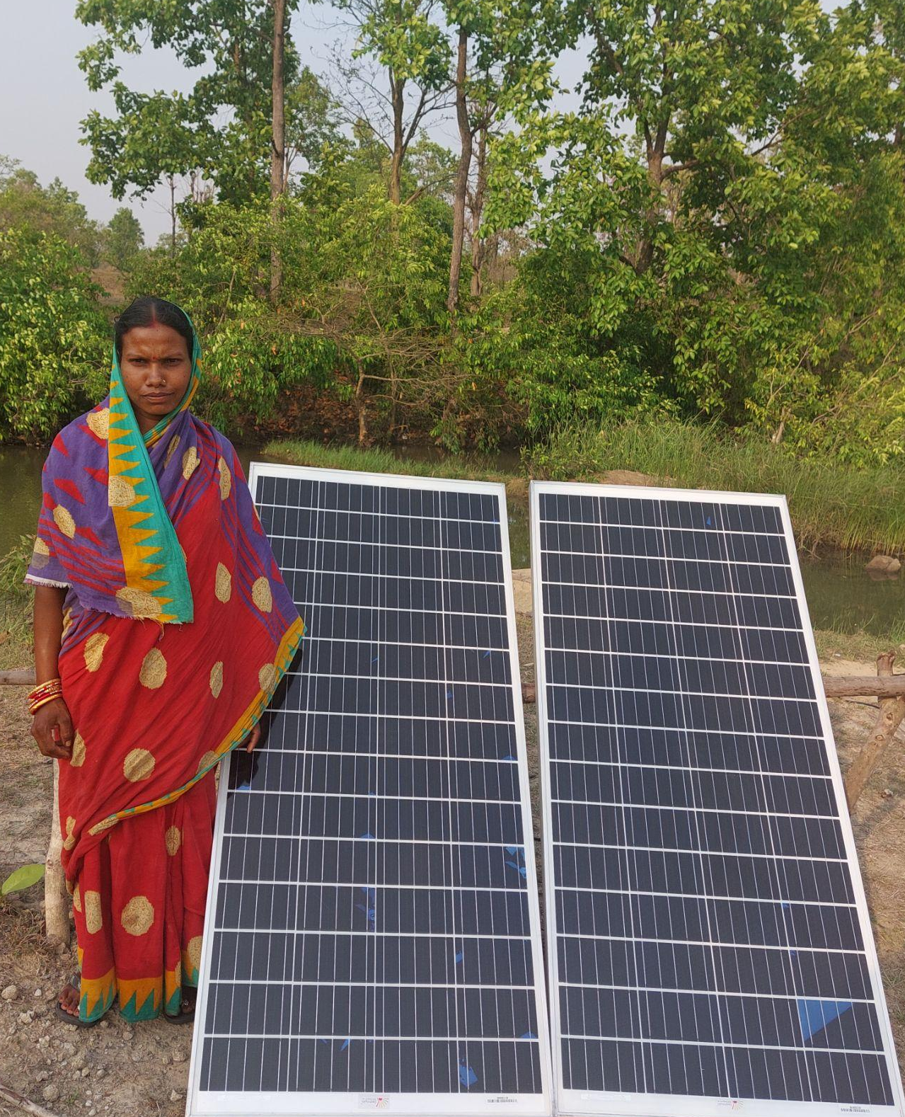






Role of Evidence in DRE
Evaluation design & insights
Limitations
Way Forward
Pathways to economic impact: An example of solar micro pump user
Improved Productivity
Higher yields due to irrigation
Additional productive time
Cropping cycles increased from 1 to 3 times a year
Savings on Fuel/Electricity
~$176 savings/year (including transport/lease)
INR 25,000** ($301) net additional income
New revenue streams
Additional products/commodities sold/processed
Quality of the output
Higher price for better quality
Amortized CAPEX
$16 EMI deduction (for initial 1.5 years)
OPEX
Costs of agri inputs
**after deduction of EMI only

Slide 19
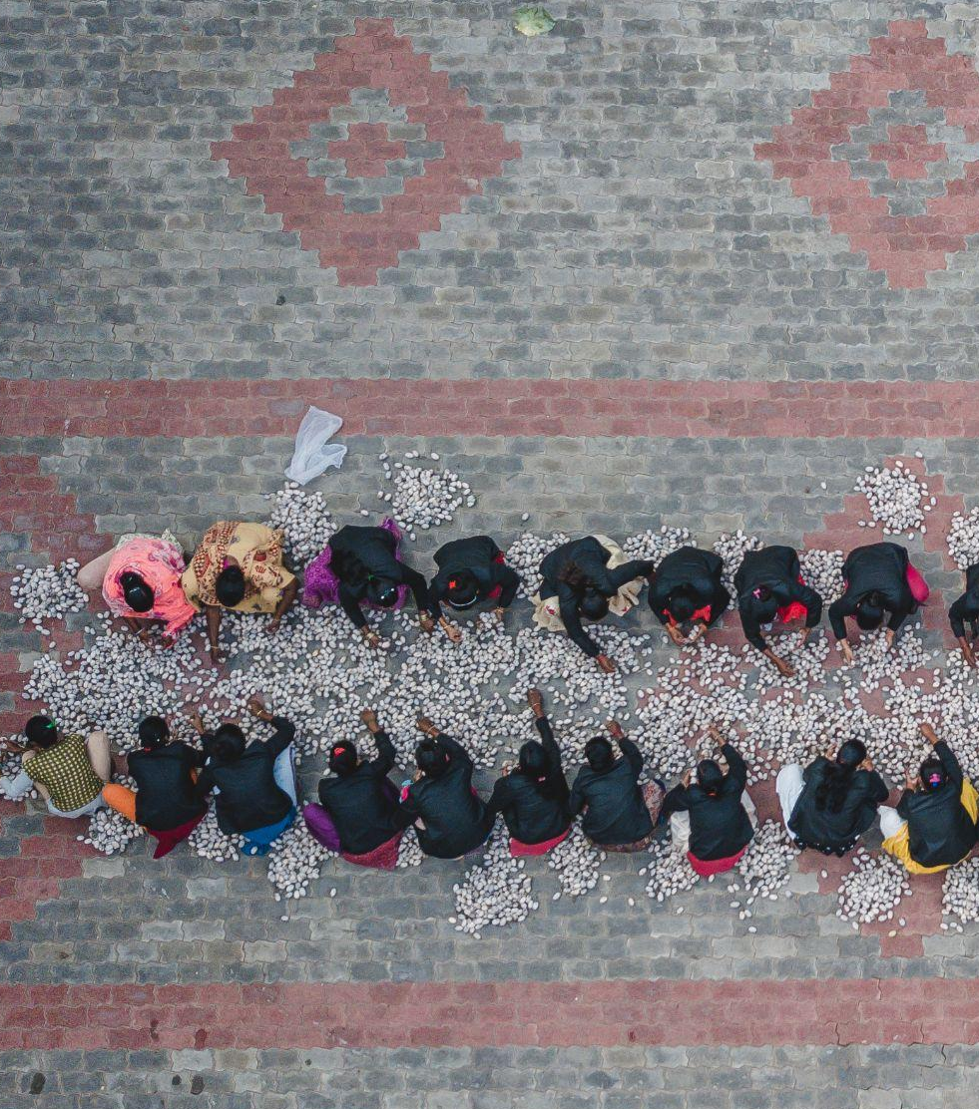
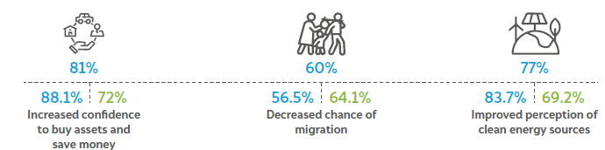
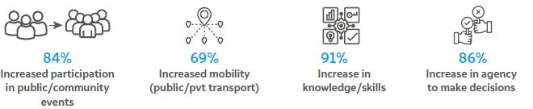
Role of Evidence in DRE
Evaluation design & insights
Limitations
Way Forward
DRE has a positive impact beyond just income increase
Women benefit from enhanced impact of DRE

Slide 20



Role of Evidence in DRE
Evaluation design & insights
Limitations
Way Forward
Pathways for DRE to enable environmental impact
Avoidance of fossil fuel/grid electricity
Avoided GHG emissions
Micro solar pump (displacing kerosene use)
CO2_{e}abated: 1.34 kg-CO2_{e}/day (10k LPD, 1 acre) of irrigation use
CO2_{e} Emissions Abated
(Units - tCO2_{e}/kgCO2_{e})
Reduced food loss/wastage
Avoided methane emissions from rotting food + displaced fresh produce
Solar dryer (avoiding food loss)
GHG saved: 2.5 kg-CO2_{e} per kg of avoided food loss

Slide 21
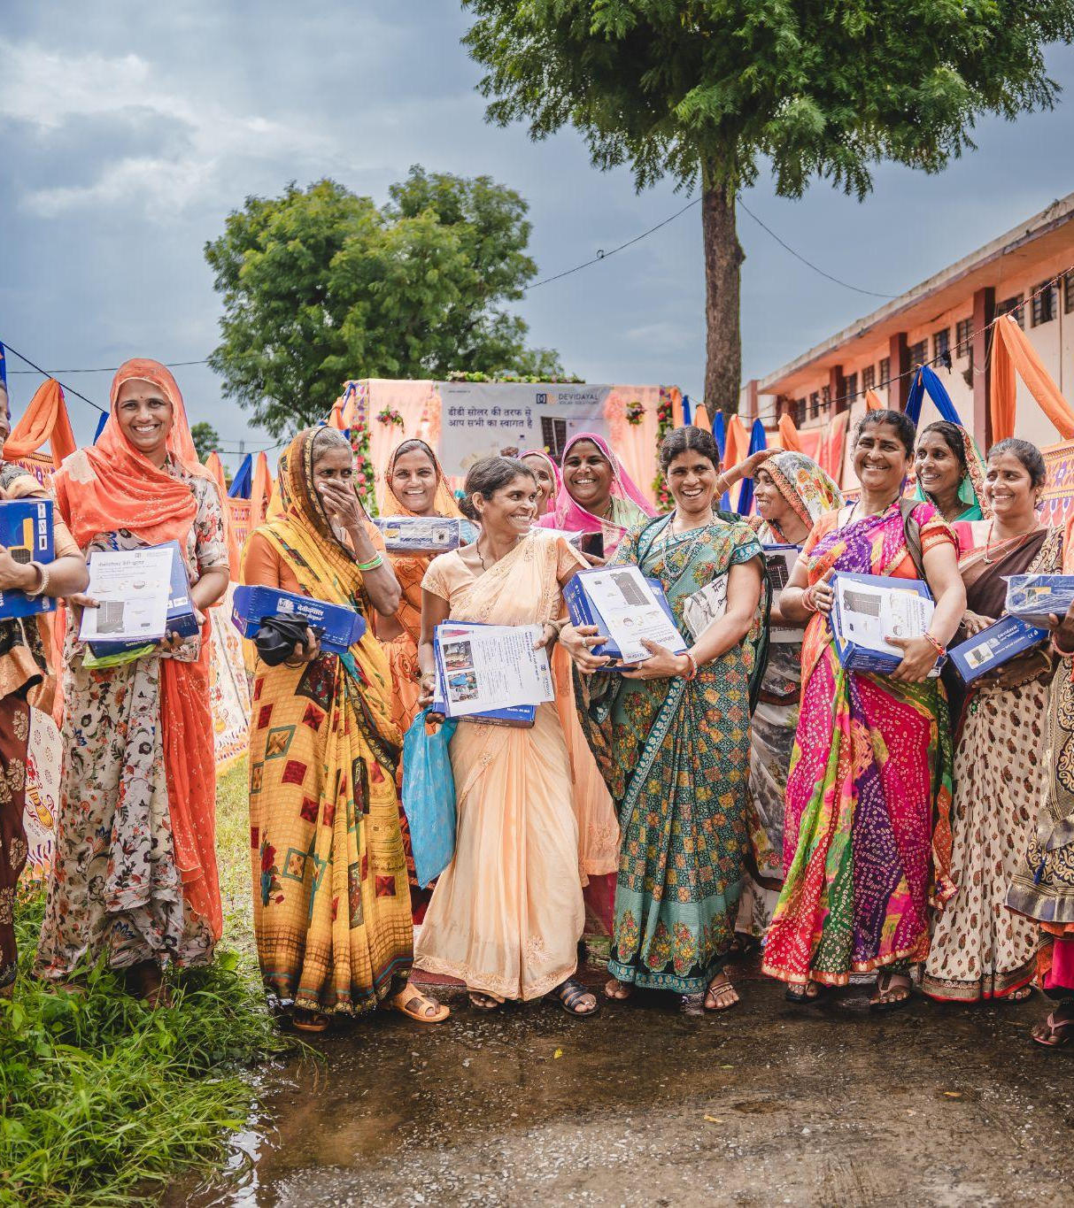
End-user Impact Evaluation Limitations

Slide 22
Role of Evidence in DRE
Evaluation design & insights
Limitations
Way Forward
We designed around self-selection, limitation by limitation
Limitation
Our response
Mitigation result
Self-selection, no baseline
Retrospective pre-post
Sample in proportion to sales
Survey within 6 months
Reliable recall of change
Perception-based answers
Likert scale + NPS
Case stories + hard numbers
Triangulated insights
Qualitative data and secondary research as supplementary
Self-reported income
Usage data
Input costs
Enterprise check
User back-checks
Source: CEEW Powering Livelihoods end-user impact evaluation design; Gaur and Yasaswi, India Development Review, 25 Sep 2024
Notes:
Detail behind each chip: pre-post is retrospective, with descriptive and multivariable logistic regression; sample drawn in proportion to sales from enterprise KYC data; first round within six months for better recall; control/treatment only for 2-3 mature, single-value-chain, clustered technologies (see hidden Alternative research designs slide). Likert and NPS added; case stories recorded in few cases with hard numbers to triangulate. Income triangulated with usage data, production and input costs, and enterprise consultation; back-checks of 8-10 users per technology per geography (IDR article). B2B/B2O user access is partly addressed by focusing baselines on B2C and B2B2C sales. No mitigation documented for duplication of on-ground efforts.

Slide 23
Role of Evidence in DRE
Evaluation design & insights
Limitations
Way Forward
Recommendations for the ecosystem from sector and MEL learnings
Sectoral learnings
Support use, not just purchase and finance
Inputs, after-sales and market links sustain adoption; size finance to user cash flows
Move from free samples to user contribution
Commitment sustains use; track subsidy against commercial demand
Match channel and design to technology, buyer and group
Distribution shapes who buys; group ties support usage
MEL process learnings
Design for disaggregation
One framework, indicators tailored per technology; report by gender, caste, group ties and geography
Validate what users tell us
Proxy questions, enterprise checks, back-checks and trained enumerators
Plan baseline and data access early
KYC quality and data-protection consent
Notes:
Sector recommendations draw on Round 2 findings (input access is the top reason for non-use; purchase mode reflects the distribution model; group and enterprise ties predict active use; higher user contribution links to commitment and sustained use) and the interim report (after-sales support, cash-flow-based support). MEL points come from the IDR article and the interim report (KYC quality in Phase I; DPDP Act). Align the 60% vs 50% commercial threshold in the main deck before presenting.

Slide 24
Thank you
divya.gaur@ceew.in, priyatam.yasaswi@ceew.in | @CEEWIndia

