Slide 1
Energy Efficiency Effects on the Carbon Emissions of Selected ASEAN Countries
Dr. Cristina Alfonso
Research Associate (Energy Infrastructure)
Asian Development Bank

Slide 2
Objectives of the Study
Show how energy efficiency can address mitigation of carbon dioxide emissions.
Evaluate the effectiveness of energy efficiency measures in the Philippines, Indonesia, and Malaysia.
Show the effect of the energy mix on carbon emissions.
Discuss the energy efficiency policies of each country and barriers to lowering energy intensity.

Slide 3
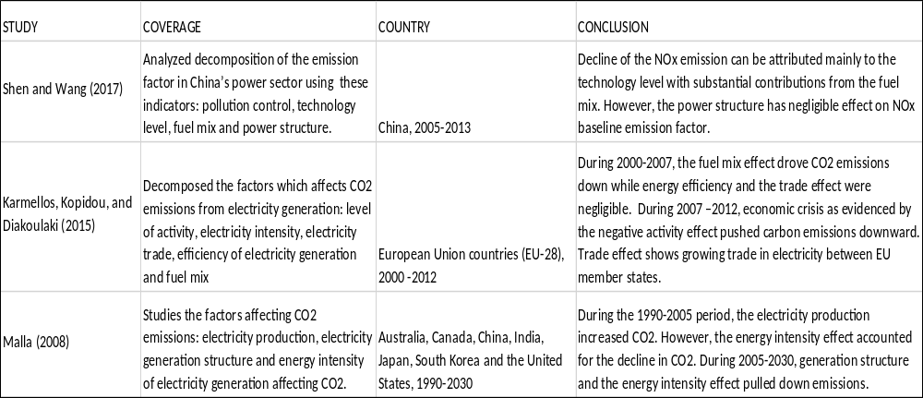
Review of Literature

Slide 4
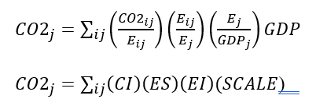
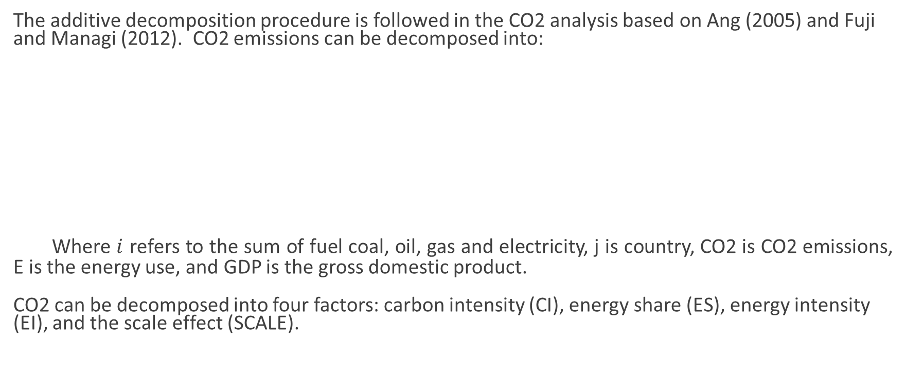
Methodology
The additive decomposition procedure is followed in the CO2 analysis based on Ang (2005) and Fuji and Managi (2012). CO2 emissions can be decomposed into:
Where $i$ refers to the sum of fuel coal, oil, gas and electricity, j is country, CO2 is CO2 emissions, E is the energy use, and GDP is the gross domestic product.
CO2 can be decomposed into four factors: carbon intensity (CI), energy share (ES), energy intensity (EI), and the scale effect (SCALE).
Notes:
The carbon intensity measures the average emission factor of energy use.
The energy share effect shows the use of fossil fuels to total energy consumption.
The energy intensity effect reflects the ratio of energy consumption to GDP.
Scale measures the effect of GDP on CO2.
The energy intensity effect also measures energy efficiency.
A high value of EI means that energy usage is high and energy efficiency is low. In contrast, lower values of EI show that energy use per unit is low and energy efficiency is high.

Slide 5
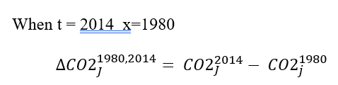
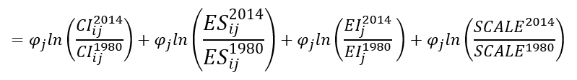

Methodology
Notes:
index decomposition identity which shows that changes in the CO2 emissions are contributed by the changes in carbon intensity (CI), energy share (ES), energy intensity (EI), and the scale effect (SCALE).
logarithmic mean weight function developed in Ang, Zhang and Choi (1998) which gives perfect decomposition and solves problems when zero values are in the data set.

Slide 6
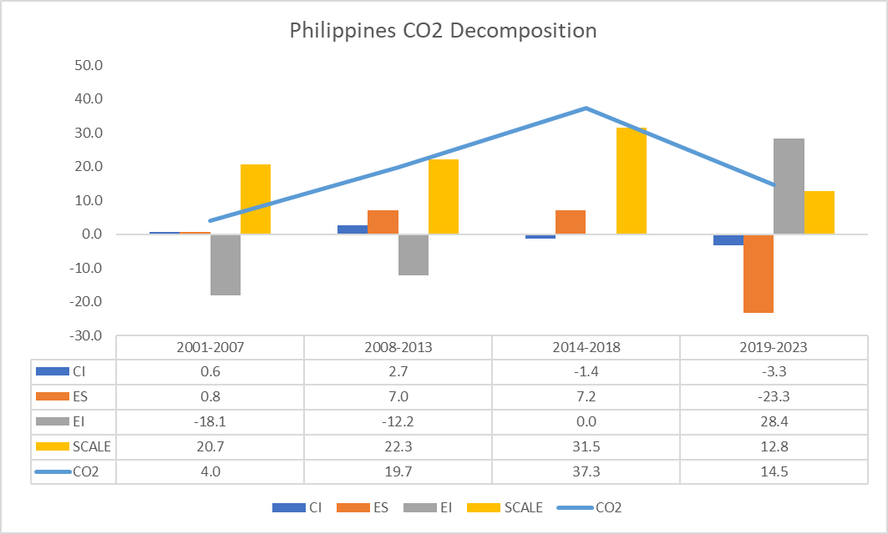
Results: Philippines
Notes:
In 2001-2007, CO2 rose by 4 MtCOe due largely to the Scale effect. Energy intensity has lowered carbon emissions by 18.1 MtCOe.
In 2008-2013, CO2 emissions jumped by 19.7 MtCOe, due mainly to GDP effects as well as ES and CI. EI continued to contribute to the decline of CO2 by 12.2 MtCOe.
In 2014-2018, CO2 emissions rapidly climbed to 37.3 MtCOe due to Scale and ES. At this point, EI contributions were nil.
In 2019-2023, the increase in CO2 emissions fell to 14.5 MtCOe driven by rising EI. Energy intensity pushed up CO2 emissions by 28.4 MtCOe. Meanwhile, ES negatively affected carbon emissions by 23.3 MtCOe as the government pursued renewable energy projects.

Slide 7
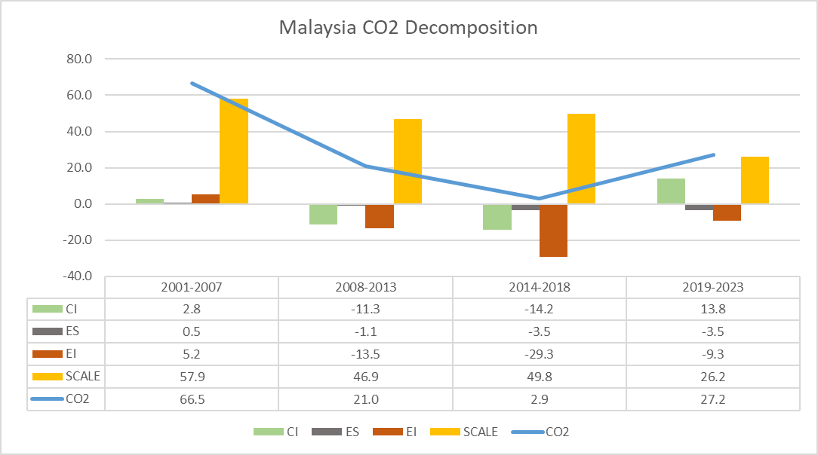
Results: Malaysia
Notes:
CO2 increased by 66.5 MtCO2e in 2001-2007 as CI, ES, EI and Scale rose.
In 2008-2013, CO2 rose by 21 MtCO2e only, as the positive effect of Scale was offset by negative contributions of CI, ES and EI.
In 2014-2018, the change in CO2 further declined to 2.9 MtCO2e pulled downwards by CI, ES and EI. However, the contribution of scale grew stronger than the previous period. This period saw the largest improvement in energy efficiency with EI shaving 29.3 MtCO2e off the CO2 emissions.
CO2 emissions started rising in 2019-2023 due to CI and Scale. ES and EI continued to decreased CO2 emissions.

Slide 8
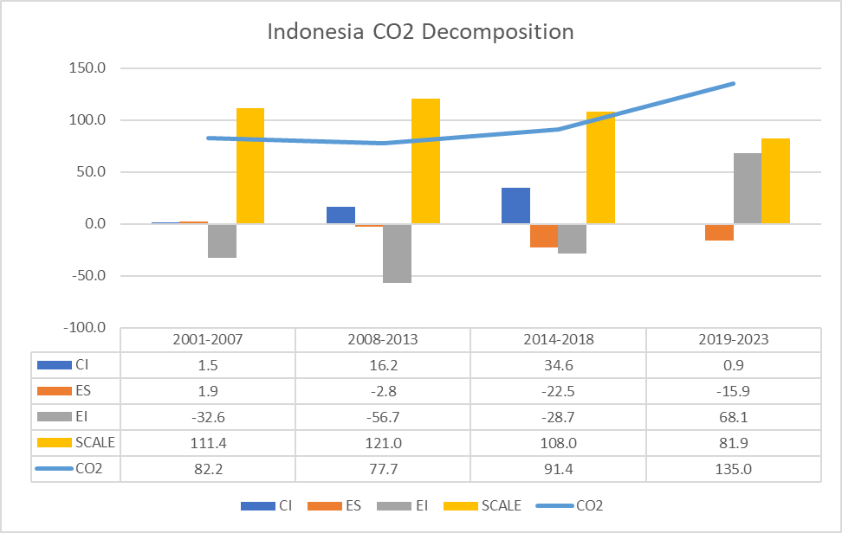
Results: Indonesia
Notes:
Between 2001 and 2007, CO2 emissions increase by 82.2 MtCOe. This is attributed to CI, ES and Scale. In contrast, EI posted negative contributions of 32.6 MtCOe which implies improvements in energy efficiency.
In 2008-2013, Indonesia posted 77.7 MtCOe increase in CO2 emissions due mainly to CI and Scale. EI decreased it by of 56.7 MtCOe which is the highest decline in EI for Indonesia over the study period.
In 2014-2018, CO2 emissions reached 91.4 MtCOe propped up by CI and Scale. Both ES and EI have negative contributions.
In 2019-2023, CO2 emission accelerated its upward trend recording 135 MtCOe increase. The drivers were Scale, EI and CI. After posting negative contributions for the previous periods, EI recorded a 68.1 MtCOe increase of CO2 emissions.

Slide 9
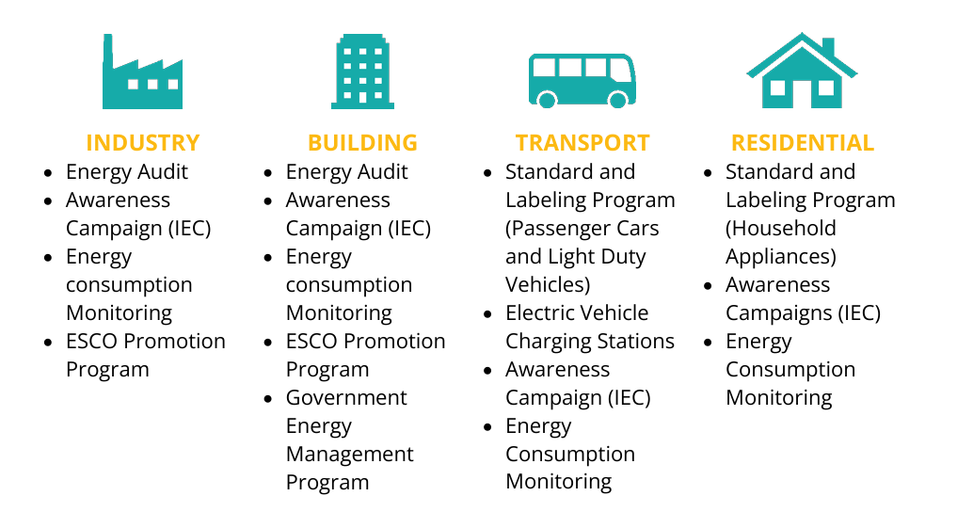
Energy Efficiency Policies
Philippines
Energy Efficiency and Conservation Republic Act 11285 (EEC Act), 2019
Source: Energy Transition Partnership, 2022.

Slide 10
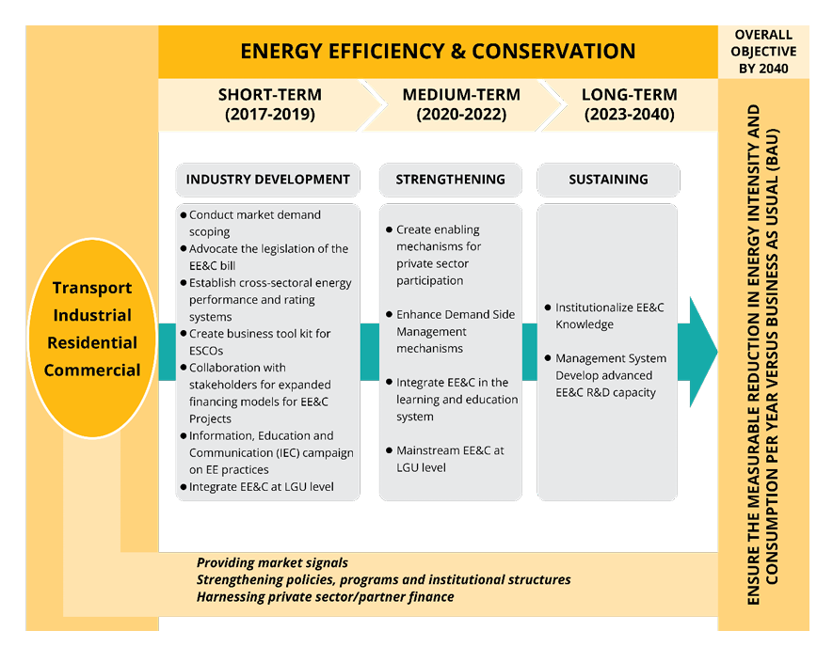
Philippines: Energy Efficiency Roadmap, 2017-2040

Slide 11
Energy Efficiency Policies: Malaysia
1. Malaysian Industrial Energy Efficiency Improvement Project (MIEEIP) – promotes energy efficiency in the industrial sector.
2. Integrated Resource Planning - capacity building for effective energy planning and forecasting.
3. GEO Building – a model building was established to show low energy consumption features.
4. Fiscal Incentives for Energy Efficiency - promote energy efficiency projects and equipment by giving tax incentives.
5. The Green Technology Finance Scheme (GTFS) – this fund provides a 2% subsidy to the interest rates offered by banks to support investments in green technology projects.
6. Sustainability Achieved via Energy Efficiency Program or SAVE - provide cash rebates for the purchase of energy-efficient refrigerators, air-conditioners and chillers.
7. Energy Performance Contracting (EPC) - promote energy efficiency in government buildings.
8. Energy Efficiency and Conservation Regulations 2024 - a comprehensive legal framework to promote efficient energy use, reduce wastage and align with global climate commitments

Slide 12
Energy Efficiency Policies: Indonesia
National Cooling Action Plan (NCAP) an initial mapping on cooling sectors such as building space cooling, food cold chain, vaccine cold chain, cooling system for industrial process, and mobile air conditioning was conducted.
Government Regulation No. 70 Year 2009 requires all companies with an annual energy consumption exceeding 6 000 tonnes of oil equivalent (toe) to appoint an energy manager, develop an energy conservation plan, perform an energy audit and report energy consumption to government.
Industry: using clean technology and optimizing the industrial process.
Transport: launching fuel efficient vehicle and shifting to Electric Vehicles.
Household: advocating for energy-efficient appliances and implementing energy efficiency standards.
Commercial: utilizing energy efficient lighting system and HVA (Heating, ventilation, and air conditioning)

Slide 13
Barriers to Energy Efficiency
Malaysia
Low energy prices - fuel subsidies lower electricity and fuel prices than the actual cost of energy generation. It prevents energy efficiency by consumers and EE investments.
Lack of finance for energy efficiency - banks do not have capacity to for project evaluation and no loan schemes for energy efficiency for individual consumers.
Lack of consistency in embarking on the energy efficiency - Without annual government budget for energy efficiency, activities are usually project based which prevent continuity of reforms.

Slide 14
Barriers to Energy Efficiency
Indonesia
Building codes are set for large commercial buildings.
Transport has no fuel efficiency standards for passenger cars and trucks.
Misalignment between national energy policies and electricity master plans
Subsidies encourage the use of fossil fuels.
Philippines
The national efficiency program encounters challenges in policy development and institutional arrangements.
The national efficiency law faces difficulties in implementation and market demand.

Slide 15
For Comments, References, Questions and Collaboration, pls. contact me at calfonso33@gmail.com

Slide 16
Thank You!

