Slide 1



Thailand’s Pathway to Net-Zero Emissions:
An Integrated Energy System Assessment
EEAP Virtual Conference 2026
1 October 2026
Nattapong Chayawatto^{a*}, Sanwit Iabchoon^{b}, Atit Tippichai^{c}, Thongchart Bowonthumrongchai^{d} , Saw Yu New^{e}, Bundit Fungtammasan^{f}, Boonrod Sujjakulnukit^{f}
ª Pilot Plant Development and Training Institute, and Office of Building and Ground Management King Mongkut’s University of Technology Thonburi (KMUTT), Thailand. ^{b} Key Laboratory of Urban Environment and Health, Institute of Urban Environment, CAS, China. ^{c} School of Architecture, Art and Design, King Mongkut Institute of Technology Ladkabang, Thailand. ^{d} Faculty of Economics, Srinakharinwirot University, Thailand. ^{e} Nanyang Technological University, Singapore and ^{f} The Joint Graduate School of Energy and Environment, KMUTT, Thailand.
Notes:
Thank you very much for the kind introduction.
Good morning, everyone. It is a pleasure to be here today.
My name is Nattapong Chayawatto from, King Mongkut’s University of Technology Thonburi. Thailand.
Today, I’m pleased to present our work on “Thailand’s Pathway to Net-Zero Emissions: An Integrated Energy System Assessment.”
I will focus on three key areas: Thailand’s energy demand, the transformation of the power sector, and the implications of different pathways for achieving net-zero emissions.
Thai German Cooperation on Energy Mobility and Climate

Slide 2
Contents
Introduction
Methodological Overview and Scenario Design
Key Assumption
Results
Summary of Findings and Recommendations
Notes:
Let me briefly introduce the structure of my presentation.
First, I will introduce Thailand’s NDC 3.0 and Net Zero commitment.
Second, I will present the methodology and scenario design, followed by the key assumptions.
Then, I will discuss the key results, focusing on energy demand, power capacity, and decarbonization.
Finally, I will summarize the key findings and recommendations for Thailand’s transition to net-zero emissions.
So, let me begin with the introduction.

Slide 3
Introduction
Thailand aims to reduce (net) greenhouse gas emissions by 47% by 2035 compared to 2019, in line with its updated Nationally Determined Contribution (NDC 3.0) and Long-Term Low Emissions Development Strategy (LT-LEDS).
Thailand is committed to achieving net-zero greenhouse gas emissions by 2050 at COP30 on Nov. 19, 2025.
Goal to maintain energy security, affordability, economic competitiveness and sustainability.
Source: NDC 3.0 Public Hearing Meeting, Bangkok, March 2025
Revision of Thailand’s Long-Term Low Greenhouse Gas Emission Development Strategy: LT-LEDS, Bangkok,
January 2026
Notes:
-Thailand targets a 47% reduction in net GHG emissions by 2035 and net-zero emissions by 2050.
- The transition aims to balance energy security, affordability, economic competitiveness, and sustainability.

Slide 4
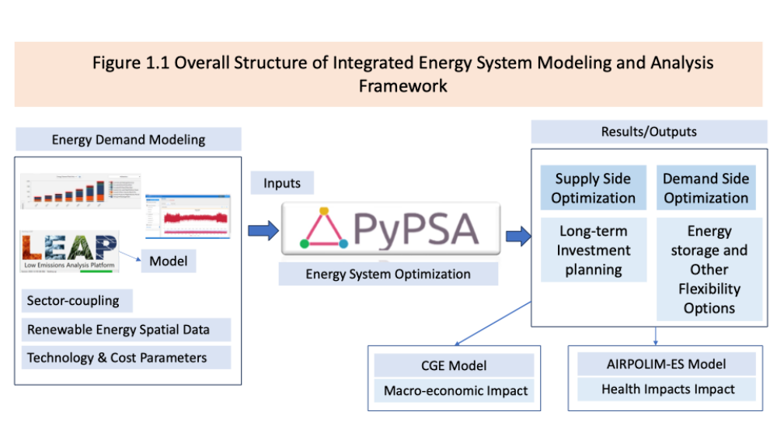
Integrated Modelling Methodology Framework
PyPSA-SPICE
Notes:
This framework presents the overall structure of the integrated energy system modeling and analysis.
Energy Demand Projection: LEAP estimates sectoral energy demand and CO₂ emissions under different policy and technology scenarios.
Energy System Optimization: LEAP outputs, renewable potentials, and technology data are integrated into PyPSA to optimize the technology mix, investment pathways, and system flexibility.
Macroeconomic Impact: PyPSA results are fed into a CGE model to assess the economic impacts of energy transition policies and technologies.
Health Impact: AIRPOLIM-ES evaluates public health impacts from air pollution associated with electricity generation, particularly fossil-fuel power plants.

Slide 5
Scenario Design and Definition
Three scenarios investigated in this study
Reference Pathway (REF) | The Reference Pathway reflects a continuation of Thailand’s current energy policies. It is aligned with the draft PDP 2024, AEDP2024 and EEP2024, 30@30 …..
COP30-Aligned Pathway (COP30) | Represents a high-ambition, long-term transition aligned with NDC 3.0 and the national commitment to achieving net zero by 2050, assumes an accelerated policy environment that enables earlier large-scale deployment of renewable, later stage CCS technologies, and stronger demand-side interventions.
Clean Firm Power Pathway (CFP) | Explores a CCS-free, low-risk transition built on high renewable penetration supported by clean firm power (primarily SMRs) combined with large-scale storage, flexibility resources, and accelerated electrification. It expands SMR deployment beyond the cautious levels in PDP 2024 to ensure year-round reliability in a system dominated by VRE.
Notes:
This study develops three decarbonization pathways toward 2050, differing in policy ambition and technology deployment.
REF: Continuation of current policies, based on PDP 2024, AEDP 2024, and the 30@30 EV target. We completed the analysis in March, before the PDP 2026 public hearing in September. The overall scenario concepts are broadly similar, but we do not compare the results due to time constraints.
COP30: Accelerated transition aligned with Thailand’s climate commitments and net-zero target.
CFP: CCS-free pathway based on renewables, storage, and expanded SMR deployment toward net zero.

Slide 6
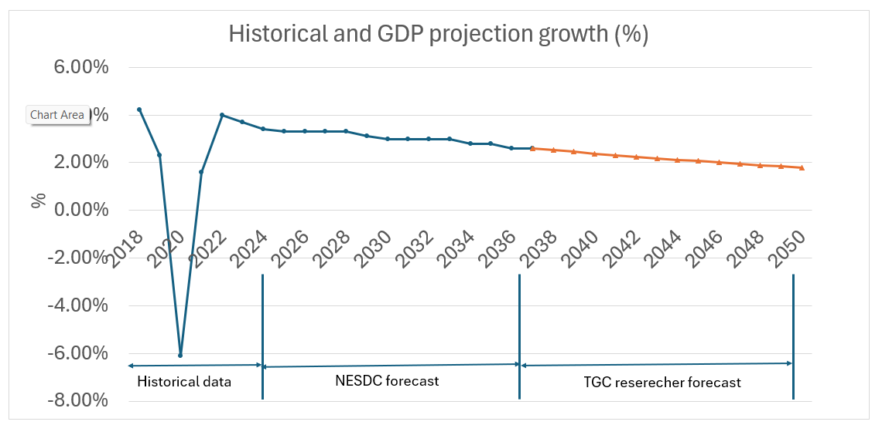
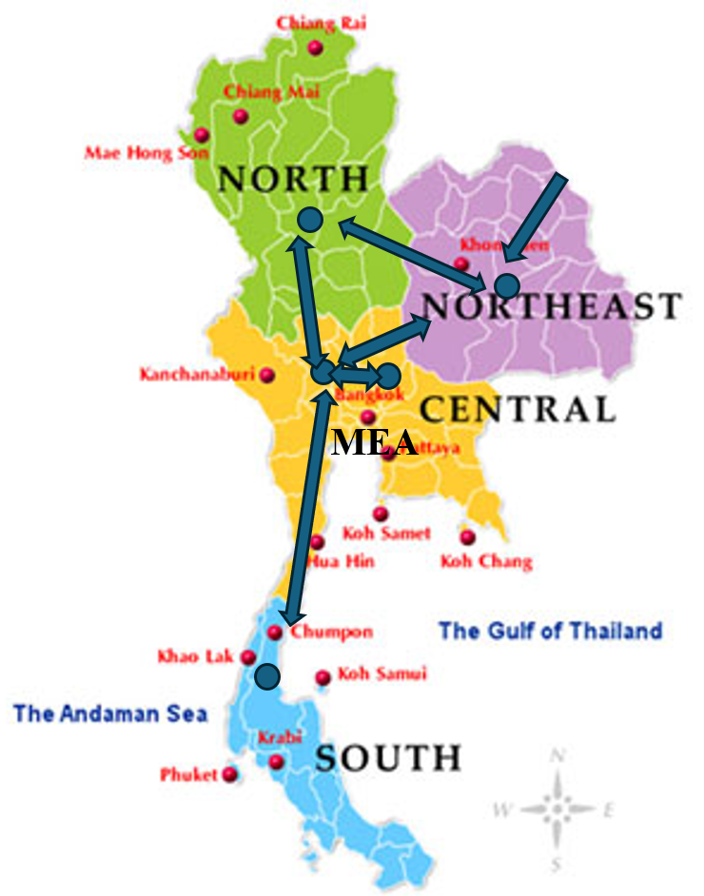
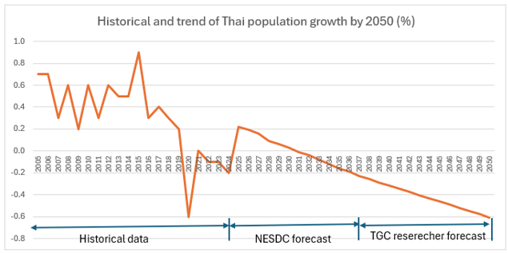
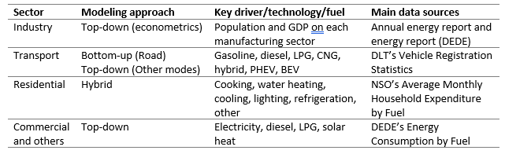
Overview of Driving Factors and Modelling Approach
GDP : average annual growth rate = 2.54% (2026-2050).
Population: average annual growth rate = ---0.24% (2026-2050).
Urbanization Trend: urban household share increasing from 34% in 2022 to about 45% by 2050.
Study region: 5 regions.
Baseyear: 2023 , endyear: 2050
Notes:
Overview of Driving Factors and Modelling Approach
-The energy system is generally represented using a comprehensive and internally consistent set of input parameters.
-This slide summarizes the key data sources and modeling assumptions for example GDP , population, 5 study region,
-In term of energy demand modelling, we use top-down, bottom-up and hybrid approach depend on data available.

Slide 7
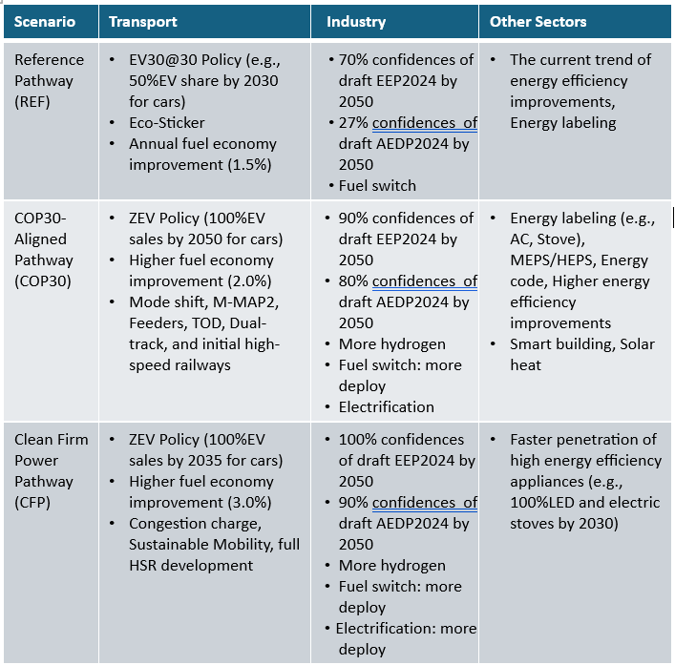
Scenario Design for PYPSA & LEAP
LEAP
PYPSA
Aspect | Reference | COP30 | CFP
Coal Phase-out | phase-out in 2050 based on lifetime of power plant | Early retirement in 2045 | Early retirement in 2040
Gas Strategy | 2 options , no CCS | 4 options inc. CCS (2040–2050) | 2 options, no CCS
Solar Potential | Growth rate post-2037 | Higher max capacity | Higher max capacity
BESS Growth (per every 5 yrs) | 10% | 25% | 35%
SMR | Constant | Constant | Optimized expansion
Transmission | Allowed to expand | Allowed to expand | Allowed to expand
Emissions Constraint | No | Yes | Yes
Notes:
Scenario design for PyPSA and LEAP were developed through stakeholder consultation and policy review
PyPSA, we assume for example the coal phase out, gas strategy, solar penetration and SMR.
LEAP include EV sales shares, fuel-economy improvement rates, reductions in building energy intensity, and, energy labeling, MEPS, HEPS, energy efficiency improvement and EEP2024 and AEDP 2024.

Slide 8
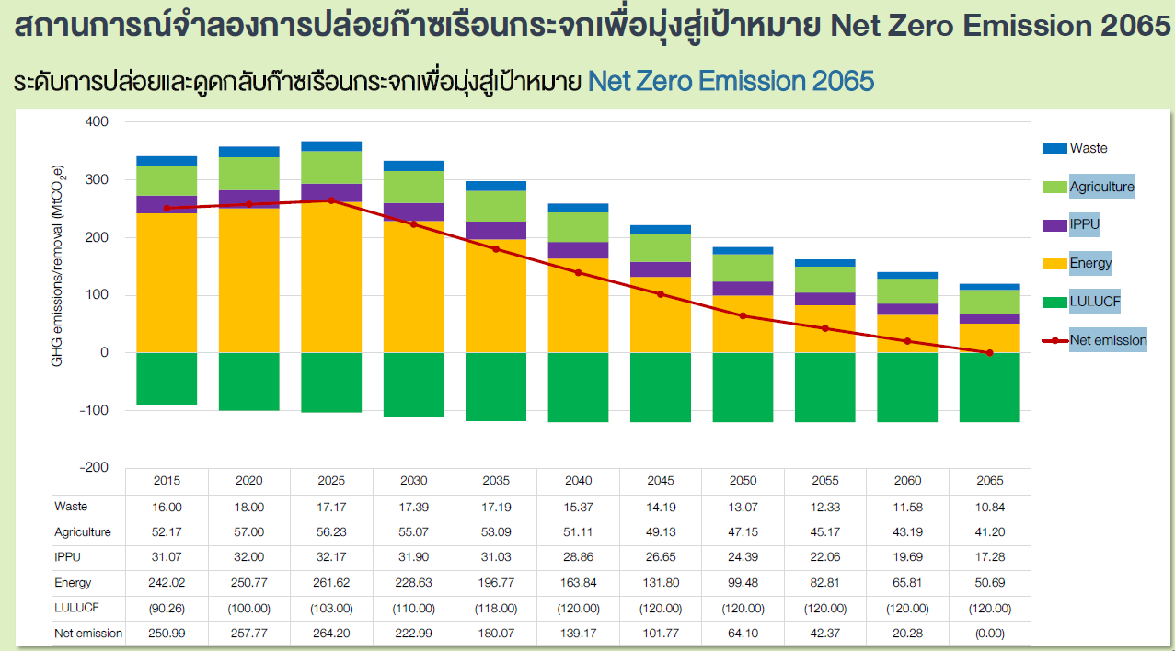
Defining the Net Zero Emission Target by 2050 in Energy Sector
Greenhouse Gas Emission and Removal Levels Toward the Net-Zero Emissions Target by 2065
New target
New target for energy sector:
35.4
Recheck: 13.07+47.15+24.39+35.4-120 = 0
Source: ONEP, The revision and update of Thailand’s Long-Term Low Greenhouse Gas Emission Development Strategy (LT-LEDS) and Thailand’s National Determined Contribution (NDC), June 2022
Notes:
To define the net zero emission target by 2050 in energy sector only
- Based on Thailand’s Long-Term Low Greenhouse Gas Emission Development Strategy LT-LEDS and NDC (2022), we shift the 2065 net-zero target to 2050 and recalculate it for the energy sector.
- The resulting energy-sector new target is 35.4 MtCO₂eq, which supports achieving net zero by 2050.

Slide 9
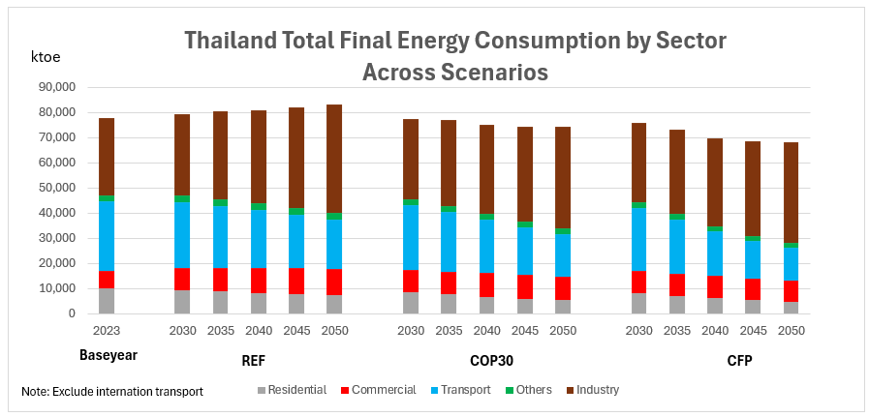
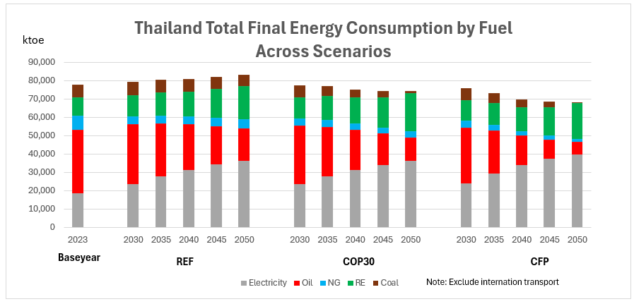
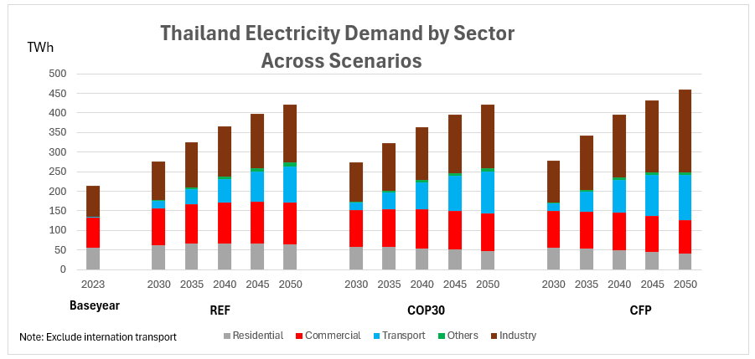
Results of Comparative Scenario Analysis : Energy Demand Projection
39%
36%
9%
13%
In 2023, Thailand’s final energy consumption was ~77 Mtoe, dominated by industry (39%) and transport (36%), which together accounted for 75% of total demand.
REF: Final energy demand rises to 83.1 Mtoe by 2050, mainly driven by industrial growth, despite efficiency gains reducing demand in other sectors.
COP30 & CFP: Final energy demand falls to 74.2 and 68.1 Mtoe by 2050, driven by efficiency and electrification, while industrial demand rises but remains below REF
In 2023, electricity and oil accounted for 23.7% and 44.7% of energy demand, respectively; across all scenarios, electrification increases electricity demand while oil demand declines.
Transport electricity use rises significantly by 2050 across all scenarios, driven by EV adoption.
Notes:
The results of Final energy demand highlight
REF increases from 77.1 to 83.1 Mtoe by 2050, while COP30 and CFP decline to 74.2 and 68.1 Mtoe, driven by efficiency and electrification.
Fuel mix: Electricity share in CFP rises from 23.7% in 2023 to 58% in 2050, while oil demand declines from 44.6% in 2023 to 10% by 2050
Electricity demand in transport increases significantly by 2050, mainly due to EV adoption.

Slide 10
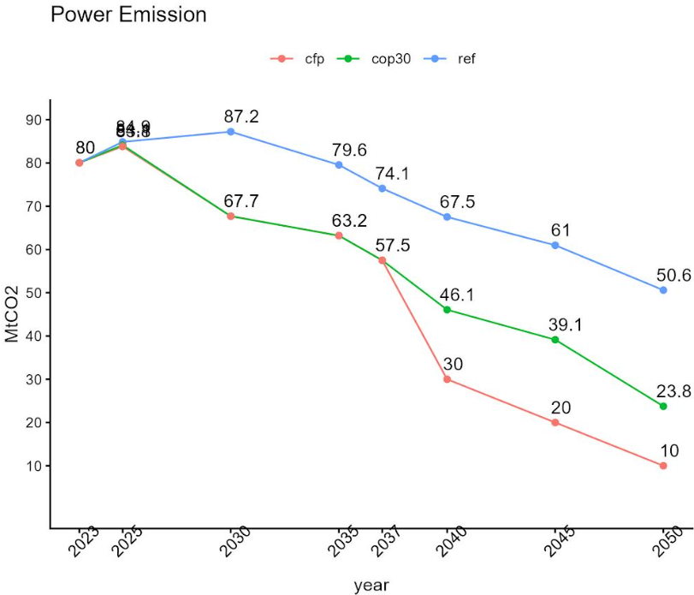
GHG Emission Pathways in Power Sector
Notes:
This slide results the GHG Emission Pathways in Power Sector
REF: 37% emissions reduction by 2050 through gradual renewable and storage deployment.
COP30: 70% reduction, driven by rapid renewables and strategic CCS deployment.
CFP: 87% reduction, supported by fossil-fuel phase-out, renewables, storage, and nuclear.

Slide 11
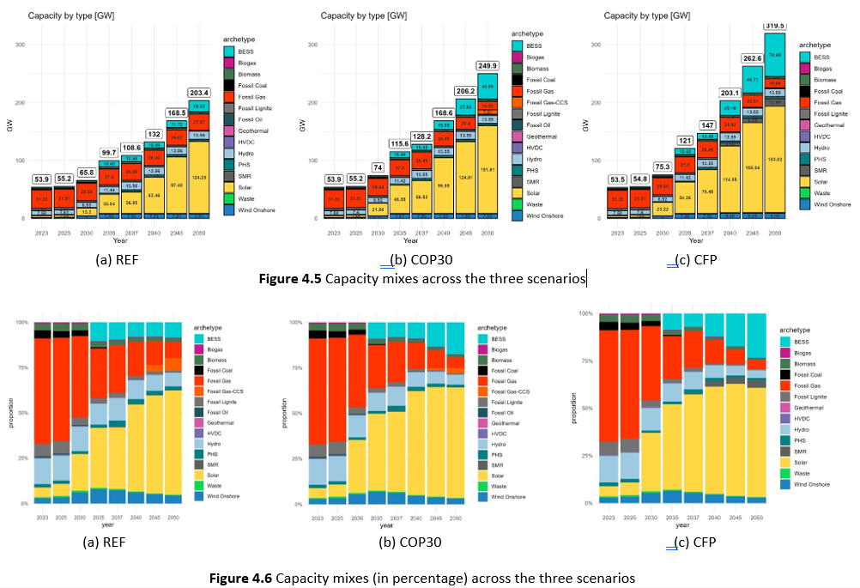
Results of Comparative Scenario Analysis : Power Capacity
REF expands capacity to 203.4 GW by 2050, led by solar (124.2 GW,61% share) and battery storage (19.2 GW).
It maintains natural gas generation with minimal nuclear power (0.6 GW)
COP30 expands capacity to 250 GW by 2050, with 151.6 GW (60% share) of solar and 44 GW of storage.
It accelerates decarbonization by phasing out coal, adding gas-CCS, and strengthening renewable deployment and system flexibility.
CFP reaches 319.5 GW by 2050, led by 183.8 GW (57% share) solar, 74.4 GW storage, and 12.9 GW SMRs.
It achieves near-zero emissions through solar, storage, and nuclear, but requires high investment and advanced grid management
Notes:
For power capacity evaluation,
REF reaches 203.4 GW by 2050, dominated by solar (124.2 GW, 61%) and battery storage (19.2 GW), while retaining gas with minimal nuclear (0.6 GW).
COP30 reaches 250 GW by 2050, led by solar (151.6 GW, 60%) and storage (44 GW), while phasing out coal and adding gas-CCS to strengthen decarbonization and system flexibility.
CFP reaches 319.5 GW by 2050, led by solar (183.8 GW, 57%), storage (74.4 GW), and SMRs (12.9 GW), enabling near-zero emissions but requiring high investment and advanced grid management.

Slide 12
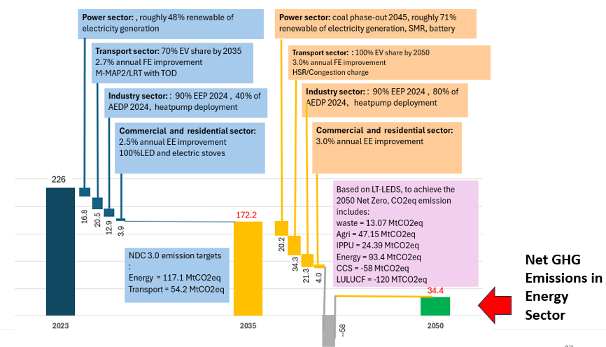
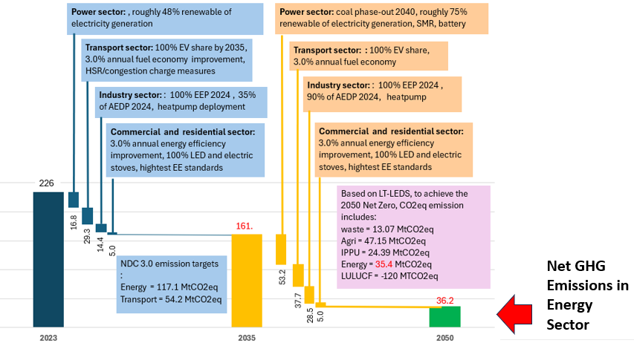
Energy System Measures for 2050 Net Zero Emissions (COP30 and CFP scenario) in MtCO2eq
COP30 scenario
CFP scenario
Notes:
Energy System Measures for 2050 Net Zero Emissions :
Both pathway confirm that Thailand Net zero by 2050 is technically feasible. With net GHG emission in 2050 approximately 34.4 and 36.2 MtCO2 for COP30 and CFP in energy sector.

Slide 13
Comparison of Economic and Price Impacts across the Three Scenarios
COP30 and CFP see modest short-term GDP declines due to upfront investment and transition costs.
During 2035-2050, both COP30 and CFP exceed REF in GDP, with CFP delivering the largest gains
COP30 and CFP cause short-term price increases due to investment and transition costs.
Over time, price impacts moderate, with CFP eventually achieving lower prices and greater long-run stability than REF.
Notes:
For economic impact : We analyze 2 issues
1.Real GDP: COP30 and CFP initially decline relative to REF due to transition costs, but exceed REF by 2050 as long-term economic benefits emerge.
2. Consumer prices: Prices initially increase due to investment and adjustment costs, but decline below REF over time due to lower fuel costs, greater efficiency, and reduced fossil-fuel price exposure.

Slide 14
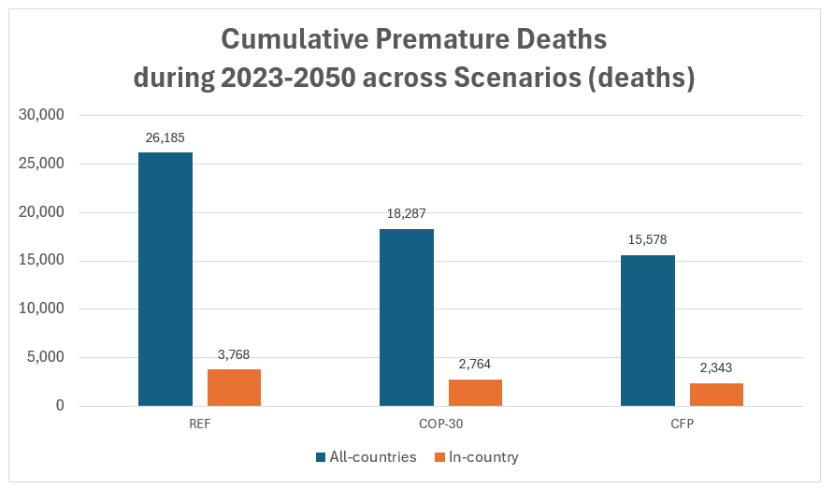
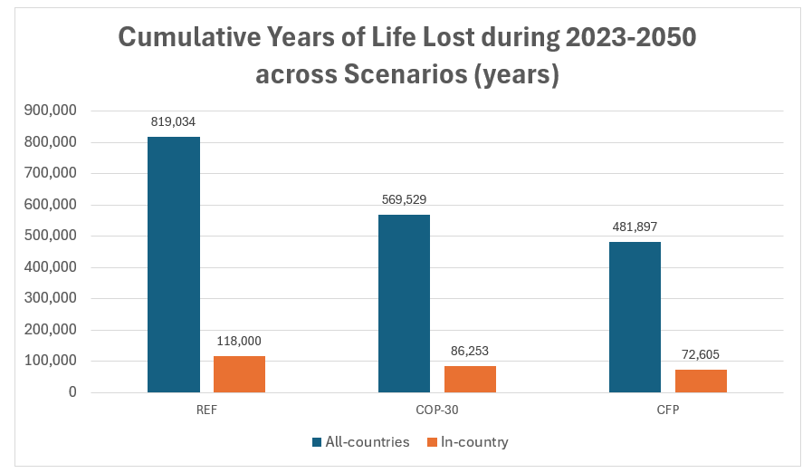
Comparison of Air Pollution Impacts from Fossil-Fuel Power Plants across the Three Scenarios
The REF : highest health burden, an estimated 3,768 in-country premature deaths and 26,185 across all affected countries over the study period.
The COP30: reduces to 2,764 and 18,287, respectively.
The CFP: lowest health impacts, 2,343 and 15,578 respectively.
REF : Highest YLL, at 118,000 years in-country and 819,034 years across all countries.
COP30 : Intermediate impacts, with 86,253 years in-country and 569,529 years across all countries.
CFP : Lowest YLL, at 72,605 years in-country and 481,987 years across all countries.
Notes:
In this slide, show the results of Comparison of Air Pollution Impacts from Fossil-Fuel Power Plants across the Three Scenarios, regarding cumulative premature deaths and cumulative years of life lost (YLL) during 2023-2050.
REF has the highest cumulative premature deaths (~26,000 in Thailand), decreasing under COP30 and CFP.
Cumulative years of life lost follow the same trend, with the highest impact under REF and progressively lower impacts under COP30 and CFP.

Slide 15
Integrated Evaluation of Thailand’s Net-Zero Pathway:
Assessing Policy Impact, Economic Feasibility, Flexibility, and Implementation Readiness
Policy Effectiveness & Emissions | 2. Economic & System Cost Evaluation | 3. Flexibility & Strategic Sequencing | 4. Governance & Capacity Building
Gap Analysis: REF fails NDC3.0; COP30 & CFP achieve emission factor of 0.05 & 0.02 kgCO₂/kWh by 2050 (from 0.36 in 2023) Sectoral Abatement Impact: Electrification drives 50-60% of final energy; transport leads mitigation (~ 56-87% GHG reduction) | CAPEX vs. OPEX Trade-off: from fossils OPEX to clean CAPEX (OPEX drops from $11.5B to $6.0B under CFP) Generation Cost Trajectory (2050): REF: 1.8 THB/kWh (high fuel risk) COP30: 2.1 THB/kWh (balanced) CFP: 2.7 THB/kWh (high capital) | VRE (solar and wind) share of power generation rises from 2.7% in 2023 to 36% (REF), 50.7% (COP30), and 57% (CFP) by 2050. Higher climate ambition increases VRE curtailment, particularly for wind, reaching around 26% in the CFP scenario. 3-Stage Investment Sequencing: 2025–30: VRE & grid Expansion 2030–40: Firming & storage 2040–50: Deep decarbonization | Grid Adequacy & Security: Carbon pricing (USD 10–50/tCO₂) is supporting; mandates required for structural deployment Capacity & Regulatory Readiness: CFP & SMR/CCS pathways require early regulatory preparedness, IAEA SSG-16 alignment, & skills.
Notes:
To evaluate Thailand’s pathway to Net-Zero using our integrated LEAP–PyPSA framework, we structure our results across four critical evaluation dimensions:
Policy Impact: We evaluate the gap between national plans and Net-Zero targets, showing that electricity must reach 50–60% of final energy, with Transport leading sector GHG reductions by up to 87%.
Economic Feasibility: Higher ambition requires upfront investment but reduces annual fuel OPEX from $11.5 to $6.0 billion, with generation costs of 2.1–2.7 Baht/kWh.
System Flexibility: Higher VRE penetration increases curtailment, reaching ~26% for wind under CFP. Storage, demand-side flexibility, and firm low-carbon capacity are therefore essential. Implementation Readiness: Finally, Carbon pricing alone is insufficient; regulatory mandates, workforce development, and institutional capacity are needed. OAP is already working with IAEA on the SSG-16 roadmap, supporting nuclear-program readiness.

Slide 16
Summary of Findings
1. Structural Pillars & Sectoral Mitigation
    Power Sector Decarbonization: Power accounts for ~36% of energy emissions; achieving near-zero intensity is critical for economy-wide decarbonization
    Electrification as Main Engine: Electricity rises to 50–60% of final energy by 2050
    Sectoral Drivers: Transport achieves the highest reductions via EVs/modal shifts followed by industry via H2 and electrification and buildings via efficiency standards
2. Pathway Dynamics & Cost Trade-Offs
  Strategic Pathways:
        REF: Minimizes near-term investment but fails NDC3.0 & Net-Zero targets.
        COP30: Balances VRE, coal phase-out, storage, and CCS to cut power emissions ~70%
        CFP: Relies on Solar–Storage–SMR architecture for near-zero emissions
    CAPEX/OPEX Trade-Off: Higher ambition increases upfront capital but significantly reduces long-term fossil fuel expenditure and energy price volatility
3. Strategic Investment Sequencing & Policy Signals
Three-Stage Capital Allocation:
    2025–2030: Accelerated VRE deployment and transmission grid readiness.
    2030–2040: Flexibility resources, long-duration storage, and firming capacity.
    2040–2050: Deep decarbonization via firm clean technology deployment (SMRs/CCS).
Firm Capacity & Carbon Pricing: Firm low-carbon capacity (SMRs/CCS) is essential for grid adequacy at high VRE levels. Carbon pricing (USD 10–50/tCO₂) acts as a supporting signal but cannot trigger structural shifts on its own without clear mandates
Notes:
"To summarize our core findings:
Power sector: The backbone of decarbonization, with electrification raising electricity’s share to 50–60% of final energy; transport delivers the largest abatement, up to 87%.
Pathways: REF delays investment but misses long-term targets; COP30 balances renewables, storage, and CCS; CFP achieves near-zero emissions through solar, storage, and SMRs, with 2050 generation costs of 2.7 Baht/kWh.
Implementation: Decade 1: grid readiness → Decade 2: storage and flexibility → Decade 3: firm low-carbon technologies, supported by clear policy mandates.

Slide 17
Operationalizing Evaluation: Key Priorities for Impact, Process, and Governance Evaluators
Evaluation as a Strategic Principle for Net-Zero Execution
Impact Evaluation (Verifying Outcomes): Evaluators must establish high-frequency M&V protocols to track actual cross-sector carbon abatement – verifying whether EV adoption and industrial fuel-switching hit modeled targets while monitoring real consumer tariff impacts and health co-benefits from coal phase-out.
Process Evaluation (Auditing Delivery): Evaluators must continuously audit execution bottlenecks – tracking institutional readiness milestones (e.g., IAEA SSG-16 regulatory alignment for SMRs), monitoring transmission grid schedules to manage VRE curtailment, and verifying that carbon pricing operates in synergy with regulatory mandates.
Adaptive Governance (Dynamic Feedback): Evaluation must evolve from static reporting into an active feedback loop that dynamically updates PDP, de-risks private capital, and keeps Thailand's 3-stage investment sequencing on track through 2050.
Key Message: Evaluators are essential governance partners – using real-time impact metrics and process audits to transform Net-Zero modeling pathways into verifiable, on-budget implementation
Notes:
Impact Evaluation: Establish real-time M&V protocols to verify emissions reductions from EVs and fuel switching, while tracking tariff and health impacts.
Process Evaluation: Monitor implementation bottlenecks, including IAEA SSG-16 milestones, grid expansion, VRE curtailment, and carbon-pricing mandates.
Finally Feedback Loop: Use evaluation results to update PDP dynamically, reduce investment risks, and keep the three-stage investment pathway on track.

Slide 18
Strategic Principles for Net-Zero Transition
  Five strategic principles emerge:
  Electrification as the backbone of mitigation: Power-sector decarbonization supports economy-wide emissions reductions, but clean electricity must expand alongside electrification to avoid upstream emissions and trade risks.
  Integrated planning across PDP–AEDP–EEP: Coordinated sector-coupled planning aligns electrification, generation, grids, and flexibility while reducing stranded assets and system imbalances.
  Early infrastructure investment reduces long-term costs: Early infrastructure investment reduces transition costs and system risks while improving power-system resilience.
  Renewable scale-up requires regulatory reform: Reforming the single-buyer framework and market design is essential to unlock prosumers, demand response, distributed storage, and large-scale private investment.
  Carbon pricing as a complementary policy instrument: Carbon pricing can support emissions reductions, but must be combined with emissions limits, technology policies, and infrastructure planning to achieve Thailand’s NDC and net-zero targets.
Notes:
"From these findings, five overarching principles emerge:
First, clean power must expand alongside electrification to avoid upstream leakage.
Second, planning across PDP, AEDP, and EEP must be fully integrated.
Third, early grid investment reduces long-term system risks.
Fourth, single-buyer framework reforms are essential to unlock private flexibility.
And fifth, carbon pricing must be backed by explicit regulatory limits."

Slide 19
Policy Recommendations
  Anchor the power sector as the backbone of economy-wide decarbonization
  Strengthen power system flexibility and anticipatory grid planning
  Accelerate electrification while containing demand growth
  Preserve technology diversity and strategic optionality
  Deploy carbon pricing as part of a broader policy package
  Strengthen institutional capacity and integrated governance
  Leverage international collaboration to reduce cost and risk
  Institutionalize evaluation as a strategic principle
Notes:
"In conclusion, we recommend eight strategic actions:
Anchor the power sector as the decarbonization engine
Build anticipatory grid flexibility, accelerate efficiency alongside electrification
Preserve technology optionality
Deploy carbon pricing within a broader policy package,
Strengthen institutional capacity,
Expand international collaboration, and
Institutionalize evaluation as a core strategic principle for governance.

Slide 20
Acknowledgement
We would like to express our sincere appreciation to:
Energy Policy and Planning Office (EPPO)
Electricity Generating Authority of Thailand (EGAT)
for their valuable support, information, and contributions to this study.

Slide 21
Thank You
Thank You
Notes:
That is all for my presentation, Thank you.”

