Slide 1
Innovative Evaluation methods for sustainable energy
Key Insights on Evaluation, Inclusion, Evidence Use, and AI in Practice
Highlights drawn from UNEG/OHCHR, GEF Independent Evaluation, ALNAP, DAC, Glocal Evaluation Week and EvalforEarth), and practitioner resources on programme evaluation, monitoring, and AI-enabled evaluation practice.
Presenter : Fayyaz Ahmed Fayyaz
1

Slide 2

01
What is evaluation framework and steps
Look closely at how framework, AI tools are applied in practice.
02
Identify ethical risks
What This Session Explores
Surface the risks that come with AI-supported evidence.
03
Strengthen trust in evidence
Explore what builds — and undermines — confidence in findings.
04
AI in evaluation
This session explores how AI is used in evaluation and what it means for the profession.
05
Impact evaluation, LNOB integration etc.
When use impact, how measure LNOB and evaluation designs
21

Slide 3





The Evaluation Journey/Framework Landscape
1
2
3
4
5
Plan
Collect
Analyze
Report
Act
Define purpose, questions, and design.
Gather data through sound sampling and methods.
Apply analytical methods and assess causality.
Communicate findings through clear reporting.
Apply evidence to guide future decisions.
Evaluation is built from interconnected components — not a single method.
A typical evaluation moves through five connected phases.
Selecting appropriate evaluation methods depends on programme objectives and evaluation questions.
MODERN EVALUATION PRACTICE
7

Slide 4

01
Design for disaggregation
Data collection tools request sex, age, disability, and other relevant markers.
APPLYING THE FRAMEWORK
Seek genuine participation
02
What This Looks Like in Real-World Evaluations
Actively involve local women's groups, grassroots organizations, and minority groups.
03
Look for concrete results
Focus on who benefited and how — not just outputs like “training held.”
Sample question: “To what extent did the programme address the needs of women, youth, indigenous peoples, and minorities?”
04
Test for depth of inclusion
Look past rhetoric (“gender is mentioned”) to practice — resources allocated, policy endorsed, law passed.
13

Slide 5

01
Evaluation depends on trust
Findings only matter if decision-makers believe them.
WHY THIS TOPIC MATTERS
02
Evidence must be credible
Evaluation Only Has Value When It Is Trusted
Credibility is the foundation of every recommendation.
03
AI can strengthen or weaken credibility
The same tool can build trust or erode it, depending on use.
04
Ethical safeguards are essential
Safeguards protect the integrity of AI-supported evidence.
Trust is the currency of evaluation — without it, evidence loses its power to inform decisions.
20

Slide 6

01
Collecting data without a clear purpose
Every data point should map to a specific decision or question.
02
Focusing on activities instead of outcomes
COMMON PITFALLS
Track what changed for people, not just what was delivered.
Common M&E Mistakes NGOs Make — and How to Avoid Them
03
Using weak or unclear indicators
Indicators should be specific, measurable, and meaningful.
04
Neglecting baseline data
Without a baseline, progress and change cannot be demonstrated.
05
Treating M&E as a reporting exercise
M&E should inform decisions, not just satisfy donor requirements.
06
Limited stakeholder involvement
Exclude stakeholders and the findings lose relevance and buy-in.
Recognizing these patterns early helps organizations build more credible, useful M&E systems.
07
Failing to use findings for decision-making
Evidence that isn't acted on delivers no real value.
5

Slide 7

01
AI transforming evaluation practice
New tools are reshaping every stage of the evaluation cycle.
OPENING CONTEXT
02
Automated data analysis increasing
AI Is Reshaping How Evidence Is Made
Machine-driven analysis is becoming standard practice.
03
Predictive modelling expanding
Forecasting and simulation are entering mainstream evaluation.
04
Ethical concerns rising
Growing use brings growing responsibility.
Artificial Intelligence is transforming how we collect, analyse, and interpret evidence.
19

Slide 8

01
Data collection tools
AI-enabled tools capture data faster and at greater scale.
'AI' IN PRACTICE
02
Machine learning analysis
AI Across the Evaluation Cycle
Algorithms detect patterns across large, complex datasets.
03
Predictive models
Models forecast outcomes to inform programme decisions.
04
Automated reporting
AI drafts and structures evaluation reports and summaries.
05
Policy simulations
AI is now used across the evaluation cycle, from data collection through to reporting.
Simulations test policy options before real-world rollout.
22

Slide 9

01
Speed
Analysis that once took weeks can now take hours.
OPPORTUNITIES
02
Scale
AI Offers Enormous Opportunities
AI can process evidence across far larger datasets.
03
Efficiency
Routine tasks are automated, freeing evaluators for judgment work.
04
Big data analysis
Complex, high-volume data becomes usable evidence.
05
Better forecasting
Used well, AI can expand what evaluators are able to see, measure, and predict.
Predictive power supports more proactive decision-making.
23

Slide 10
1. Digital Data Collection
2. Quantitative Analysis
3. Qualitative Analysis
Kobo Toolbox (ODK), • ONA, mWater app, MS forms and google surveys
SPSS • Excel • Power BI
NVivo — coding & thematic analysis
Atlas and MaxQDA
PRACTITIONER RESOURCE
Evaluator's Toolkit
4. Visualization
5. Design & Planning
6. Data Ethics
Dashboards • Charts & graphs • Maps • Storytelling
Logframes • Theory of change • Results frameworks • Workplans
Do no harm • Informed consent • Confidentiality • LNOD and Data security,
“The most important tool is judgment — and that comes from experience.”
9

Slide 11

01
Reliability
Evidence must hold up consistently under scrutiny.
TRUST IN EVIDENCE
02
Transparency
Trust Depends on Transparency
Methods and tools used must be openly disclosed.
03
Verification
Findings must be checkable and independently confirmed.
04
Professional judgment
Human expertise remains central to interpreting evidence.
05
Accountability
Trust in evaluation depends on transparency about how evidence is generated and used.
Someone must own the outcomes AI helps produce.
24

Slide 12

01
Algorithm bias
Biased training data produces biased evaluation outputs.
ETHICAL RISKS
02
Data privacy issues
AI Reflects the Data Used to Train It
Sensitive personal and community data can be exposed.
03
Misuse of outputs
AI findings can be taken out of context or misapplied.
04
Lack of consent
Data may be used without the knowledge of those it describes.
05
Manipulation risk
Because AI mirrors its training data, its outputs can carry hidden ethical risks.
Outputs can be shaped to fit a predetermined narrative.
25

Slide 13

01
Fairness
Ensure AI-supported findings treat all groups equitably.
02
Transparency
GUIDING PRINCIPLES
Make AI methods and limitations clearly visible.
Principles to Guide AI-Supported Evaluation
03
Accountability
Assign clear responsibility for AI-informed conclusions.
04
Inclusiveness
Involve diverse voices in shaping and reviewing AI use.
05
Human oversight
Keep people in control of key evaluative decisions.
06
Context sensitivity
These principles should guide the responsible use of AI throughout evaluation practice.
Adapt AI use to the realities of each specific setting.
Evaluation, Evidence & Trust | M&E, Inclusion, and AI in Practice
29

Slide 14

01
AI should support
AI is most valuable when it assists the evaluator's work.
HUMAN JUDGMENT
Artificial Intelligence Must Remain a Tool
02
Not replace
AI is not a substitute for professional evaluation expertise.
03
Human evaluators
People remain accountable for judgment, context, and meaning.
No matter how capable AI becomes, evaluation is ultimately a human responsibility.
Evaluation, Evidence & Trust | M&E, Inclusion, and AI in Practice
26

Slide 15

01
Ethical standards
Clear, shared standards must guide AI-supported evaluation.
RESPONSIBILITY
02
Oversight systems
Evaluators Must Strengthen Professional Standards
Structured oversight catches errors before they cause harm.
03
AI literacy
Evaluators need the skills to understand and question AI tools.
04
Institutional review
Institutions must review and approve AI use in practice.
05
Accountability
Responsible AI use requires evaluators to actively strengthen their professional standards.
Responsibility for outcomes must always rest with people.
Evaluation, Evidence & Trust | M&E, Inclusion, and AI in Practice
27

Slide 16

01
Review before use
Assess any AI tool before applying it to real evaluation work.
PRACTICAL FRAMEWORK
02
Validate data
Practical Steps for Evaluators
Check that underlying data is accurate and representative.
03
Document methods
Record how and where AI was used in the process.
04
Keep human control
Retain final decision-making authority with people.
05
Engage stakeholders
Evaluators should apply practical steps to keep AI use safe, credible, and accountable.
Involve stakeholders in reviewing AI-assisted findings.
Evaluation, Evidence & Trust | M&E, Inclusion, and AI in Practice
30

Slide 17

01
Better awareness
Evaluators gain clearer insight into AI's role and limits.
EXPECTED OUTCOMES
02
Stronger ethics
AI Can Strengthen Evaluation
Ethical standards become more robust and explicit.
03
More credible evidence
Findings gain greater trust from stakeholders and decision-makers.
04
Responsible AI use
AI is applied deliberately, not as an unexamined shortcut.
05
Improved evaluation practice
Applied responsibly, AI strengthens rather than undermines the evaluation profession.
The overall quality of the profession's practice rises.
Evaluation, Evidence & Trust | M&E, Inclusion, and AI in Practice
31

Slide 18
Designing Innovation Into Evaluation
Perspectives on credibility, rigor, and human interpretation in an AI-enabled era

Slide 19
1
1. Is the programme new?
5
5. Is randomized assignment feasible?
If yes, design the monitoring and assessment system from the outset.
If yes, outline measurable impact questions and proceed with the design.
2
2. Is scaling, expansion, or attribution the goal?
6
6. Are the groups large enough for causal judgments?
When to Conduct an Impact Evaluation
If no, use a performance evaluation design without a counterfactual.
If no, fall back to a performance evaluation with no counterfactual.
3
3. Is the programme a realistic scope for impact evaluation?
7
7. Is there sufficient data for the evaluation period?
If no, a performance evaluation without a counterfactual is more appropriate.
If no, use an interrupted time series or quasi-experimental design.
A step-by-step path for choosing the right evaluation design based on programme readiness and data availability.
4
4. Can a comparison group and baseline data be established?
8
8. Does the data span a sufficiently long duration?
If no, consider a retrospective or quasi-experimental design.
If yes, use a prospective experimental design or a randomized controlled trial.
3

Slide 20
Consider Impact Evaluation When:
Impact Evaluation Is NOT Appropriate When:
Scaling or replication is planned
Contribution needs to be demonstrated
Knowledge gaps exist
The intervention is stable and measurable
A counterfactual cannot be established
The programme is still in early development
Existing evidence already answers effectiveness questions
Measuring indirect effects is not feasible
Impact Evaluation (When to Do or Not to Do)
Impact evaluation is a strategic choice, not required for every programme.
2

Slide 21

01
How evidence is generated
AI now produces evidence at a pace and scale unseen before.
THE SHIFT WE ARE EXPERIENCING
Evidence Is Changing Faster Than Judgment
02
How evidence is synthesized
AI condenses and connects information across many sources.
03
How evidence is communicated
AI reshapes how findings are packaged and delivered to users.
But more evidence does not automatically lead to better decisions.
33

Slide 22
01
Designing around decisions
Evaluation design should start from the decisions it will inform.
TRUST BEGINS BEFORE THE EVALUATION STARTS
Credibility Cannot Be Retrofitted
02
Appropriate rigor
Rigor should match the stakes and context of the decision.
03
Collective interpretation and use
Findings gain trust when interpreted and used together.
Credibility cannot be added at the reporting stage — it is shaped from the very beginning of the process.
34

Slide 23
01
Decision stakes
Higher-stakes decisions call for a higher standard of rigor.
APPROPRIATE RIGOR IN DATA-RICH ENVIRONMENTS
02
Context
More Data Does Not Mean More Credibility
The setting shapes what counts as sufficient evidence.
03
Uncertainty
Rigor must account honestly for what remains unknown.
04
Timelines
Available time constrains how much rigor is feasible.
In data-rich environments, appropriate rigor — not sheer volume — is what builds credibility.
Evaluation, Evidence & Trust | M&E, Inclusion, and AI in Practice
35

Slide 24

01
Context
Human evaluators understand the situation behind the numbers.
WHY HUMAN INTERPRETATION STILL MATTERS
02
Tacit knowledge
Innovation/Trust Is Strengthened Through Collective Interpretation
Unwritten, experience-based knowledge shapes sound interpretation.
03
Dialogue
Meaning is negotiated through conversation among stakeholders.
04
Human judgment
Final interpretation requires a person's considered judgment.
AI can identify patterns, summarize information, and accelerate synthesis — but interpretation still depends on people.
Evaluation, Evidence & Trust | M&E, Inclusion, and AI in Practice
36

Slide 25

01
Clearer decision intent
Every evaluation should start from a clearly defined decision to inform.
IMPLICATIONS FOR EVALUATION PRACTICE
02
Proportional rigor
What Trusted Practice Requires Going Forward
Match the level of rigor to the stakes of the decision at hand.
03
Human oversight
Keep meaningful human review embedded throughout the process.
04
Stronger facilitation of evidence use
Invest in helping decision-makers actually use the evidence produced.
Trusted evaluation practice in the AI era requires deliberate, structural change.
Evaluation, Evidence & Trust | M&E, Inclusion, and AI in Practice
37

Slide 26

01
Policy, guidance, and Terms of Reference
Set the foundation for a rights- and equality-sensitive evaluation.
02
Team, management, and reference group
UNEG GUIDANCE DOCUMENT, JANUARY 2024
Assemble people who bring the right expertise and perspectives.
Integrating Human Rights, Gender Equality, and Leaving No One Behind in Evaluations
03
Objective, scope, criteria, and questions
Frame the evaluation around inclusion from the start.
04
Methodology and stakeholder mapping
Design data collection that reaches and represents all groups.
05
Findings and analysis
Interpret results through an equality and rights lens.
A six-part framework for embedding rights, equality, and inclusion across the evaluation cycle.
06
Conclusions and recommendations
Translate findings into actionable, inclusive recommendations.
12

Slide 27

01
Participation
Were rights-holders involved in defining what “meaningful” means?
UN HUMAN RIGHTS (OHCHR)
A Human Rights-Based Approach to Data
02
Disaggregation
Are results broken down by relevant group?
03
Self-identification
Are people defining their own identity characteristics, rather than having them assigned?
Example: measuring the “meaningful participation of rights-holders.” Rights-based data spans participation, disaggregation, self-identification, transparency, privacy, and accountability.
11

Slide 28

01
If people are involved, you can integrate it
Inclusion is possible in virtually any evaluation with people at its center.
02
Terms of Reference are the best tool
PRACTICAL GUIDANCE
Build inclusion requirements directly into the ToR from the start.
For Successfully Integrating Leaving No One Behind
03
If you are not an expert, look for one
Bring in specialist expertise where your own knowledge has gaps.
04
Ask the right questions
Well-framed questions surface who is being reached and who is not.
05
Rely on your colleagues at the country level
Local staff bring context that headquarters cannot replicate.
Practical, field-tested advice for evaluators working to integrate LNOB into their practice.
06
Look for real results, or make a recommendation
If results aren't there yet, recommend how to get there.
Evaluation, Evidence & Trust | M&E, Inclusion, and AI in Practice
14

Slide 29



New Methodologies in Evaluation
Evaluation is moving beyond fixed, pre-set targets toward approaches that track change as it happens.
Outcome Harvesting
Real-Time Dashboards
Shared Measurement
Rather than checking progress against a strict pre-set goal, this method looks at what actually changed and works backward to understand how the project contributed.
Digital dashboards track project data as it is generated, giving leaders the ability to make faster, better-informed decisions.
Organizations pool their data in a common system, allowing results to be compared consistently across peers working in the same field.
Resources such as the Better Evaluation guide offer detailed, practical steps for applying these modern techniques.
MODERN EVALUATION PRACTICE
2

Slide 30



Why AI Matters in Evaluation
Evaluation only creates value when stakeholders trust the evidence behind it.
AI Can
AI Risks
Improve analytical efficiency
Algorithmic bias
Enhance prediction accuracy
Lack of transparency
Ethical concerns
Increase decision support
Reduced accountability
Key Principle
AI should strengthen — not replace — credible evaluation.

Slide 31






Choosing the Right Evaluation Approach
Different evaluation paradigms are suited to different kinds of questions.
Formative
Summative
Developmental
Improves a programme while it is still being designed or delivered.
Judges overall merit and results once implementation is complete.
Supports adaptation in complex, fast-changing environments.
Participatory
Realist
Utilization-Focused
Engages stakeholders directly in shaping the evaluation itself.
Asks what works, for whom, and under what conditions.
Designed from the outset around how findings will be used.
MODERN EVALUATION PRACTICE
6

Slide 32





Components of Modern Evaluation Practice
Modern evaluation integrates several dimensions into one coherent, integrated framework.
Evaluation Purpose
Programme Theory
Evaluation Questions
Data Collection
Sampling
Analysis
Reporting
Quality Standards
Each component contributes to producing reliable, actionable evidence — and none of them stands alone.
MODERN EVALUATION PRACTICE
4

Slide 33
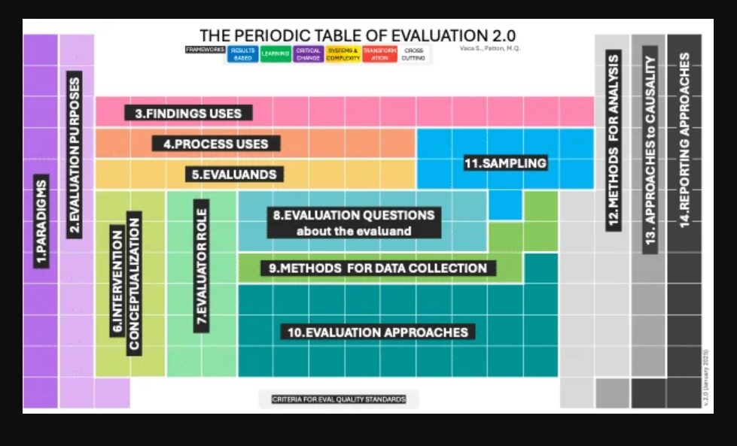
The Periodic Table of Evaluation - lovingclarity.com

Slide 34
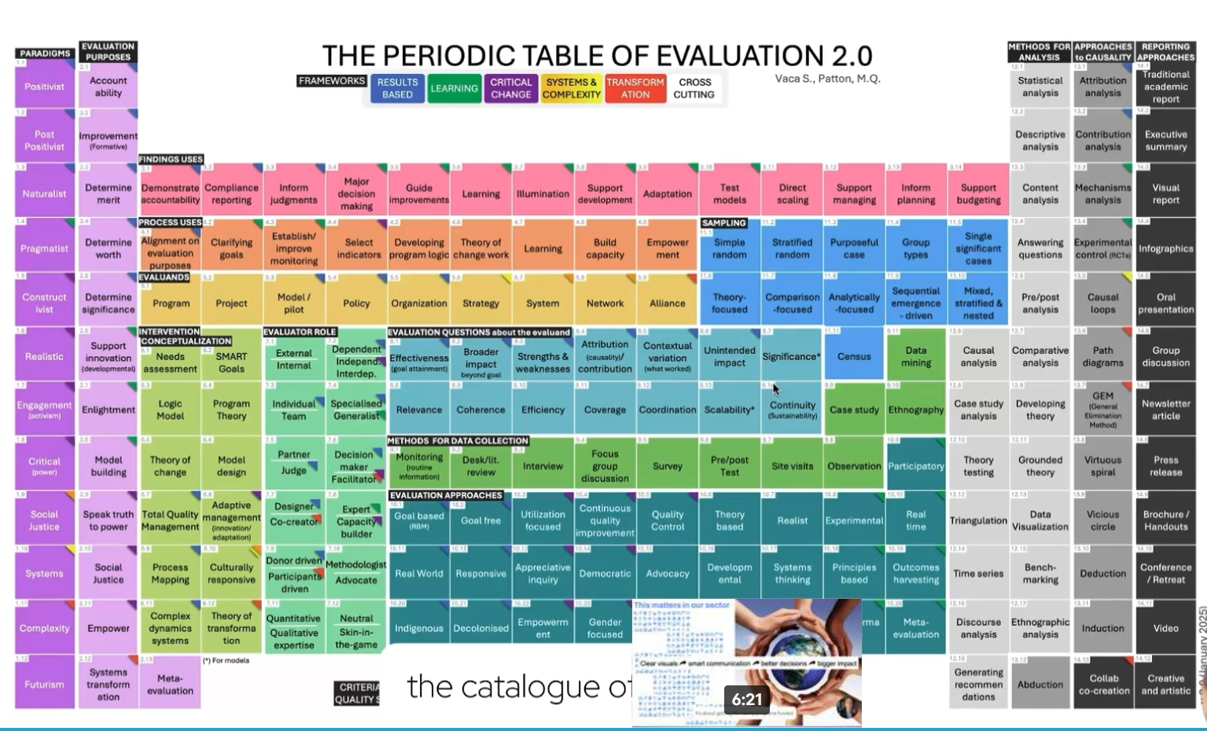

Slide 35
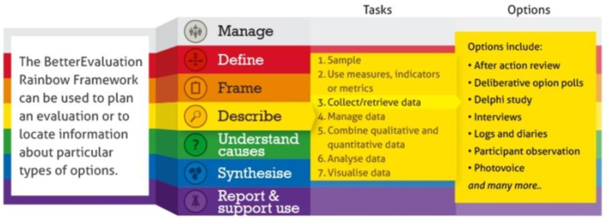

The Rainbow Framework (Better Evaluation)
Thank You

Slide 36
Good Evaluation Delivers
✔ Credible evidence
✔ Better decision-making
✔ Accountability
✔ Organizational learning
✔ Improved program performance
✔ Sustainable development outcomes
Thank You
Evidence we can trust is built by people — AI is the tool, not the judge.

