Slide 1


Impact Evaluation at UNDP
IMPACT EVALUATION GUIDANCE
April 28, 2026

Slide 2
UNDP programme specificities and implications for measuring impact
Mandate and positioning
UNDP operates as an integrator across governance, environment, and socio economic development
Mandate anchored in implementation support, policy advisory, and capacity development
Embedded country presence across diverse political and institutional contexts
Positioned between normative UN agencies and financing institutions; less capital intensive than World Bank
High variation in programme design across countries
Compared to multilateral banks, less predictable long term financing
Measuring impact
Impact is often indirect, mediated through systems and institutions
Attribution becomes complex due to overlapping intervention pathways
Impact measurement must account for volatility and counterfactual instability
Need for proxy indicators and intermediate outcome tracking
Measurement approaches must be tailored to institutional model rather than standardized
Impact is cumulative, system driven, and context dependent
Notes:
Multi sector engagement spanning governance, climate, livelihoods, and crisis response Integrated programming linking policy, institutions, and communities Compared to specialized agencies, outcomes are less discrete but more interconnected

Slide 3
Why Impact Evaluation for UNDP?
Moves beyond results to causal impact Identifies what changes are attributable to UNDP interventions by comparing outcomes with a credible counterfactual.
Strengthens learning and adaptive programming Explains what works, for whom, and under what conditions, supporting course correction and design improvements.
Informs scaling and strategic investment Provides robust evidence to decide when programmes are ready for scale‑up, replication, or redesign.
Enhances accountability and credibility Responds to growing expectations from partners and donors for rigorous, evidence‑based programming and demonstrating results.
Demonstrates contribution to the SDGs
PROGRAMME MANAGEMENT TOOL
DEMONSTRATE EFFECTIVENESS
COMPARATIVE ANALYSIS OF STRATEGIES

Slide 4
What do we mean by Impact?
Refers to the positive and negative, primary and secondary, intended or unintended effects attributable partly or entirely to a UNDP intervention.
Requires (1) comparing outcomes with what would have happened without the intervention (counterfactual), and (2) isolating programme effects from external factors.

Slide 5
What is Impact Evaluation in UNDP
•Impact evaluation is a rigorous, empirical assessment focused on causality, attributing changes to UNDP programmes and interventions.
•It seeks to answer the "So what?" question, assessing whether interventions lead to meaningful, transformative development change.
•It seeks to answer ‘ how the lives of the people changed different as a result of the programme?’
•It tests hypotheses to provide evidence that sustained changes are caused by UNDP interventions, using a suitable counterfactual to establish a comparison.
Impact evaluations are categorized as integrated, where data is collected before and during programme implementation for both treatment and comparison groups (ex-ante), or retrospective, where impact is assessed after implementation without prior data planning (ex post).
Due to the diversity and complexity of UNDP programmes, defining long-term effects can be challenging in all cases. Impact level can be determined based on the programme objectives.

Slide 6





UNDP Impact Evaluation Guidance Package
IMPACT EVALUATION GUIDANCE

Slide 7
What’s Inside the Guidance?
Impact Evaluation Guidance: Chapeau
Rolling out Decentralized Impact Evaluation
Guide for Programme Managers
Impact Measurement Data Metrics
Approaches and Methods
Introduces the full Impact Evaluation Guidance package
Presents the rationale for expanding impact evaluation at UNDP
Outlines UNDP’s strategic approach to institutionalizing impact evaluation Positions impact evaluation as a core tool for evidence‑based programming and organizational learning
Emphasizes strategic selection of evaluation and alignment with programme priorities Supports embedding impact evaluation within decentralized evaluation systems
Provides a practical framework to plan, design, and implement impact evaluations
Assesses whether programmes lead to meaningful and transformative change
Strengthened evidence on UNDP’s contribution to development outcomes and the SDGs
Guides the design and management of impact evaluation data sytems
Focuses on collecting high-quality, reliable data, and supports the measurement of transformative development outcomes
Provides an overview of impact evaluation methodologies
Focuses on establishing clear cause-and-effect relationships
Emphasizes counterfactual analysis and understanding what would have happened without the intervention

Slide 8
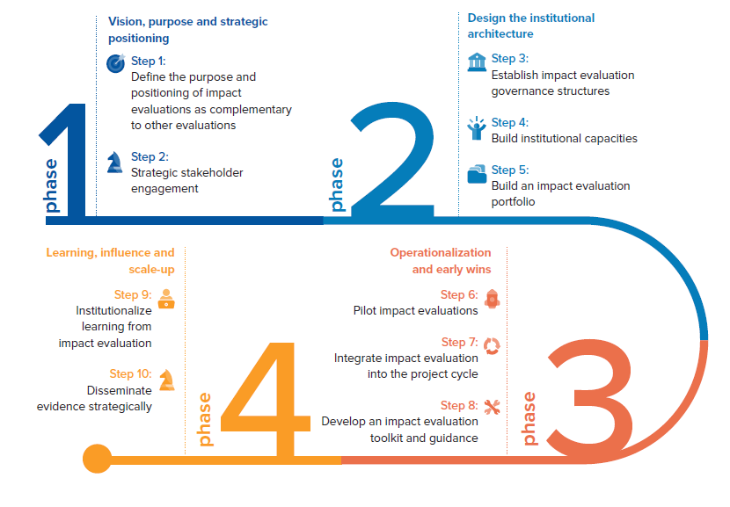
Long‑Term Planning for Impact Evaluation

Slide 9
For Programme Managers: When to Do (or Not Do) Impact Evaluation
Impact evaluation should be considered when:
Scaling or replication is planned
Contribution needs to be demonstrated
Knowledge gaps exist
Intervention is stable and measurable
Impact Evaluation is NOT appropriate when:
Counterfactual cannot be established
Programme is still in early development
Existing evidence already answers effectiveness questions
Measuring indirect effects is not feasible
Impact evaluation is a strategic choice, not required for every programme.

Slide 10
Why impact evaluations are hard to do well
Practical constraints
Weak counterfactuals: universal coverage, ethical concerns around withholding benefits, politics/operational resistance, spillovers/contamination
Data limitations: missing baselines/comparison data; inconsistent indicators; quality/access issues (attrition, recall bias, sensitive admin data)
Real-world context & feasibility: shocks and instability; implementation varies by site; high cost/time and limited in-house capacity; ethical/equity risks if focus narrows to what’s easiest to measure
Design and evaluability constraints: unclear or shifting theory of change; adaptive programming
Complex interventions: multi-component, multi-actor or systems/governance work makes “treatment vs. control” hard to define
Timing misalignment: commissioned too early (impacts not yet visible) or too late (baseline is gone)

Slide 11
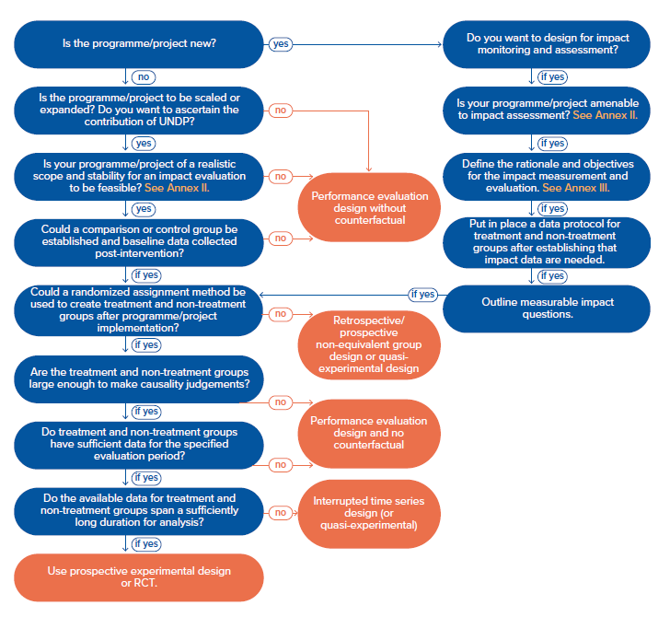
Decision Tree -When to conduct an impact evaluation and when not to

Slide 12
Methods: Why Mixed Methods Matter
Impact evaluation in UNDP programming requires quasi‑experimental designs
Mixed methods approach allows us to:
Establish causal impact
Understand how change happens and why
Capture complex programme effects in governance, peacebuilding, institutional reform
High‑quality impact evaluations integrate quantitative attribution and qualitative contextual understanding
Check out the Methods Portal for Impact approaches

Slide 13

Thank you! Vijayalakshmi Vadivelu Chief of Corporate and Thematic Evaluations Independent Evaluation Office UNDP, New York Impact evaluation guidance, Impact approaches, & Evaluation approaches, methods, techniques

