Slide 1

Advancing Evaluation for Better Governance in the Philippines: Institutionalizing a Whole-of-Society Approach
14 January 2026
Romulo Emmanuel Miral, Jr., Ph.D. Deputy Secretary General House of Representatives Congress of the Philippines

Slide 2

Background
The Philippines recognizes the importance of M&E for good governance and accountability.
Several reforms introduced, but implementation remains fragmented.
Challenge:
How to move from isolated efforts to a coordinated national system?

Slide 3

Past and Ongoing Efforts
NEDA (now DEPDev)
National Evaluation Policy Framework (NEPF)
DBM
RBPMS, PIB, and OPIF
COA Performance audits
Development Partners, academia, CSOs:
M&E training and evaluations
Foundation exists, but a fully institutionalized system is still lacking.
EO 230
NEDA mandated M&E of PDP
NB Resolution No. 30 ICC Review of ODA Projects
RA 8182: Annual review of ODA
NEDA-DBM Sector Effectiveness and Efficiency Reviews
AO 25 on RBPMS; 1st PDP Results Matrix
DBM adopted PREXC
1987 1989 1992 1993 1996 1999 2001 2007 2011 2015 2016 2025
EO 376: established RPMES
EO 93: streamlined RPMES
NB Resolution No. 3:
Reporting of Project Outcomes and Impacts
DBM adopted OPIF
NEDA-DBM JMC 2015-01 National Evaluation Policy Framework (NEPF)
NEDA-DBM JMC 25-01 Revised NEPF

Slide 4
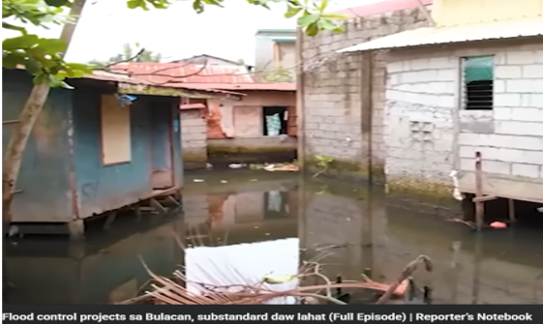


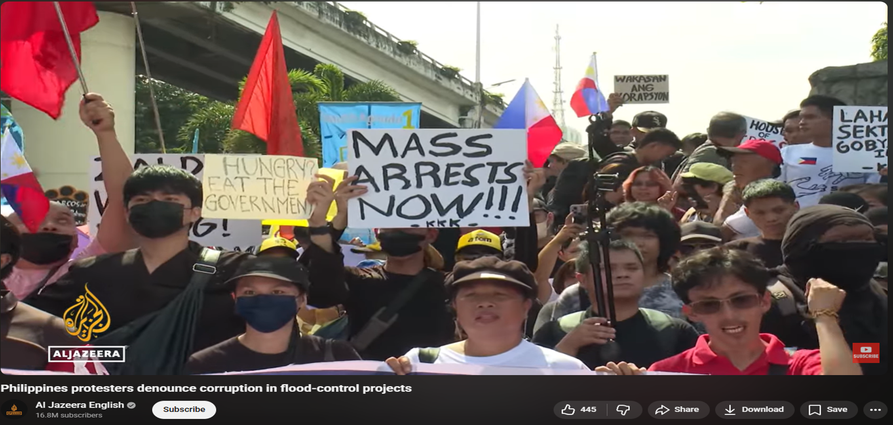




Persistent Weaknesses
Despite reforms, M&E remains weak.
Evidence of inefficiencies:
Flood control projects that fail
Poorly located farm-to-market roads
Incomplete health facilities
Low learning outcomes in education
Weak accountability and performance tracking

Slide 5
Why Is M&E Still Weak?
Gatekeeper Mentality
M&E seen as compliance by oversight agencies
Limited data sharing and use for learning
Fragmentation:
Multiple unlinked systems
Minimal coordination and no integrated national system.

Slide 6
Revised National Evaluation Policy Framework (NEPF)
Strengths (Design & Intent)
Clear policy mandate positioning evaluation as a core government function linked to planning and budgeting
Coherent institutional architecture with defined roles for NEDA, DBM, and implementing agencies
Strong emphasis on evaluation quality and use to inform policy and budget decisions
Weaknesses (Execution Risks)
Limited integration with monitoring systems, weakening feedback and learning loops
Weak demand and incentives for use, especially beyond the executive branch
Institutional fragility, as a non-legislated framework dependent on leadership and capacity

Slide 7
Why a Whole-of-Society Approach
Advancing evaluation for better governance requires participation beyond the executive:
Government
leadership and coordination
Congress
evidence-based oversight
M&E becomes everyone’s
business
Civil society & media
accountability and voice
Academia
analytical rigor
Private sector
efficiency and innovation
Citizens
feedback and lived experience
Evaluation becomes a shared public good.

Slide 8





Why This Matters
A Whole-of-Society M&E System can:
Strengthen
Accountability
and Trust
Improve
Efficiency in
Spending
Foster
Learning and
Adaptation
Empower
Citizens and Communities

Slide 9
What if Members of Congress DO NOT YET Appreciate M&E
Legislators
short political cycles
seek visible, short-term results
M&E
overly technical
politically risky
Promoting M&E
Reframe M&E as a tool for oversight
Make M&E Useful
Build M&E Champions
Institutionalize Demand for M&E

Slide 10
Operationalizing the Approach
Enact a National Evaluation Law
Defines roles, standards, accountability
Institutionalize Stakeholder Engagement
Include CSOs, academe, private sector.
Integrate M&E in Planning and Budgeting
Link evidence to priorities and funding
Establish a National Integrated M&E System
Harmonize data and indicators
National Budget
Programs/Projects
Development Plan
Policies/Laws
Monitoring & Evaluation
INPUTS
ACTIVITIES
OUTPUTS
IMMEDIATE
(Short Term)
INTERMEDIATE
(Midterm)
IMPACT
(Long Term)
Focus on efficient implementation
Focus on results/outcomes

Slide 11
Monitoring and Evaluation in the Results Chain
Monitoring ensures implementation discipline.
Evaluation explains outcomes and impacts.
Together, they close the governance feedback loop—from inputs to impact.

Slide 12
Concluding Remarks
Advancing evaluation is not just a technical reform—it is a governance reform.
A Whole-of-Society approach transforms evaluation from a compliance exercise into a pillar of accountability, learning, and better governance.

Slide 13
Thank you
Very much

