Slide 1

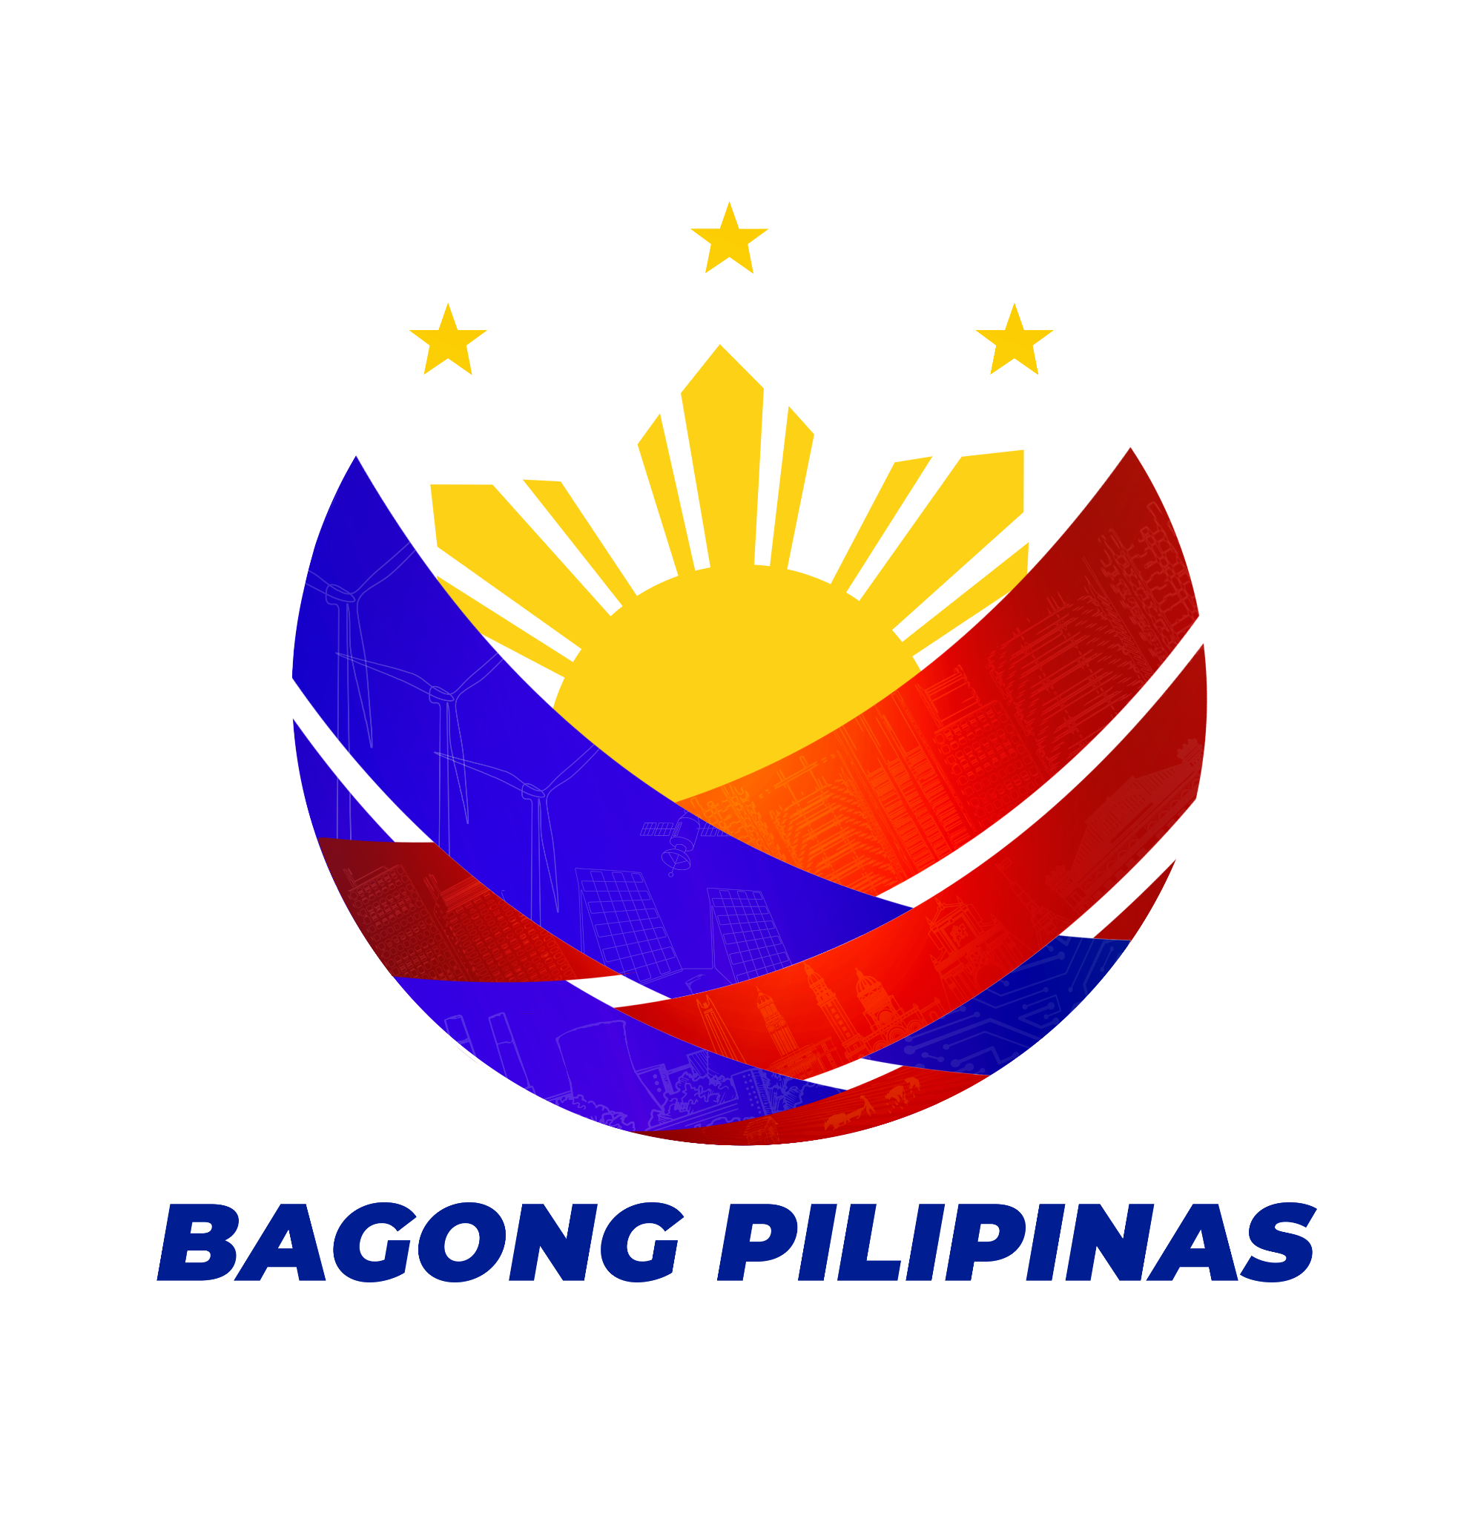
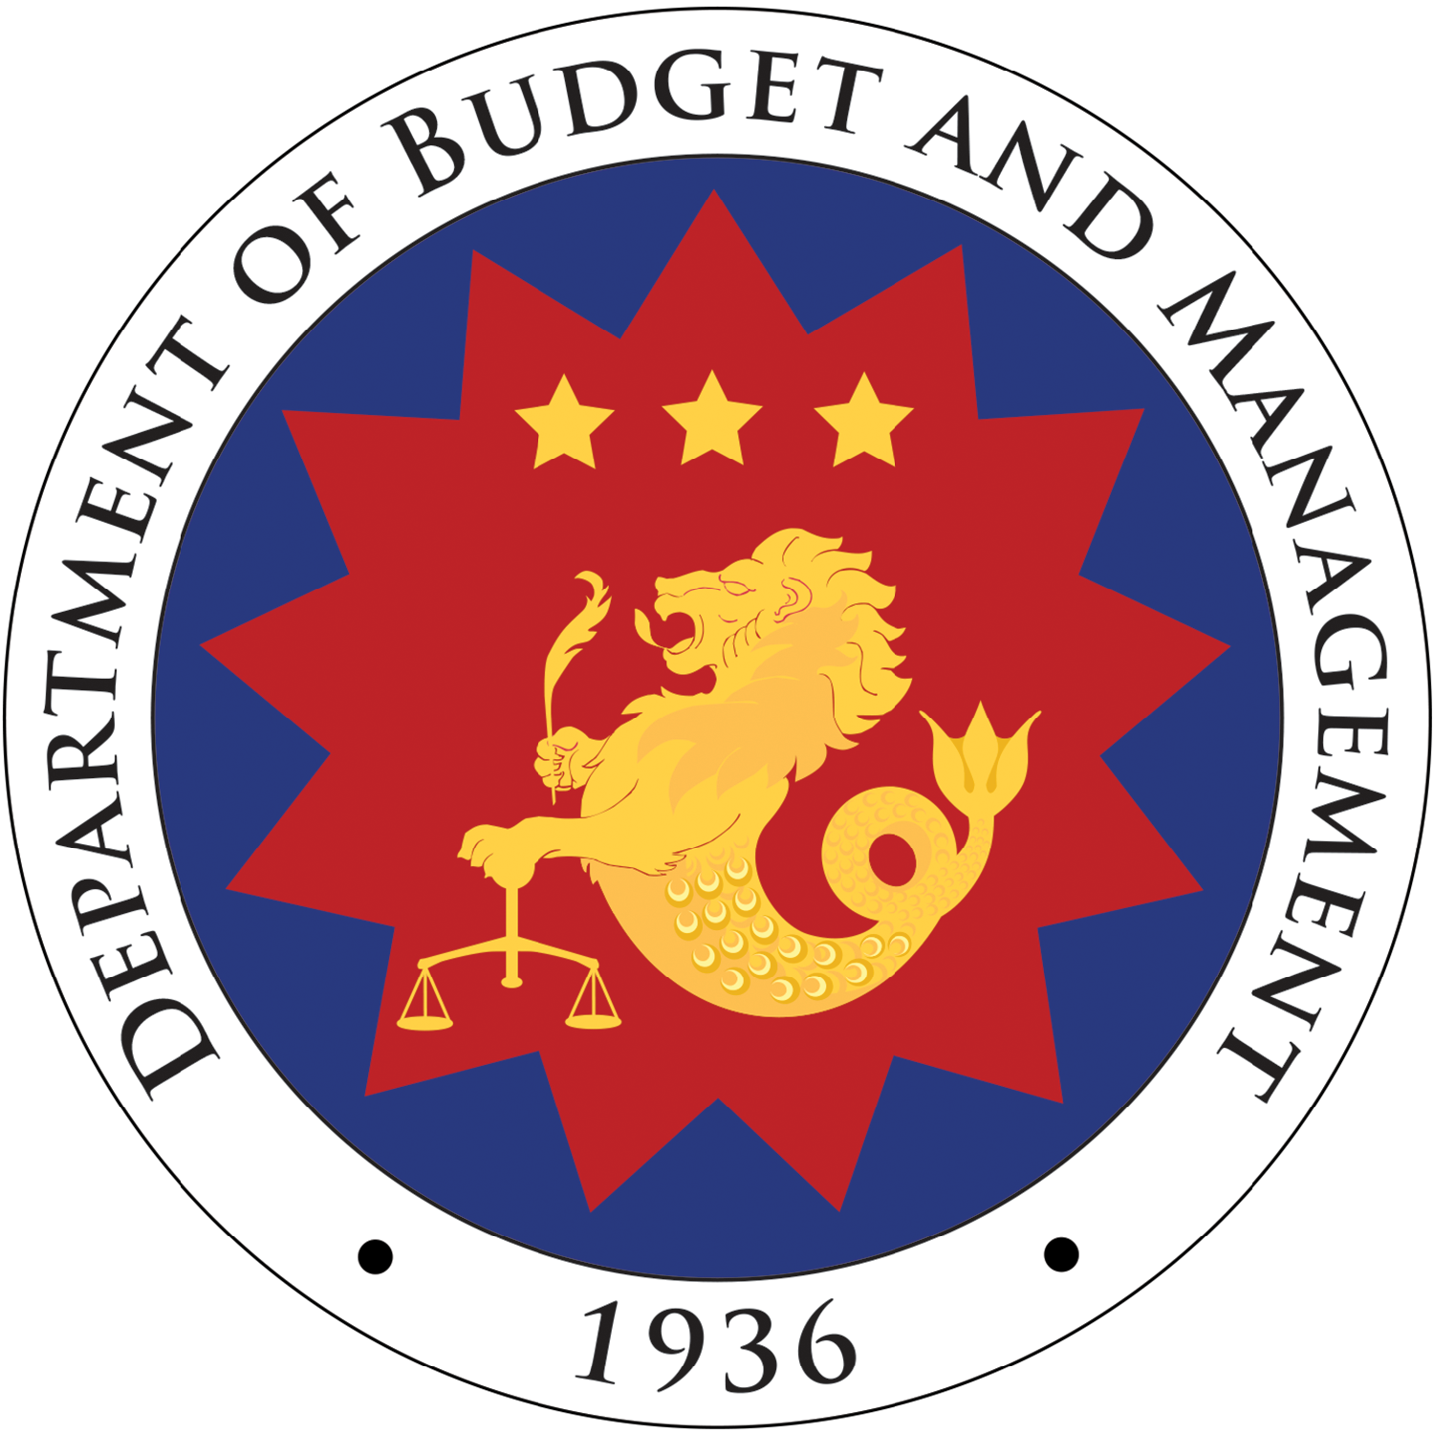
Integrating Evaluation into Budgeting
EDELITA B. OCAMPO
EAAP Webinar on the National Evaluation Policy Framework
Zoom | January 14, 2025

Slide 2


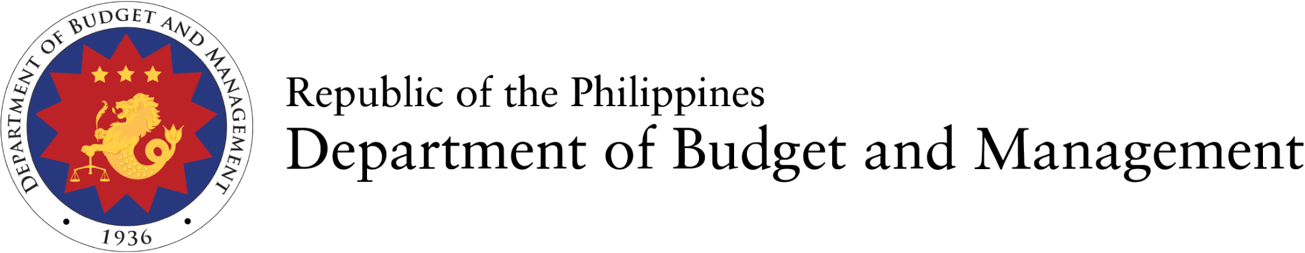
The Public Financial Management is the Government’s Pipeline for Delivering Public Services

Slide 3

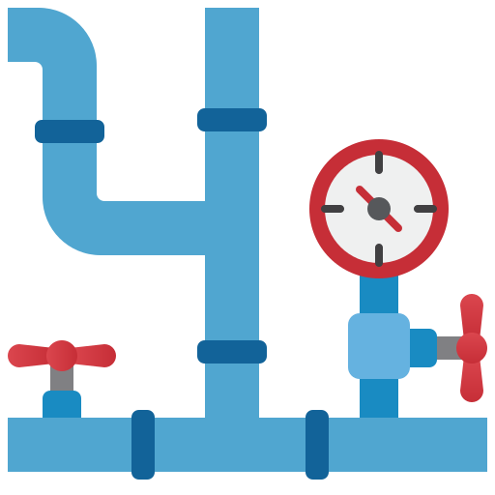

The quality of PFM performance depends on how these elements interact, and how stakeholders collaborate to meet public service goals.
Water= Revenue Generation
Pipes and valves=
PFM System Design,
Public Fund Allocation,
and Expenditure Management
Water Flow= Continuous PFM Operation ensuring efficient movement of public funds

Slide 4

M&E is the meter reader that enables the government to make informed decision as it implement projects and programs
Monitoring and Evaluation

Slide 5
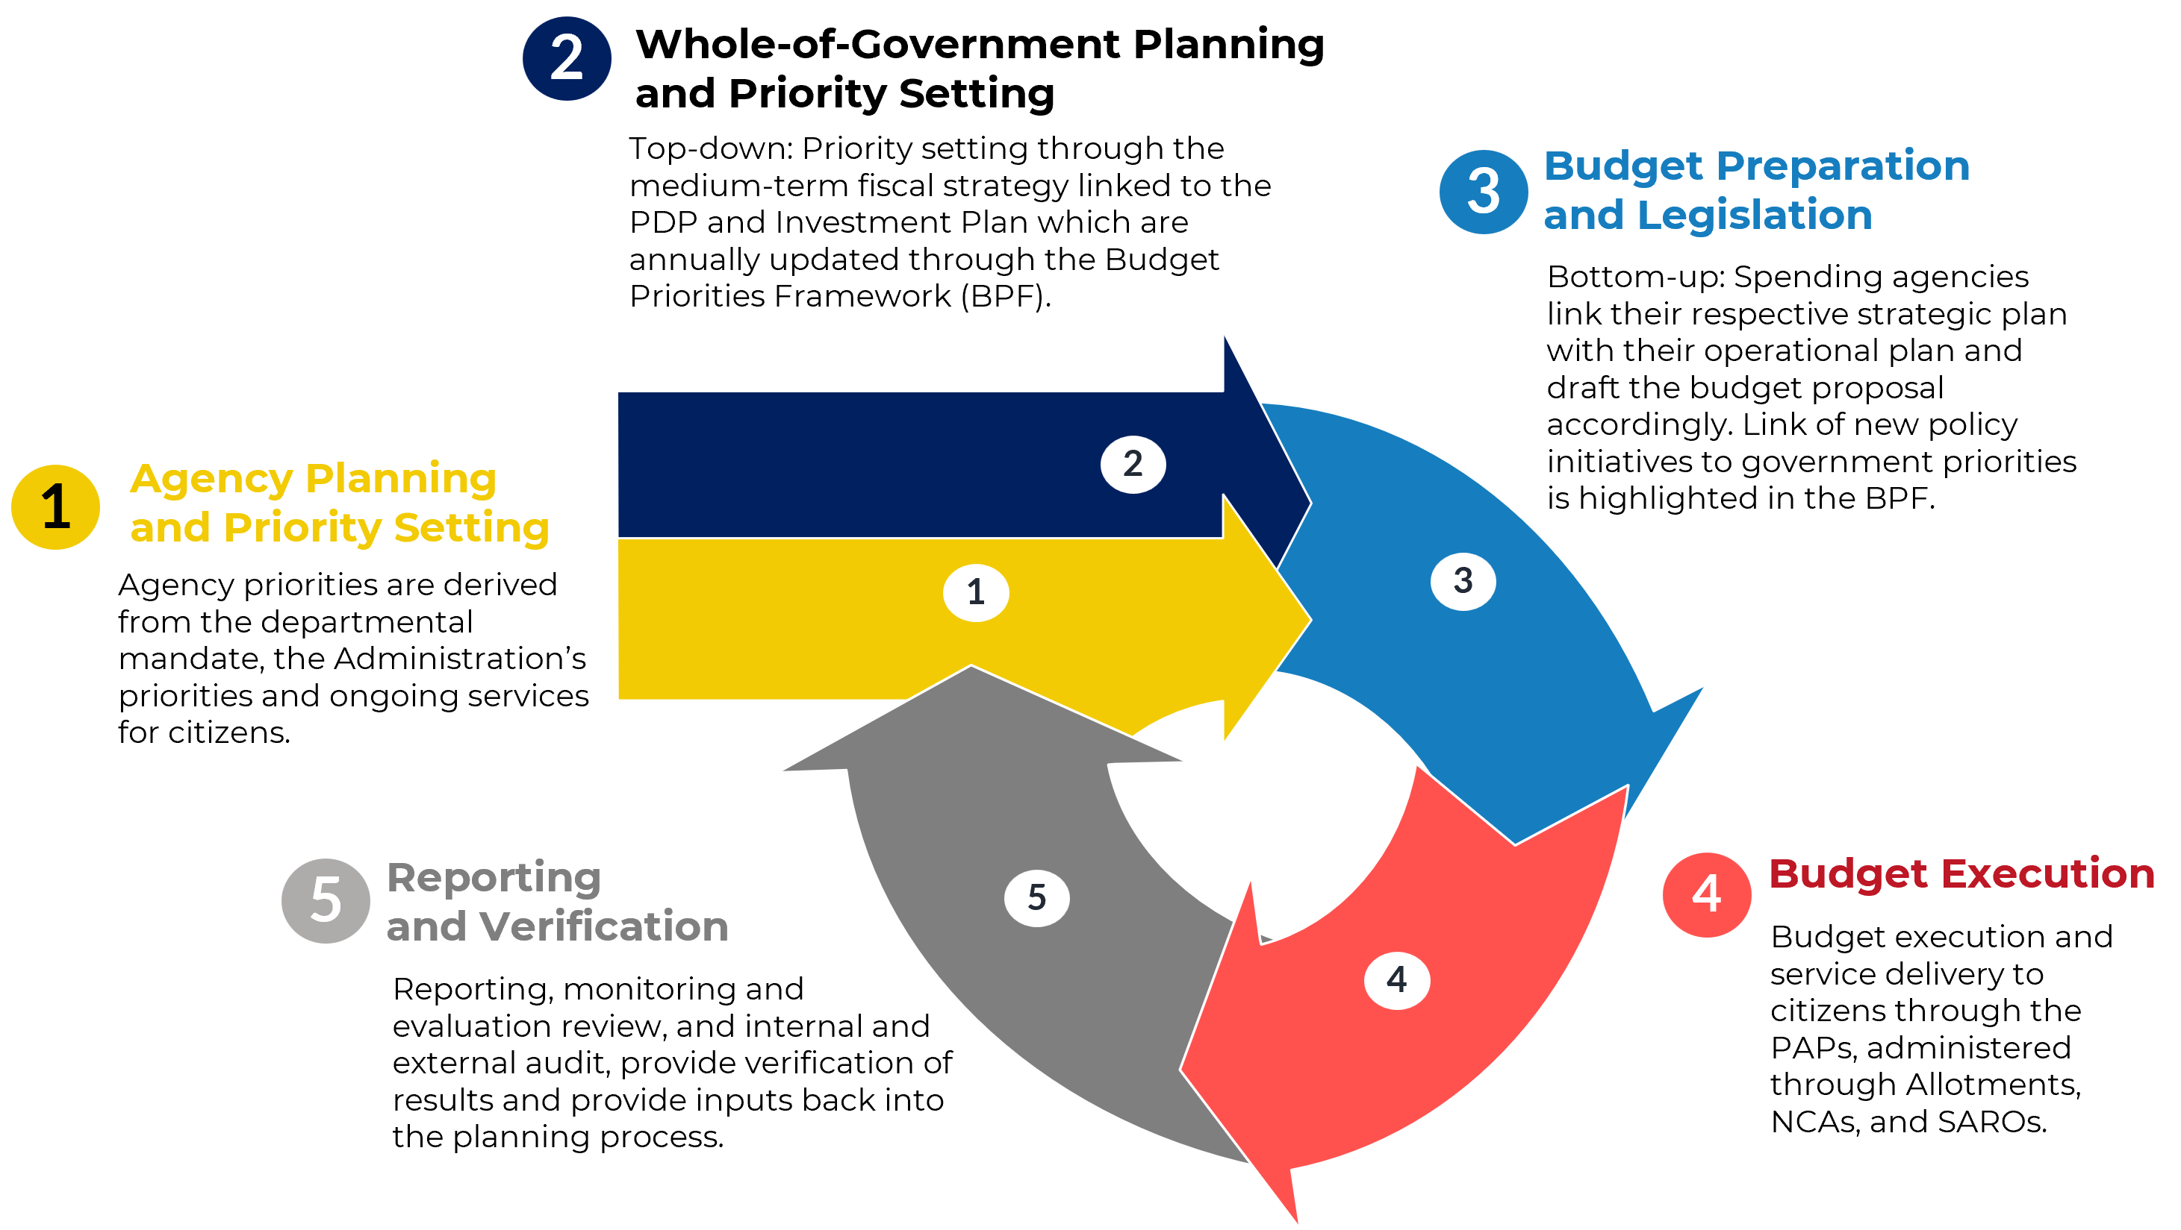
The PFM Cycle
M&E

Slide 6
Challenges Persist
Results-based principles are not fully integrated into planning, budgeting, and implementation processes;
Limited use of evaluation findings to influence policy decisions;
Timing remains a major issue
Lack of rigorous monitoring data, baseline information, performance information to base evaluation studies; and
M&E results are not well-communicated.
Footnotes

Slide 7




Persistent Institutional and Capacity Gaps
Weak evaluation culture
Institutional Fragmentation
Capacity Gaps

Slide 8
Enhancing oversight for public expenditures through M&E under the Public Financial Management (PFM) Reforms Roadmap 2024-2028
Embedding M&E culture through the issuance of the Revised National Evaluation Policy Framework (NEPF)
Integration of evaluation results through the Agency Performance Review (APR)
Ensuring financial management in the government is transparent, accurate, and linked to expected outcomes through the Integrated Financial Management Information System (IFMIS)
Enabling Policies for M&E
Footnotes

Slide 9
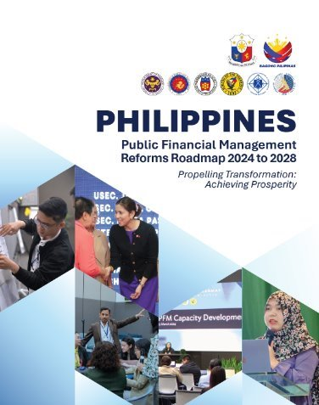
1. Enhancing oversight for public expenditures through M&E under the Public Financial Management (PFM) Reforms Roadmap 2024-2028
Comprehensive review of the current institutions and mechanisms that support M&E practices in the country;
Strengthening M&E function across the government through capacity-building programs, including performance and M&E target setting, and costing of M&E activities; and
Enhancing mechanisms and tools to produce and use evaluation findings to feed into priority-setting, budget allocation, and audit processes.
Footnotes

Slide 10
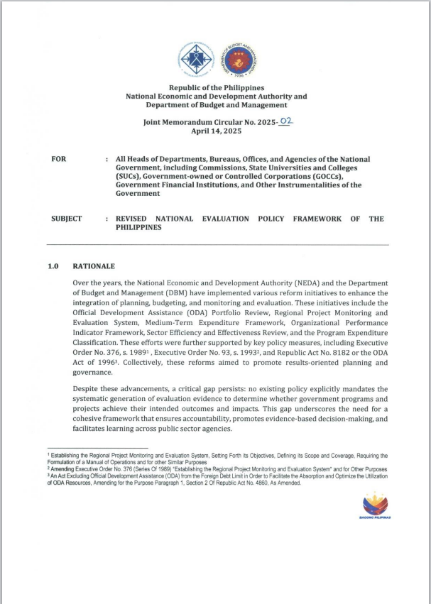
2. Embedding M&E culture through the issuance of the Revised National Evaluation Policy Framework (NEPF)
Institutionalize the governance structure for public sector evaluations by defining roles, responsibilities, and coordination mechanisms;
Guide the formulation of the National Evaluation Agenda to identify priority government programs and projects for evaluation, ensuring alignment with national development priorities and decision-making processes; and
Mandate the development and submission of Agency-Based Evaluation Agendas to provide a structured approach for agencies in planning, conducting, and utilizing evaluations.
Footnotes

Slide 11
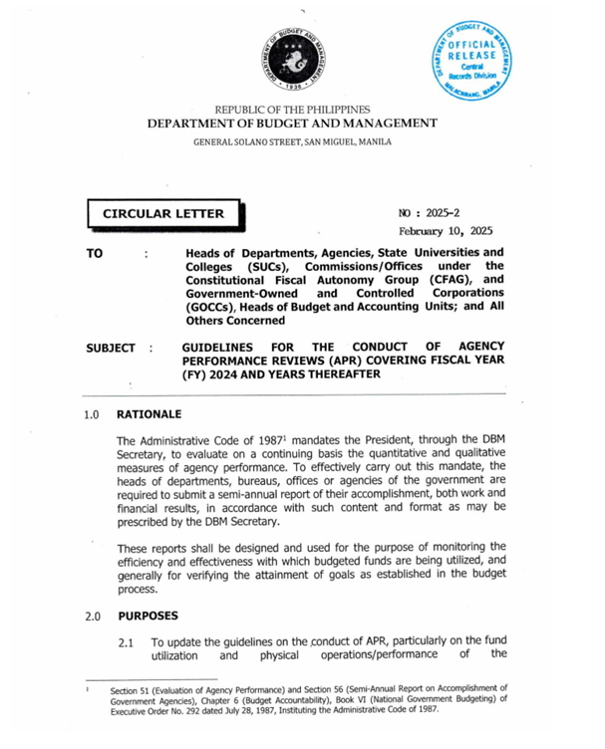
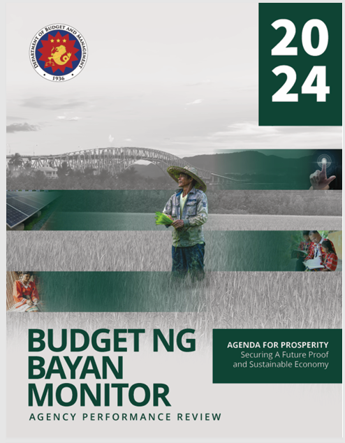
3. Integration of evaluation results through the Agency Performance Review (APR)
DEPDev and DBM promote the use of results of evaluation studies to:
    inform and strengthen their respective planning and budgeting processes; and
    serve as input to DBM’s Agency Performance Review (APR) process, providing objective evidence to aid in better performance of programs/ activities/ projects consistent with the revised NEPF [Section 7.3].
Footnotes

Slide 12
Findings of the 2024 Agency Performance Review
Recommendations
Of the 32 NGAs and offices assessed, 16 agencies received Very Satisfactory ratings, while the remaining earned Satisfactory ratings based on both physical and financial efficiency.
Out of 31 OEOs, 2 received Outstanding ratings, 16 were rated Very Satisfactory, and 10 were rated Satisfactory;
FY 2024 APR affirms the strong fiscal and institutional performance of SUCs nationwide, with Luzon emerging as the best-performing, with several institutions demonstrating near-perfect budget utilization and comprehensive fulfillment of performance targets.
To elevate physical performance across the bureaucracy, institutions are advised to reassess the planning and execution of their programs, activities, and projects (PAPs).
Institutionalize a periodic review of physical targets (ideally every three years)
Streamline internal systems and modernize processes
Conduct capacity-building initiatives to ensure staff competencies align with their functional mandates
Establish efficient procurement systems and adopt e-procurement strategies.
Footnotes

Slide 13
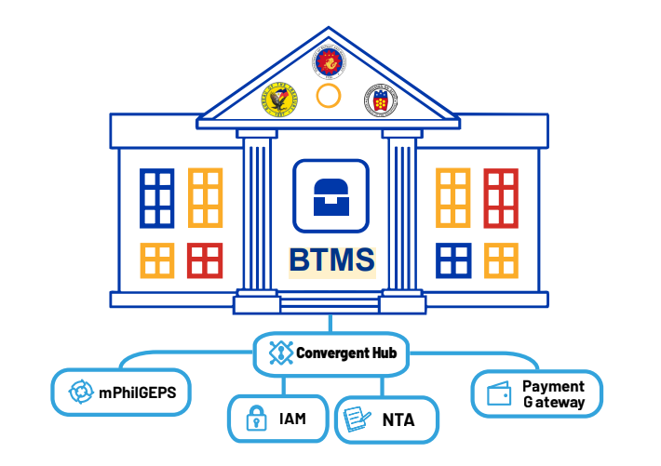
4. Ensuring financial management in the government is transparent, accurate, and linked to expected outcomes through the Integrated Financial Management Information System (IFMIS)
With the Budget and Treasury Management System (BTMS) at its core, this will facilitate real-time online accounting, monitoring, and control of financial transactions to aid in the processing and consolidation of data for fiscal management and reporting, thereby supporting timely and informed policy decisions.

Slide 14


Other Institutional Efforts at the Local and National Levels
Results-based Monitoring and Evaluation of LGU Infrastructure Projects
Digital Information for Monitoring and Evaluation (DIME) Project
Footnotes

Slide 15
M&E keeps the PFM pipeline strong, credible, and responsive.
Monitoring and Evaluation

Slide 16
Integrating Evaluation into Budgeting
EDELITA B. OCAMPO
EAAP Webinar on the National Evaluation Policy Framework
Zoom | January 14, 2025

