Slide 1


21st webinar of Energy Evaluation Asia Pacific (EEAP)
Industrial Energy Transitions in South Asia: Policies, Impacts, and Future Pathways
Industrial Energy Efficiency in Bangladesh: Assessing the Journey and Looking Ahead
Firuz Ahamed Nahid
Postdoctoral Researcher, SMARTS Center
Asian Institute of Technology, Thailand

Slide 2
Developmental Goal and Industrial Energy Use In Bangladesh
Bangladesh has set the goal of attaining developed country status by 2041.
Industry sector consumes ~ 26.94% (23 TWh) of total electricity in Bangladesh (BPDB, 2024).
It includes 6 key industrial sectors of Bangladesh (Textiles, Steel, Cement, Glass & Ceramics, Chemicals including fertilizers, Agro-industries).
These 6 key industrial sectors contributes 21.85% of Total GDP (2024) and 62% of Industrial sectors GDP (2024).
Key primary fuel share of the industry sector in Bangladesh is :
      GAS – 51.05%
      Furnace Oil – 28.15%
      Coal – 7.86%
      Diesel – 5.74%
      Renewables – 2.04%

Slide 3
Sectoral CO₂ Emission in Bangladesh
2024
Power Industry - Power and heat generation plants (public & auto producers) | Industrial combustion - Combustion for industrial manufacturing
Buildings – Small scale non-industrial stationary combustion | Transport – Mobile combustion (road & rail & ship & aviation Agriculture – Agricultural soils, crop residues burning, enteric fermentation, manure management, indirect N2O emissions from agriculture
Fuel exploitation - Production, transformation and refining of fuels | Waste - Solid waste disposal and wastewater treatment Processes - Industrial processes (e.g. emissions from the production of cement, iron and steel, aluminum, chemicals, solvents, etc.)
Notes:
Power sector followed by industrial combustion

Slide 4
Energy Efficiency Opportunities in Key Industrial Sectors
Textiles and Ready-Made Garments ( RMG)
Iron and Steel
Cement
EE opportunities* for this sector includes – Intervention Potential Energy Savings Exhaust Gas Heat Recovery (~20%), Insulation (~5-10%) and Automation (~20-25%)
EE opportunities* for this sector includes – VRM (~15%), Motor and Drives (5-8%), Fans (~3%), Air Flow (~5-10%)
~13% GDP Contribution
80% of the factories have their own captive power plants (Gas and Oil Based)
EE opportunities* for this sector includes – Motors (~10-20%), Boilers (~15-20%), Variable Frequency Drives (~15%), Lighting (~20%).
Chemicals
EE opportunities* for this sector includes – Injection Molding Machines (~20-30%), Combustion Efficiency Improvements (~ 5-10% )
Agro-industries and Ceramics have ~ 18% and ~24% energy saving potential with EE.
These represent significant but largely unrealized potentials for Bangladesh’s industrial sector
* Bangladesh: Industrial Energy Efficiency Finance Program | Audits by ADB

Slide 5
National Targets in Bangladesh Towards Energy Efficiency
Bangladesh has an Energy Efficiency & Conservation Master Plan (EECMP 2016) targeting a 20% reduction in energy intensity by 2030 (vs. 2013).
Provides a national framework for end-use efficiency to overcome implementation gaps.
The efficiency in power sector planning is gaining importance
The Integrated Energy & Power Master Plan (IEPMP 2023) identifies the power sector as the central pillar of Bangladesh’s energy transition for economic development.
Studies show that efficiency improvements can reduce LNG imports, and lower system costs, while opening the door to integrate demand-side measures alongside supply-side planning in the power sector.
Industrial EE → directly reduces demand on both the national grid and captive power plants.
* Bangladesh: Industrial Energy Efficiency Finance Program | Audits by ADB

Slide 6
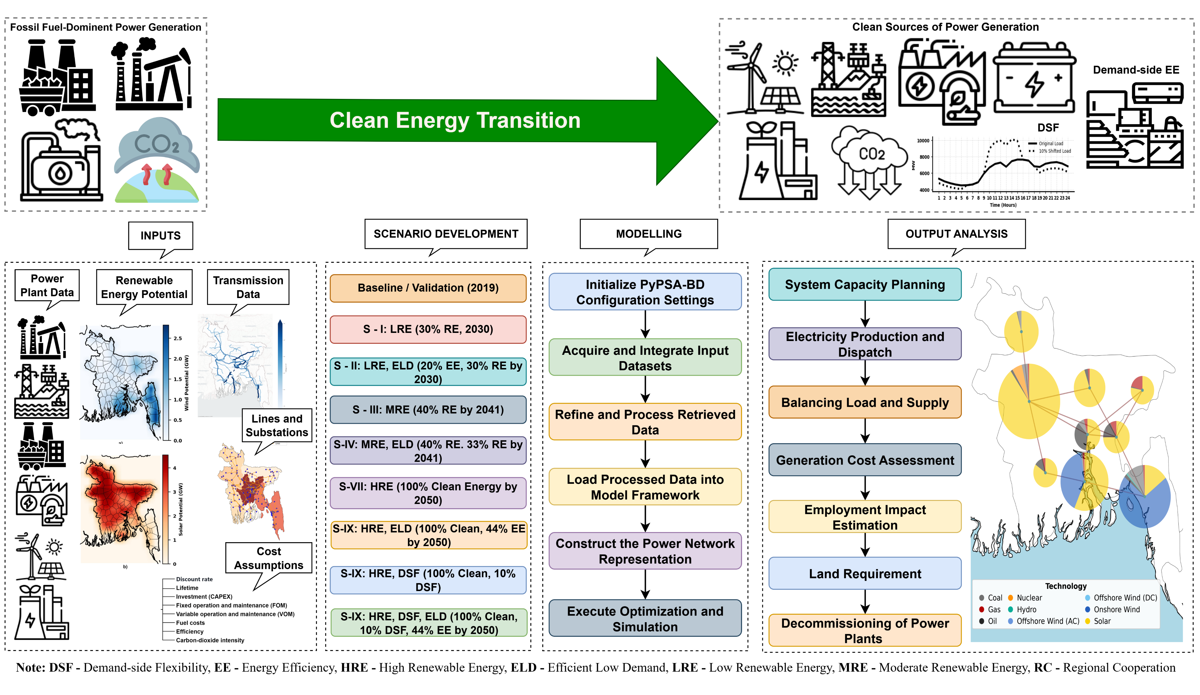
Integrated Modeling Framework: PyPSA-BD-IDS

Slide 7

Pledged and Higher Ambitious Scenario Design
Scenario name | Year | Narrative and Assumptions | Scenario Acronyms/Cluster
Reference | 2030, 2041, and 2050 | 2019 Policy Frozen | Reference
Scenario – I | 2030 | 30% renewable energy | LRE (S) | PAS
Scenario – II | 2030 | Scenario I + 20% energy efficiency | LRE (S), ELD (D)
Scenario – III | 2041 | 40% renewable energy | MRE (S)
Scenario - IV | 2041 | 33% energy efficiency, 40% renewable mix | MRE (S), ELD (D) | PAS, HAAS
Scenario - V | 2050 | 100% clean energy | HRE (S) | HAAS
Scenario - VI | 2050 | 100% clean energy, 44% energy efficiency | HRE (S), ELD (D)
Scenario - VII | 2050 | 100% clean energy, 10% demand-side shift | HRE (S), DSF (D)
Scenario - VIII | 2050 | 100% clean energy, 44% EE, 10% demand shift | HRE (S), DSF(D), ELD (D)

Slide 8
Capacity Expansion Pathways
IDS Scenarios avoids large supply side expansion.
EE in industries can help achieve these by utilizing the full potential of EE at end use devices.

Slide 9
Financial Mobilization Requirements
IDS scenarios reduces the financial burden compared to supply-side only expansion by avoiding overbuilt of power plants

Slide 10
Land Footprint: Model Results
IDS scenarios lowers land footprint which helps avoiding land use conflicts.

Slide 11
Job Creation Potential: Model Results
IDS scenarios boosts new jobs to the economy. EE will potentially bring more jobs in retrofits and supply-chains.

Slide 12
Power Generation Cost: Model Results
IDS scenarios shows the lowest power generation costs, ensures affordable and clean power.

Slide 13
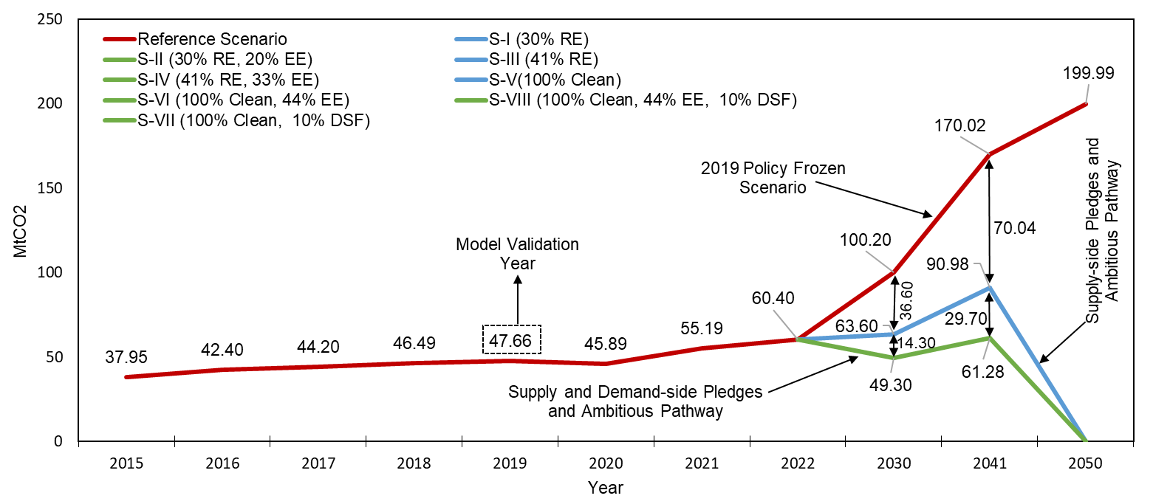
Emission Pathway: Model Results (Bangladesh)

Slide 14
Opportunity
Industrial Efficiency Gains – High-efficiency motors/VSDs, optimized steam & compressed-air systems, WHR, cogeneration, and modernization in RMG, steel, cement, fertilizer → 17–32% savings**; US$460m* LNG savings in captive plants.
Buildings & Appliances – LEDs, inverter ACs, efficient fans/refrigerators, chillers, and insulation/shading → large, low-cost savings; public retrofits <3-year payback.
Residential Potential – Behavioral change and appliance upgrades could cut household demand by ~50%.
Demand-Side Flexibility (DSF) – Smart cooling, thermal storage, load shifting in industry/agriculture, managed EV charging.
System Benefits – Lower system costs & land footprint, same reliability with smaller fleet, near-term emissions reduction.
**Industrial energy efficiency to curb Bangladesh's short-term LNG demand growth
* Bangladesh: Industrial Energy Efficiency Finance Program | Audits by ADB

Slide 15
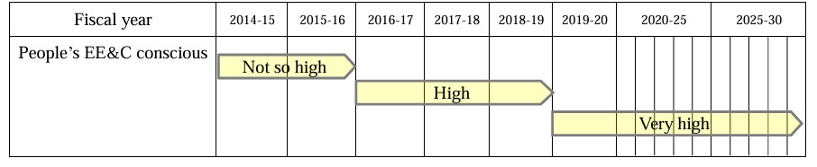
Barriers to Energy Efficiency Implementation
Shortage of trained manpower with right skills Institutional Barrier due to lack of inclusiveness and Lack of coordination among different departments/implementation agencies.
Policy and governance barrier due to appropriate regulations.
Technical barrier due to limited research and development and demonstration, lack of infrastructure and innovation.
Economic and financial barrier due to investment preference for production over efficiency, few private investments.
Informational barrier due to lack of awareness, lack of supply and demand side information, technological benchmarks, cost-benefit analysis and other relevant information.
(EECMP – 2016)

Slide 16
Key Message
EE = first step → reduces waste in energy use, LNG imports.
Going forward Model-based results show EE and DSF can help achieve Bangladesh more affordable, land-sparing, reliable and sustainable power system.
National targets for zero carbon Power sector by mid century can be reached better by strategically combining demand-side interventions (EE and DSF) with supply-side solutions.
Integrating demand side energy efficiency and flexibility planning help
  Avoiding excess RE capacity expansion plan
  Lowering the total need for financial mobilization for the decarbonization of the power sector
  Reducing competing demand for land allocation for RE expansion
  Increasing overall employment potential
  Reducing generation cost, which ensures more affordable power in the future compared to the current price.
  Generating less CO₂ with clear near-term benefits

Slide 17
Thank you for your attention.
Your Questions, Comments, and Feedback are appreciated.
Firuz Ahamed Nahid
SMARTS Center (https://smartscenter.ait.ac.th)
Contact: firuz@ait.asia

