Slide 1
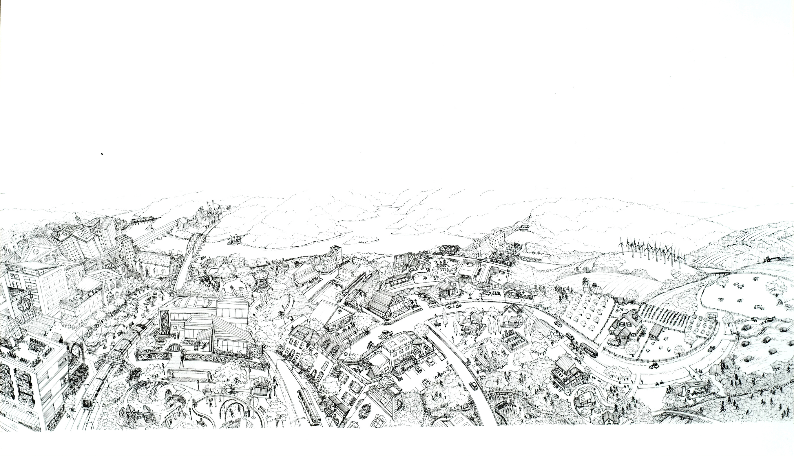
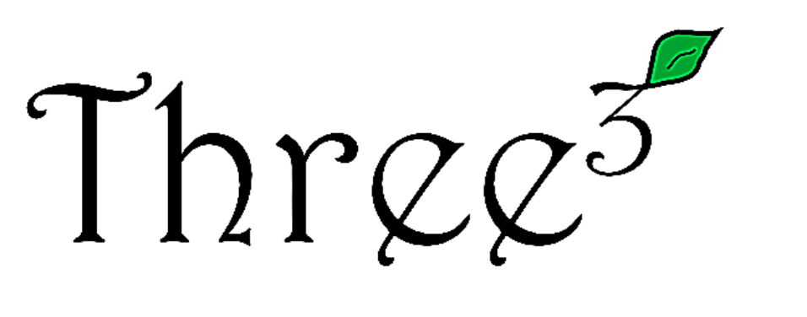
Non-Energy Impacts of Weatherization
Bruce Tonn, Michaela Marincic
EEAP Webinar
August 5, 2025

Slide 2

Three³ (“Three Cubed”) is a 501(c)3 research nonprofit dedicated to fostering equitable, sustainable futures located in Knoxville, Tennessee, USA.
We conduct innovative social science research and facilitate stakeholder workshops on complex social issues.
We are deeply embedded in community-driven initiatives that aim to advance transformative social outcomes for historically underserved individuals and populations.
About
Three³

Slide 3
Non-Energy Impacts of Low-Income Weatherization: Overview

Slide 4
What is low-income weatherization?
Energy efficiency programs that install comprehensive sets of measures in low-income homes and affordable multifamily buildings.
Measure installation decisions are guided by energy audits.
Weatherization is generally free to income eligible households.

Slide 5
What are non-energy impacts (NEIs) of weatherization?
Changes in important variables that are not energy related.
The benefits could go to households, society, or ratepayers.
The benefits could last the lifetimes of the weatherization measures.

Slide 6
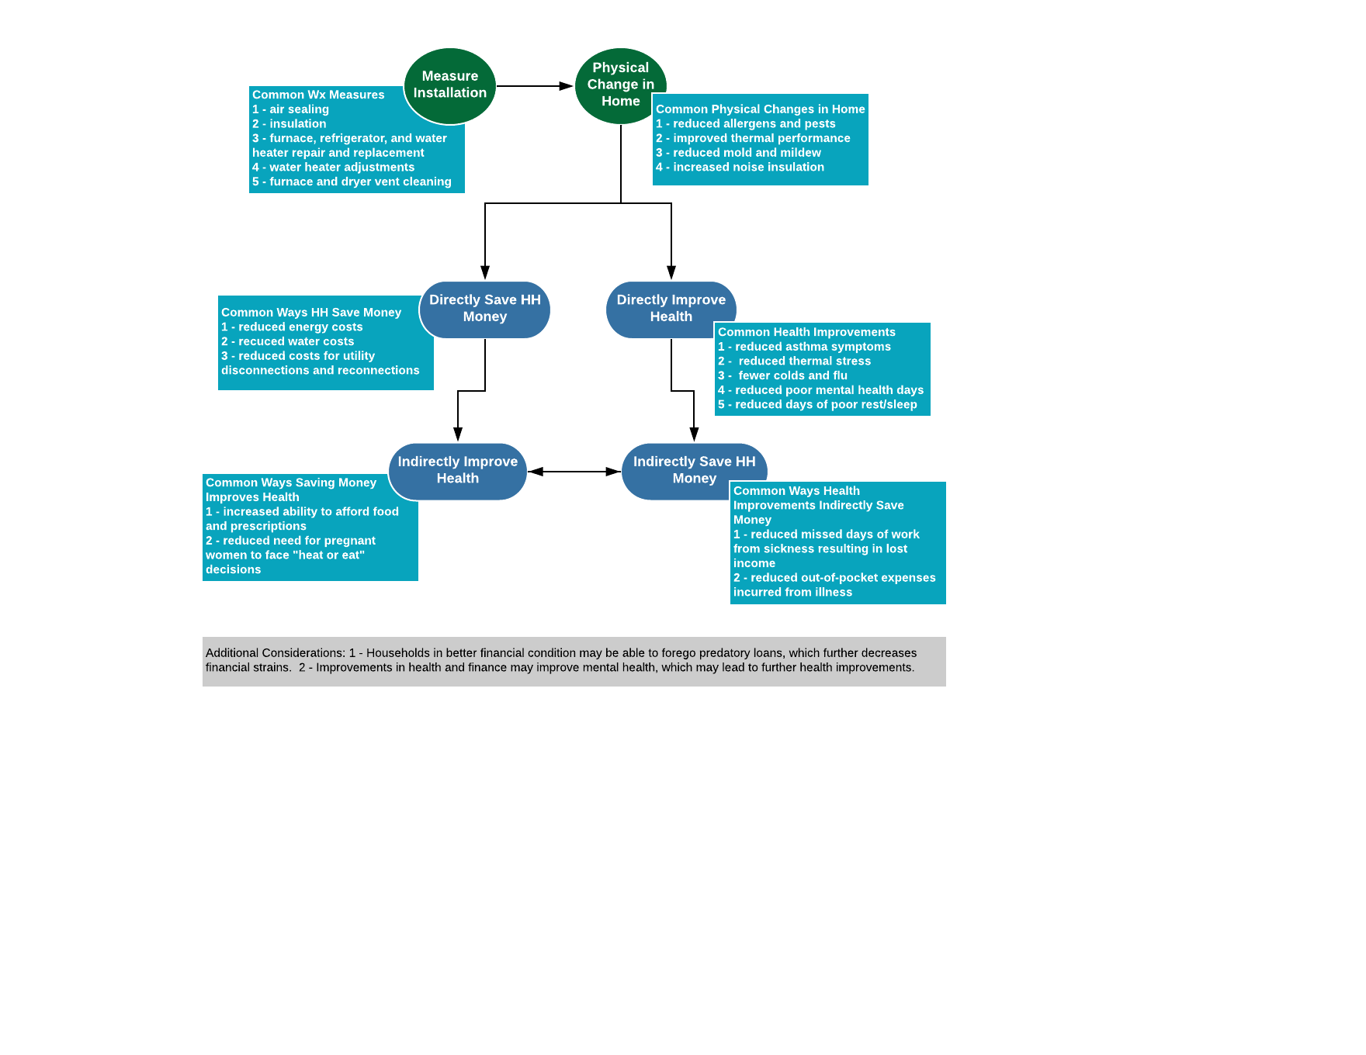
How can weatherization produce non-energy impacts? It starts with physical changes in the home, which can directly improve health and save households (HH) money. Then there are indirect and positive feedback effects.

Slide 7
Approaches to measuring NEIs.
Resident Survey: Pre-post weatherization with control group.
Direct measurements: e.g., sleep watches, blood pressure tests, medical records
Link measures installed to impacts captured in the literature.

Slide 8
Our major NEI evaluations:
U.S. Department of Energy’s Weatherization Assistance Program
Tennessee Valley Authority’s Home Uplift Program
Affordable Multifamily Buildings in the Northeast and Midwest U.S.

Slide 9
Summary of NEI Results:
Improvements in Home Conditions
Improvements in General Health
Reductions in Acute Health Events
Improvements in Household Finances
Improvements in Life Satisfaction

Slide 10
Home Conditions:
Temperature less frequently kept at unsafe levels.
Reductions in drafts, dust, mold, mildew, and standing water.
Reduction in noise, odors, and allergens from outside.

Slide 11
General Health:
Improvements in physical and mental health.
Improvements in rest and sleep.
Fewer headaches and respiratory illnesses.

Slide 12
Acute Health Events:
Fewer medical interventions for thermal stress, arthritis and asthma.
Fewer deaths from carbon monoxide poisoning and fires.

Slide 13
Household Finances:
Utility bills are more affordable.
Households are less likely to tradeoff buying food and prescriptions to pay utility bills and vice versa.
Reductions in utility disconnection notices and disconnections.

Slide 14
Life Satisfaction:
Improved satisfaction with life in general.
Improved satisfaction with quality of life.
Improved satisfaction with neighborhood.

Slide 15
Weatherization’s non-energy impacts can cascade through this household system.
Please note that the central node of this system is general health.

Slide 16
Concluding Thoughts:
NEIs attributable to weatherization are considerable.
NEIs can be enhanced through blending healthy homes and climate change resilience programs with weatherization.
It is important to encourage healthcare and public health organizations to invest in weatherization.

Slide 17
Economic Valuation and Monetization of Non-Energy Impacts

Slide 18
Why do we monetize NEIs?
To balance out cost-benefit analyses
Policy analysis
Program evaluation
Utility financial planning
To promote equitable investments
Support funding for programs that serve lower income residents
Support climate mitigation and resilience investments
Contribute to healthier built environment

Slide 19
How do we monetize NEIs?
Avoided Costs and Measured Benefits
Uses established research methods
Quantifiable and based on clear line of reasoning
Not inherently biased
Surveys
Findings from peer-reviewed journals

Slide 20
Residential NEIs
Example: Thermal Stress
Thermal stress refers to medical conditions caused by extreme temperatures, either heat or cold.
Measure how often people need medical care for thermal stress before vs. after weatherization*
Multiply the change by the average cost of care for thermal stress
*Surveys or other research methods should ideally have a control group

Slide 21
Residential NEIs
Example: Thermal Stress
$$NEI=Change in number of thermal stress related hospital visits$$
* $Average cost of a thermal stress related hospital visits$
* $Percent of hospital visit paid “out of pocket” by the resident$
$$(i.e. not covered by medical insurance)$$
* $Cost of living adjustment (if estimate is not local)$

Slide 22
Non-Residential NEIs
Businesses, schools, factories, public or government buildings, and more
Improved lighting may increase worker productivity and reduce accidents, theft, and vandalism
Improved ventilation and air sealing can reduce sick building syndrome (SBS), airborne infections, and exposure to air pollutants
Improved thermal comfort can improve productivity and student learning and test scores

Slide 23
Non-Residential NEIs
Example: Airborne Infections
The Wells-Riley equation comes from the field of epidemiology¹
Estimates how many people will become infected with an airborne disease (e.g. COVID-19, influenza or “flu”) based on:
  Size of the building
  Number of people in the building
  Amount of time spent in the building
  How infectious the disease is
  Air exchange rate (amount of ventilation): May be influenced by upgrades to ventilation or the building envelope
1 Noakes CJ, Beggs CB, Sleigh PA, Kerr KG. Modelling the transmission of airborne infections in enclosed spaces. Epidemiol Infect. 2006 Oct;134(5):1082-91. doi: 10.1017/S0950268806005875. Epub 2006 Feb 14. PMID: 16476170; PMCID: PMC2870476.

Slide 24
Resilience NEIs
Solar Panels/On-Site Renewable Energy
In-Home Battery Storage
Buildings that can Resist Severe Storms

Slide 25
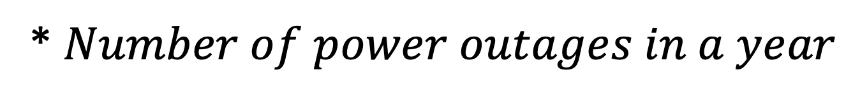
Resilience NEIs
Example: Battery Storage
$$NEI=Hours of electricity provided by battery storage$$
* $Avoided costs of power outage (e.g. food going bad)$
* $Number of power outages in a year$
Sometimes captured as “Value of Lost Load” (VOLL)

Slide 26
Your Turn
What NEIs might be especially relevant where you live or work?
Protecting people indoors from outdoor air pollution or smog?
Replacing coal or biomass-burning heaters and cookstoves with electric equipment to reduce indoor air pollution?
Providing backup power during rolling blackouts?
Protecting people against extreme heat and storms?

Slide 27
Thank you!
Contacts: Bruce Tonn, btonn@threecubed.org
Michaela Marincic, mmarincic@threecucbed.org

Slide 28
Why do we not use willingness to pay?
Willingness to Pay
Uses survey methods to measure how much someone would pay to achieve a good outcome or avoid a bad outcome
If survey respondents say they are willing to pay a lot to avoid a power outage, for example, then this result can be weighed against the cost of investing in grid resilience
Highly subjective and not clear how respondents come up with their answers
Lower income residents cannot afford the same level of “willingness” as higher income residents – that does not mean they deserve to experience worse service
Willingness to pay is not the same as the value derived by the customer

