Slide 1

Are Evaluation, Measurement and Verification (EM&V) practices ready for the energy transition?
  Key findings from a North American jurisdictional scan
Study commissioned by Hydro-Québec in 2021, carried out in 2022, finalized in 2023.
The study does not represent Hydro-Québec’s views or positions.
This document represents a summary of the study. The full report is not publicly available.

Slide 2









Dunsky Overview
Accelerating the Clean Energy Transition
ANALYSIS + STRATEGY
BUILDINGS
MOBILITY
INDUSTRY
ENERGY
20
60⁺
1000⁺
Dedicated
Professionals
Projects across
31 States & Provinces
Projects across
35 States & Provinces
Years

Slide 3
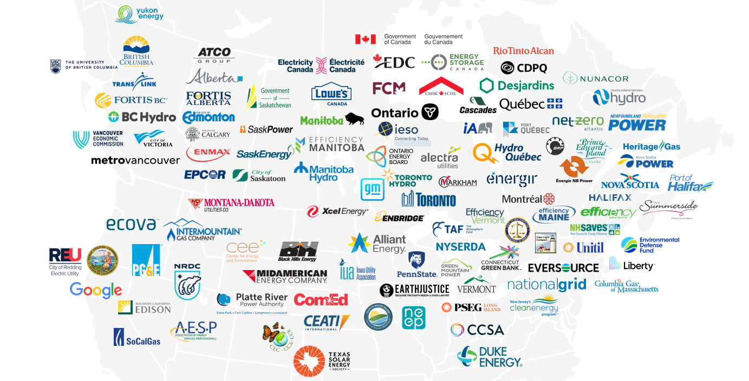
Client Map
Accelerating the Clean Energy Transition
ANALYSIS + STRATEGY
BUILDINGS
MOBILITY
INDUSTRY
ENERGY
GOVERNMENTS
UTILITIES
CORPORATE + NON-PROFIT

Slide 4



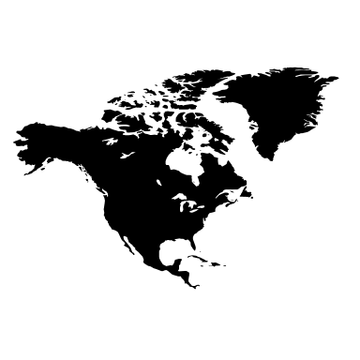

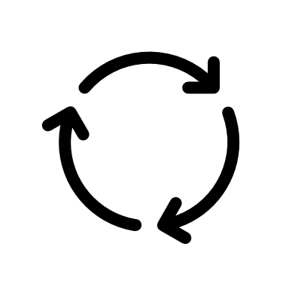



Repositioning EM&V in a transition context
1 minute
Why revisit the role of evaluation, measurement and verification (EM&V)?
The historical role of evaluation
Little change in 20 years
Changes in context
At Hydro-Québec and beyond
Objective of this study
Best practice guidelines
Evaluate, measure and verify savings from energy efficiency programs
Ensure compliance with energy regulator’s requirements
New ambitious targets in energy efficiency
Changes in HQ’s structure and goals
New types of programs and technologies in North America
Evaluation is evolving across the continent
  "Initiate a reflection process to position the activities and service offering of the Program Evaluation function in light of... new strategic orientations“, in particular as they relate to accelerating the clean energy transition.
  (source: call for proposals)

Slide 5























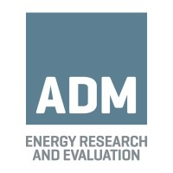



We explored eight themes and jurisdictions
Study themes & coverage
2 minutes
Evaluation planning
What proportion of programs and savings are evaluated?
24 interviews and 50+ documents consulted
10 utilities or program administrators, 5 regulatory or regional agencies, 9 consultants or evaluation researchers
Overlap
How can growing overlap between programs & actors be managed?
BC
Continuous improvement
What practices promote continuous improvement?
QC
ON
Organizational structure
What are the org. links between evaluation and program functions?
WA
OR
NB
Greenhouse gasses (GHGs)
Are GHG savings measured, and how?
CA
NY
MA
Equity
Is equity evaluated, by whom and how?
Market transformation (business sector)
What approaches are used and when are they relevant?
Jane S. Peters Advising
M&V 2.0
(in real time)
What is M&V 2.0, and what opportunities does it offer?

Slide 6
Three types of jurisdiction stand out
2 minutes
What's the overall picture?
Disclaimer: positions are approximate and may have evolved since 2022.
Regulatory flexibility
Types of jurisdiction:
1
1
The Holistic: Jurisdictions that benefit from a high degree of flexibility in their evaluation practices, a collaborative culture, and a wealth of experience in market transformation.
OR
BC
WA
Tradition & flexibility
Ambition & flexibility
NB
MA
2
The Demanding: Jurisdictions that have aggressive transition goals, while being subject to stringent regulatory precision requirements (overlap, impact), requiring increasingly refined methodologies
Climate
ambition
NY
3
QC
2
Tradition & control
Ambition & control
ON
The Traditionalists: Jurisdictions that had not yet – at the time of study – significantly evolved their climate ambitions and/or evaluation practices.
CA
3

Slide 7
The "demanding" ones are facing an inherent tension
1 minute
The dilemma:
Regulatory stringency
Obligation to accurately evaluate and allocate savings
Climate ambition
Large needs, growing targets, more programs and actors

Slide 8
Is it useful, or even possible, to check and allocate all savings precisely?
Only if time allows
"We spend all this money on bean-counting. As our goals get harder and harder, maybe we should spend more on process or market evaluations, on how to achieve more goals, not on whether we've achieved a given part of them."
(independent evaluation specialist)
"We don't have time to overplan or overvalue. Our entire state is on fire. We need to make sure things move forward. The only way to do that is to accept a little less certainty. It's impossible to slice everything up and take credit for it. Because in the end, we get less, and that discourages cooperation. In this period of transition, we need 100% solid effort, not 10% perfect effort."
(independent evaluation specialist)
"Everyone is fighting for their piece of the pie - that's where we are. It's not productive. And it's an impossible task to fairly allocate what each player's share of the project is... The regulators are basing this decision on the idea that it's possible, and I'm here to tell you that it's not. There are limits to what valuation can do".
(utility)

Slide 9
A diversity of approaches is possible
2 minutes
Overview
Disclaimer: positions are approximate and may have evolved since 2022.
Audit paradigm
Learning paradigm
Evaluation planning
Strict framework
QC
ON
CA
WA
NY
NB
BC
MA
OR
Flexible framework
Overlap
Precise allocation
QC
CA
ON
NY
BC
MA
WA
OR
Holistic approach
Continuous improvement
Secondary objective
ON
QC
CA
WA
MA
NB
NY
BC
OR
Primary objective
Organizational structure
Distance and independence
ON
CA
QC
NB
MA
NY
OR
BC
Proximity and collaboration
Classic approach
Emerging approach
Greenhouse gasses (GHGs)
No evaluation
QC
OR
ON
NB
WA
BC
CA
NY
MA
no one here
GHG savings measured
Equity
No evaluation
QC
ON
NB
BC
OR
WA
CA
MA
NY
no one here
Equity impacts measured
Market transformation (business sector)
No market evaluation
NB
ON
BC
QC
MA
CA
NY
WA
OR
Active market evaluation
M&V 2.0
NB
ON
OR
QC
MA
BC
NY
WA
CA
Growing use
Little use

Slide 10



A new North Star, and two transformation pillars
2 minutes
Proposal: Framework for a transition-aligned evaluation function
Decarbonation  Electrification  Energy efficiency
Rigorous, credible evaluation
Adopting a learning orientation
by focusing on utility and agility, to help achieve ambitious energy efficiency and decarbonization targets
Adding strings to one’s bow
by updating methodologies, to measure new sources of value and generate more lessons for programs
Right-size evaluative effort
Enable program improvement
Expand the scope of evaluation
Holistic measurement
Prioritize evaluation according to needs
Gather and share lessons quickly
Build out capacities for market transformation evaluation in all segments
Measure GHG savings and focus on initiatives with the highest savings’ potential
Simple formulas to adjudicate overlaps
Foster a culture of collaboration between eval. and program teams
Study equity to help reach more difficult market segments
Build M&V 2.0 capacity to leverage distributed data and resources
Note: many of these changes may require regulatory changes or approvals.

Slide 11
The benefits of changing exceed the costs of stagnating
Can this work?
Only if time remains
Perceived risks from changing | Risk-mitigation elements | Risks of not changing
Loss of precision Overestimation of savings Loss of independence Loss of credibility | Evaluation will continue for most programs Various safeguards to ensure quality, including the use of consultants Opportunism rates will drop, as almost all users will have to be reached for the energy transition The proposed practices work in other credible jurisdictions | Slowing down and complicating the scaling-up of demand-side management efforts Falling into "false precision" – a lot of effort to distinguish inseparable effects Focusing on the size of branches, not on the growth of the forest Miss opportunities for program improvement

Slide 12

Contact
Lorenzo Daieff
Senior Consultant
Lorenzo.daieff@dunsky.com
Tel: 514-504-9030 ext. 4254

Slide 13
Annexes

Slide 14
M&V 2.0 are analysis methods that make it possible to attribute savings to certain interventions in real time.
What is M&V 2.0?
« M&V 2.0 refers to the increasing granularity of available energy consumption data, and the enabling of automated M&V methods that continuously analyze the data and provide early, accurate and valuable insights to various stakeholders about energy savings estimates. »
Lawrence Berkeley National Laboratory (2017).
Données granulaires
Analyses avancées et automatisées
Résultats détaillés en temps réel
M&V 2.0
Notes:
Lawrence Berkeley National Laboratory (2017). The Status and Promise of Advanced M&V: An Overview of “M&V 2.0” Methods, Tools and Applications. Website: https://eta.lbl.gov/sites/all/files/publications/lbnl-1007125.pdf. Cité dans le IESO EM&V protocol 4.0, 2021: https://www.google.com/url?sa=t&rct=j&q=&esrc=s&source=web&cd=&ved=2ahUKEwj1qPjvgquOAxWSv4kEHXEaAmoQFnoECA0QAQ&url=https%3A%2F%2Fwww.ieso.ca%2F-%2Fmedia%2FFiles%2FIESO%2FDocument-Library%2FEMV%2FEvaluation-Measurement-and-Verification-Protocol-V4.ashx&usg=AOvVaw0us_h8Q_dLQN_40WrzLFwN&opi=89978449

