Slide 1

Energy Transition and Security in Emerging Economies
TEEVRAT GARG
ASSOCIATE PROFESSOR OF ECONOMICS

Slide 2

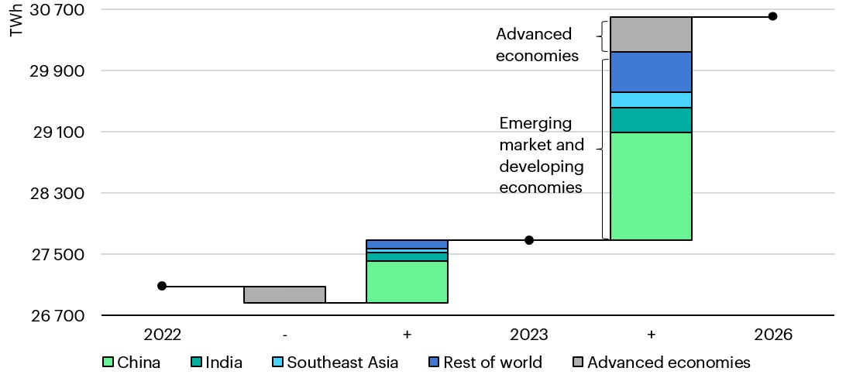
Increase in Energy Demand from Emerging Economies
Source: International Energy Agency

Slide 3
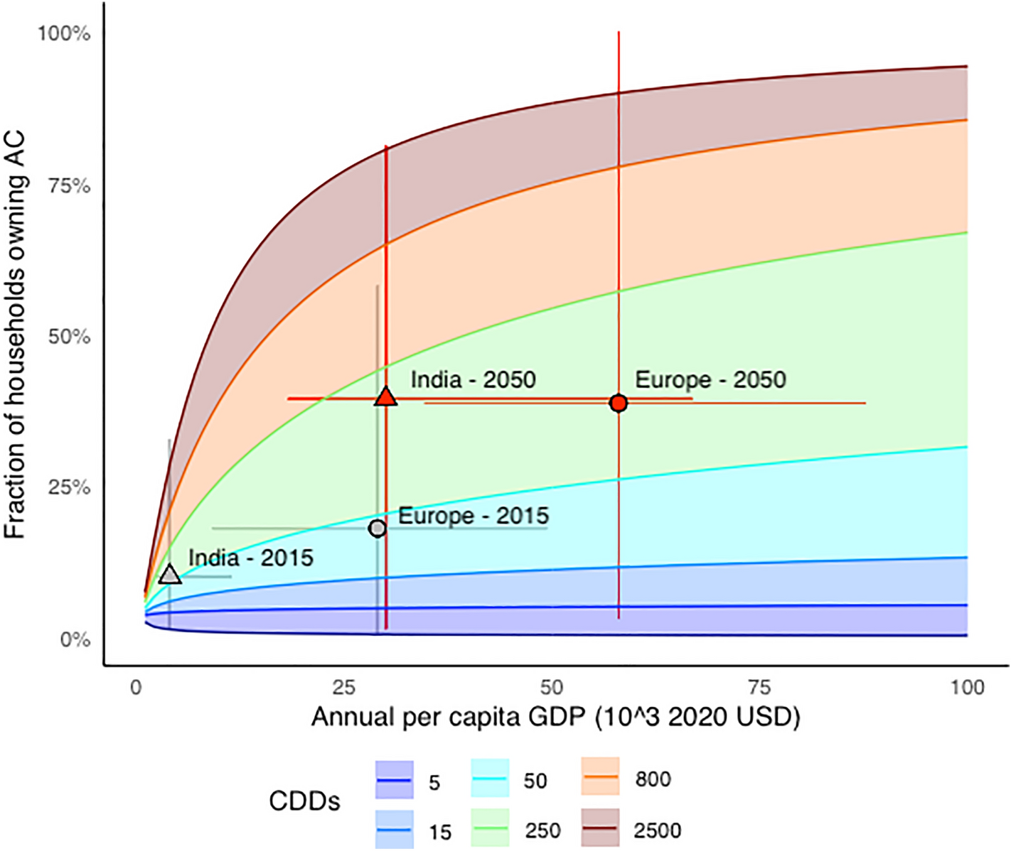
Grid instability is a cross-cutting problem
AC Adoption Expected to Increase 4x by 2050
In India alone, that is 3.3 Billion additional AC units. But the grid is not ready. Substations and transformers are strained.
Air Pollution is a health emergency
Transition out of coal is urgently needed. Renewable intermittency must be solved through demand management.
Energy Transition and Security
Geopolitical concerns and supply chain security are major barriers to the energy transition.
Source: Colelli et al. (2023)
Notes:
It is a concern for adaptation to climate change, for economic growth and productivity and for national security

Slide 4
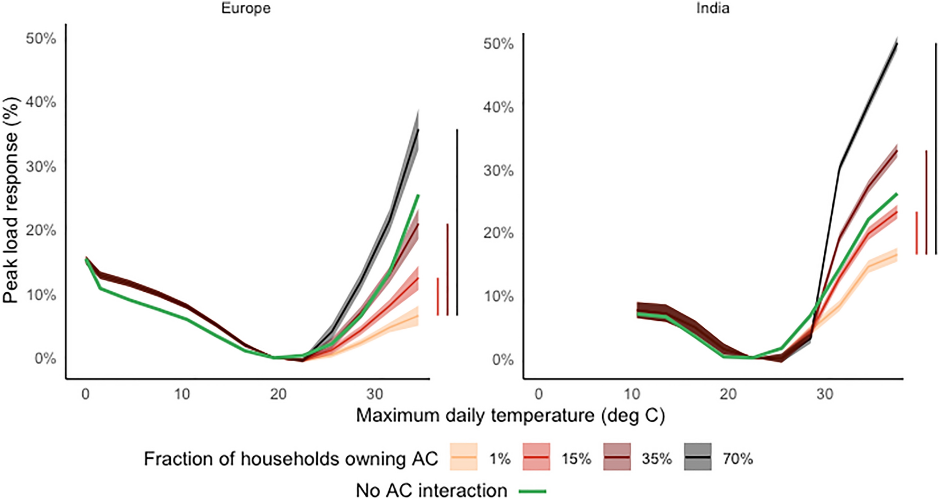
Peak load amplification
Source: Colelli et al. (Scientific Reports, 2023)

Slide 5
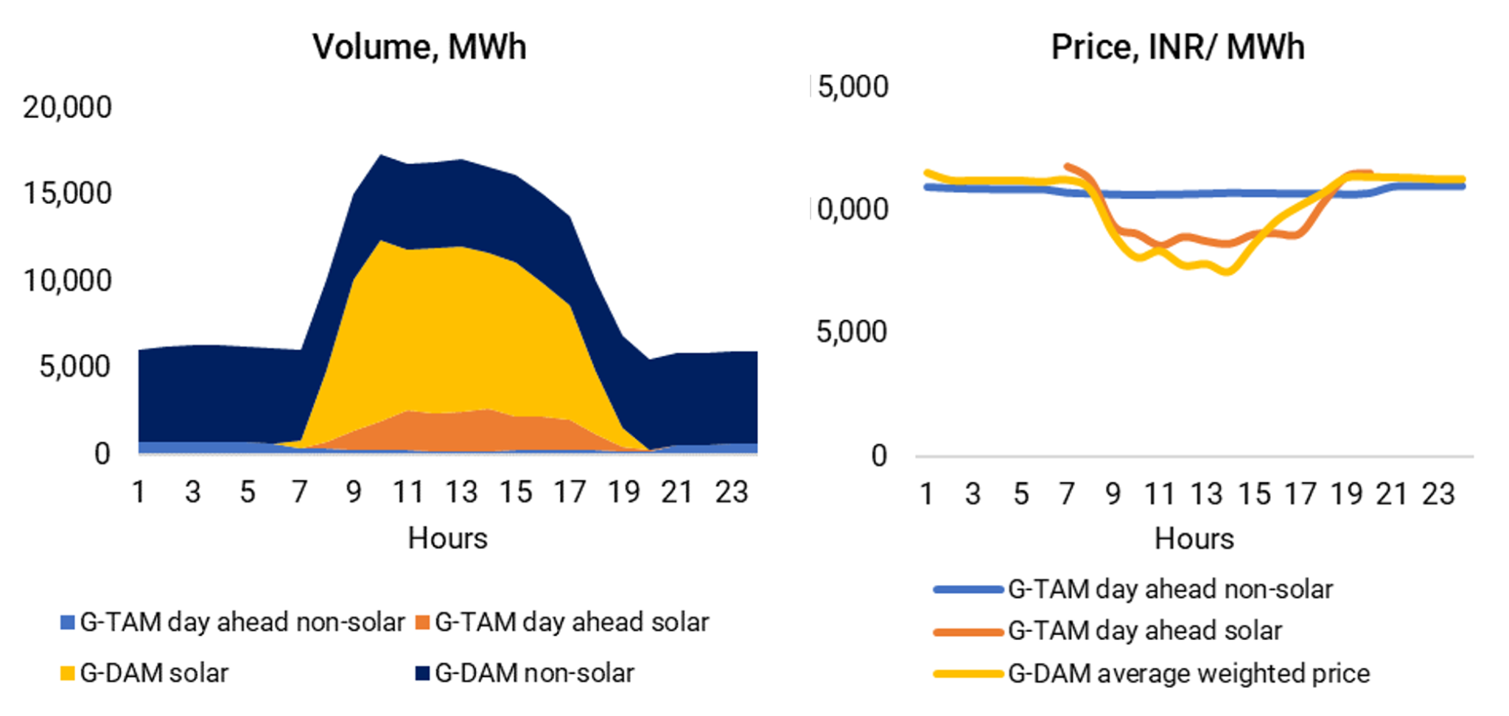
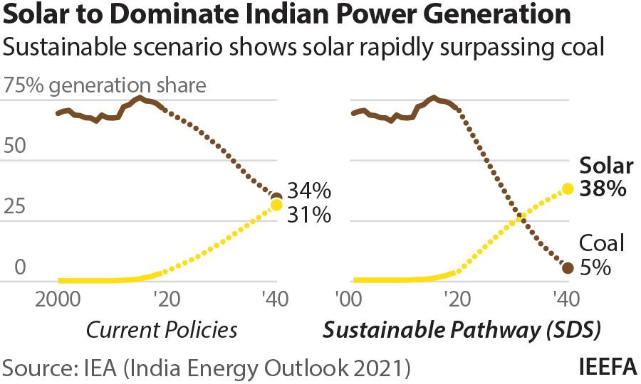
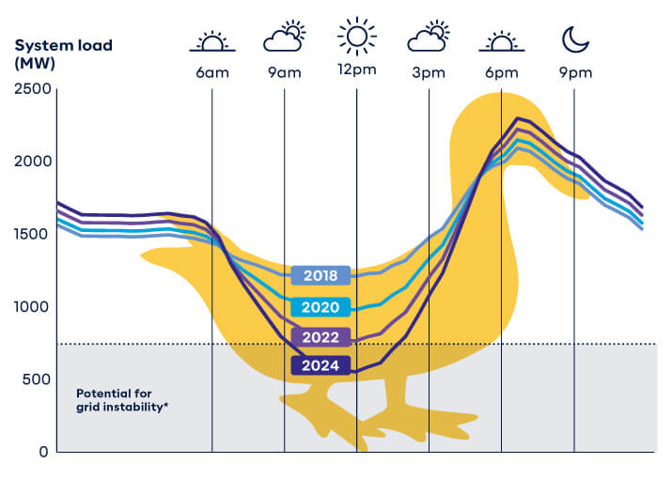
Renewables will help, but intermittency remains an issue

Slide 6
The need for Real-time demand response
Intermittency creates the need for demand management
Batteries will help, but also create opposing effects because of start-up costs associated with fossil plants and curtail costs associated with solar/wind.
Increasing uncertainty around extreme weather events

Slide 7
The Business Case for Demand Management
Utility finances: peak electricity is often sold at a loss; demand management can yield fiscal savings.
Grid stability: Avoid rationing electricity through blackouts or overloading infrastructure.
Sustainability: Peak electricity typically has highest carbon/particulate matter footprint.
Notes:
Note: Explain how it is the opposite – selling less during peak hours is actually good for the utility – reduces need for starting up an additional plant (start up costs), overinvesting in DRE (curtailment costs) etc.

Slide 8
Vietnam

Slide 9
The Problem
Utility wants to incentivize peak demand reduction (July-August 2023)
Incentives to reduce peak energy use are incomplete – utility unable to observe effort (observes energy use through smart meters)
Can the utility design a more cost-effective incentive structure?

Slide 10
Incentivizing Effort: Contests v. Contracts
Contests:
  Groups of 50 households (don’t know each other)
  USD 87 per HH for winner (max reduction relative to same period in 2022)
  Fixed ex-ante budget
Theory: incentivize high savers, potentially discourage low-savers.
Effective even under unanticipated shocks (e.g., weather)
Contracts:
  Contract 1: $4.35 (5%), $6.52 (10%), $10.87 (15%)
  Contract 2: $6.52 (10%), $10.87 (15%), $15.22 (20%)
  Must predict compliance
Theory: people save what they think is “worth it”.
Over/under compliance under unanticipated shocks.

Slide 11
What we did
Randomize 11,194 households into contests, one of two contracts, and a control group.
Record energy use before, during and after the experimental period via smart meters.
Compare cost-effectiveness across three treatments: energy conservation per $ spent.

Slide 12
Contracts and Contests deliver 7-9% energy reduction
Source: Garg et al. (2024)

Slide 13
Scalable Insights
It is possible to achieve peak demand reductions of 7-9% in hottest months.
Contests are 2x cost-effective. And have fixed, stable budgets.
Carbon reductions (not accounting for other benefits) = $59/MtCO2.
Abatement costs negative when oil (3%) is marginal source.

Slide 14

India
Virtually Powered By

Slide 15
The Problem
Demand response that requires active behavior change is difficult to scale
HVAC systems/smart devices are not widespread in LMICs
Passive behavior change can be more cost-effective to incentivize but requires low-cost technologies + adoption.

Slide 16



We deploy inexpensive smart technologies that enable flexible virtual power plants
Data-driven default-in management of demand → high compliance (easy to over-ride)
Use low-cost smart plugs to connect to virtual power plant.
2
Work with existing appliances.
1

Slide 17
Experimental Design (Kane et al., 2024)
POWBAL algorithm randomly assigns individual smart switches to turn off automatically for a given half-hour interval between 8am and midnight.
  No more than 2 events per day and 8 events per week per device
Rewards are earned in proportion to the reduction in electricity consumed during the event compared to right before the event begins
  Randomly assign the reward rate for each user-event: 6, 12, 18, 24 or 30 INR/kWh
SMS alerts with the timing of the event and reward rate are sent prior to each event
  Randomly assign the notice period for each user-event: 2 hours or 8 hours

Slide 18
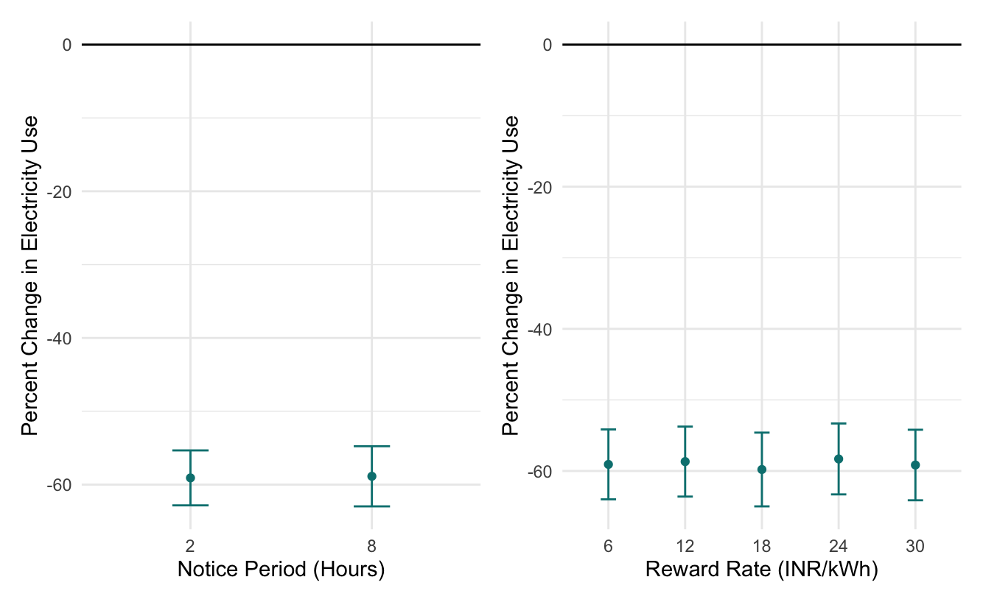
Switch-off events led to a 60% reduction in energy use

Slide 19
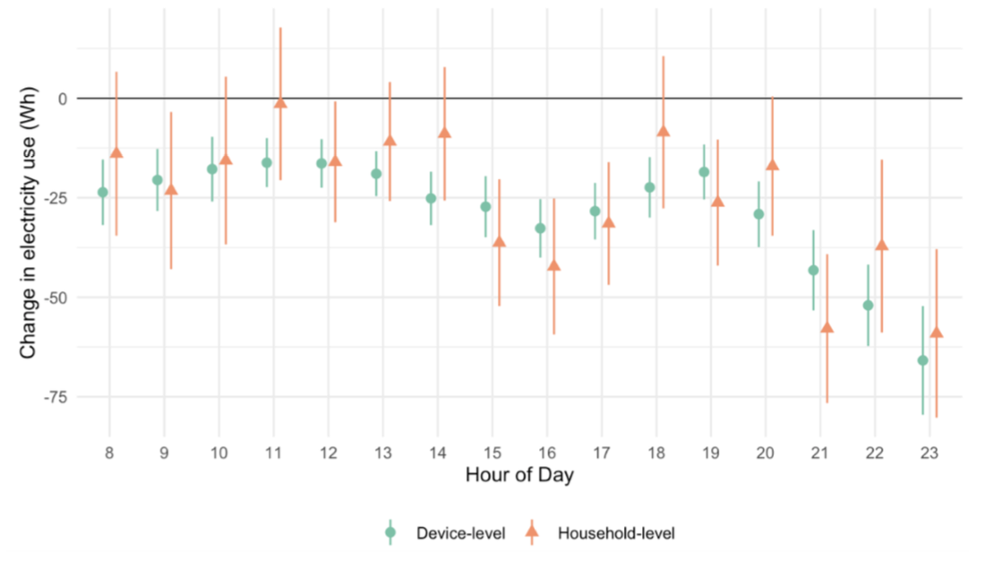
Device level reductions translate to household level

Slide 20
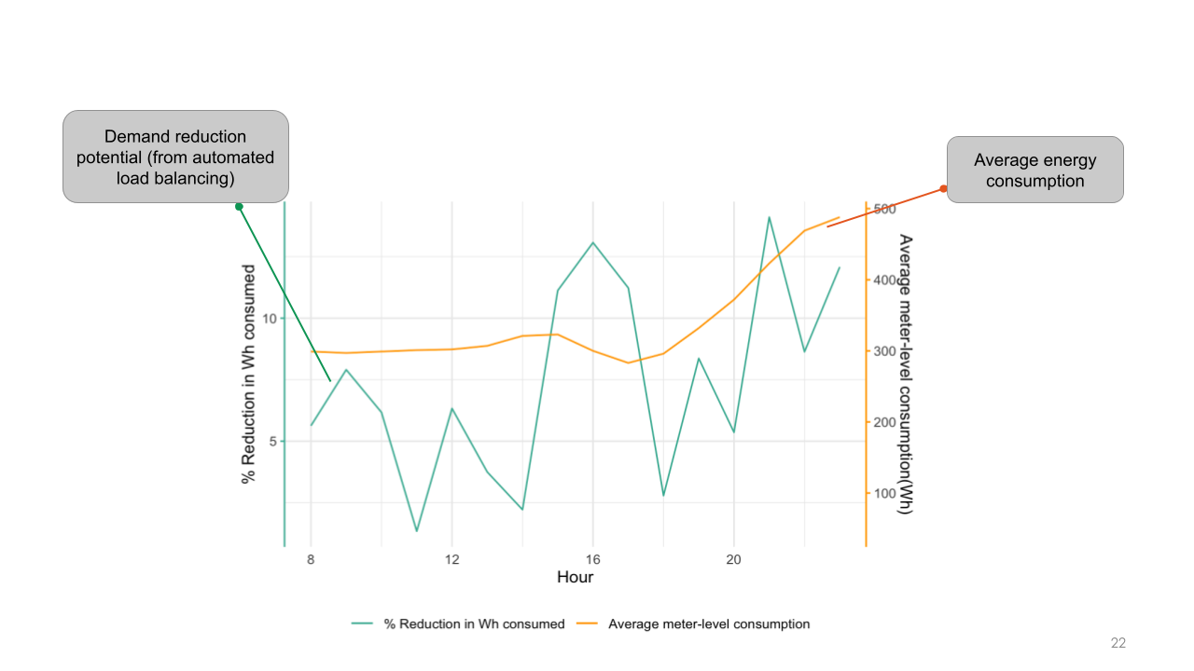
Flexibility potential coincides with aggregate residential peak demand

Slide 21
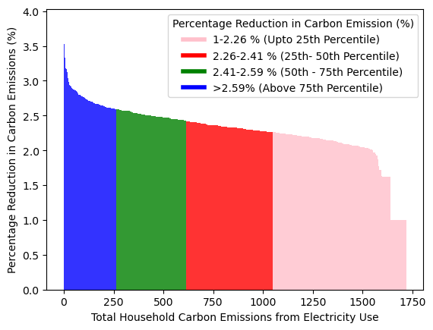
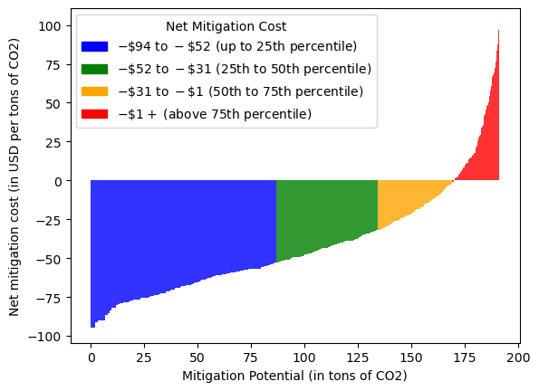
Emissions reductions delivered at negative prices!

Slide 22
Towards scale
Partnerships with utilities in India, Vietnam (with future planned expansions to Indonesia, South Africa and Turkey)
Target 20,000 households by mid-2026.
Experimentally design best practices to scale → estimate grid level effects.

Slide 23
San Diego

Slide 24
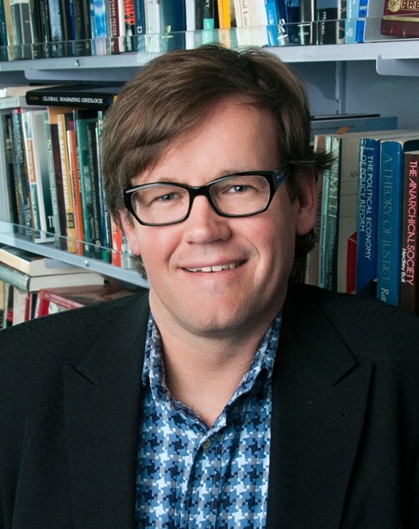
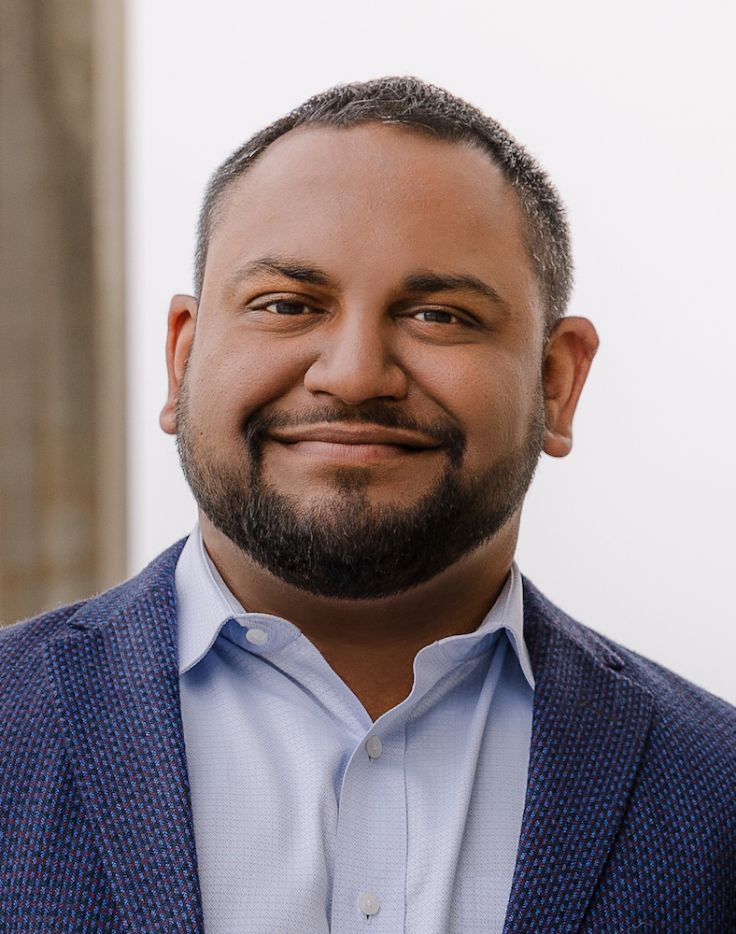
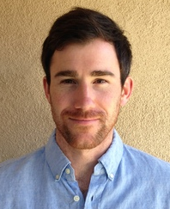
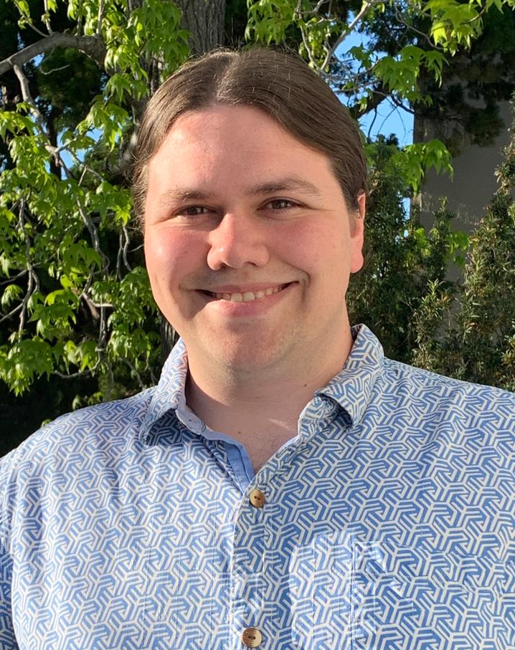

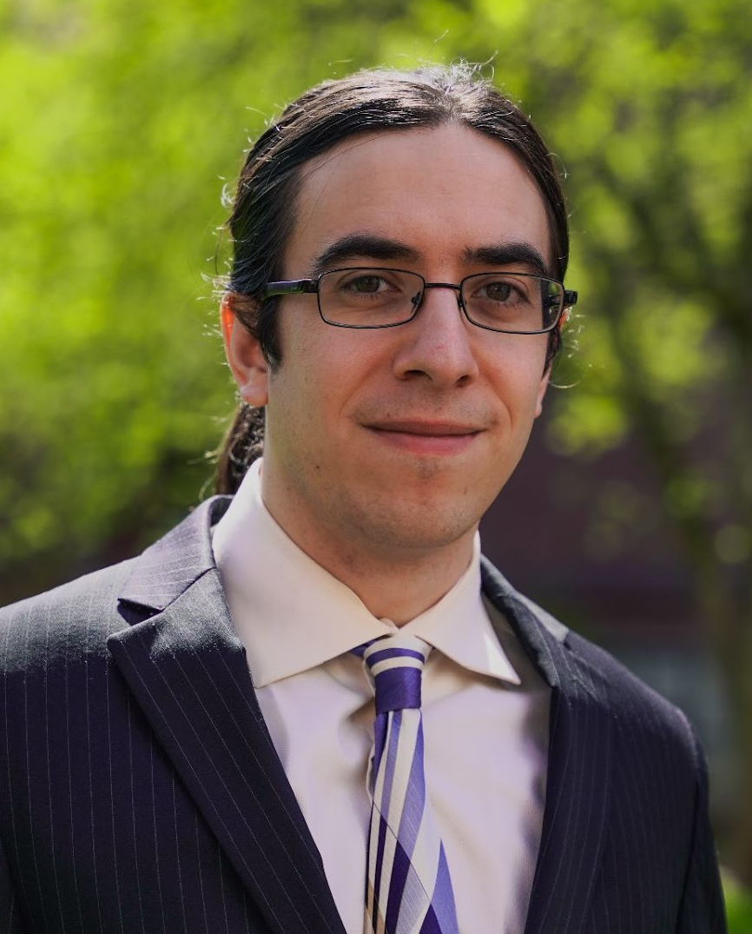
Human Behavior with Electric Vehicles (EVs):
Experimental results on workplace charging
The Deep Decarbonization Initiative (D2I) is an interdisciplinary team based in the School of Global Policy & Strategy (GPS) at UC San Diego.
David G. Victor
Professor of Innovation and Public Policy, GPS
Professor, SIO (Adjunct)
Professor, JSOE (by Courtesy)
Director, D2I
Teevrat Garg
Associate Professor of Economics, GPS
Ryan Hanna
Research Scientist,
Center for Energy Research
Jeff Myers
Staff Research Associate, D2I
Sebastian Tebbe
Professor of Economics, Univ. of Melbourne
(Formerly postdoc, GPS)
Charles Thompson
Postdoc, GPS

Slide 25
What we know about EV charging demand flexibility
Most charging (perhaps 80%) is done at home and encouraged by residential electricity tariffs
Utility smart charging programs are proliferating but only provide anecdotal insights
There’s been some rigorous experimental research around home charging
  Drivers significantly increase charging when discounted and “green”
  Drivers respond strongly to financial incentives to charge during off-peak periods
There remain huge unknowns about shifting people away from home
  Why do we care about shifting location?

Slide 26
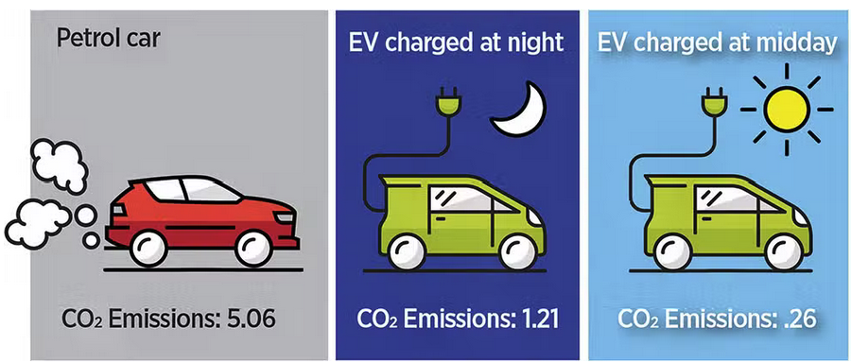
Midday (workplace) charging has many advantages
Existing residential EV tariff structures emphasize congestion, not emissions
To affordably minimize emission on a solar dominant grid, charging must shift to midday
  Daytime charging, in turn, implicates workplace charging for most EV drivers
Annual Carbon Emissions By Vehicle Mode in California
5 tCO₂/yr
1.2 tCO₂/yr
0.3 tCO₂/yr

Slide 27
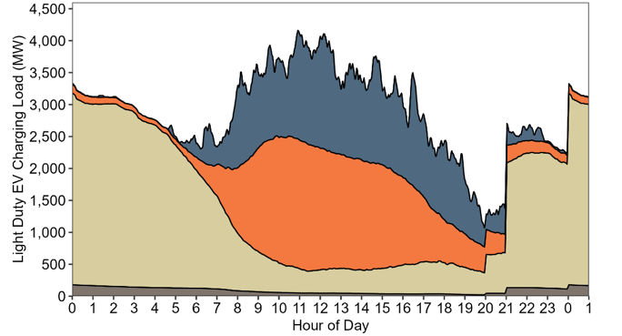
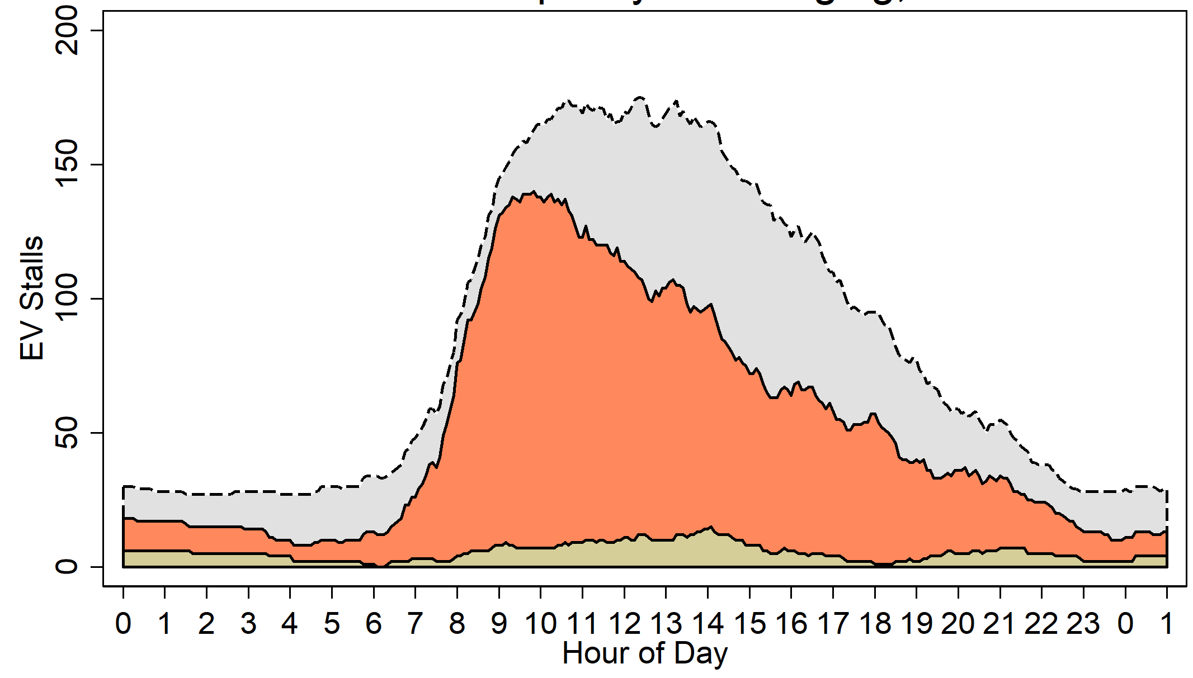
What does EV load look like today?
CALIFORNIA’S VISION FOR 2030
UCSD’s REALITY TODAY
Occupied stalls
EV Stalls
DC Fast
[Jeff’s UCSD charging figure]
Public & Work Level 2
Residential Level 2
Workplace Level 2 charging
Residential
Source: California Energy Commission, Assembly Bill 2127 Second Electric Vehicle Charging Infrastructure Assessment, 2024
UCSD EV stall occupancy and charging; October 17, 2023
Turning vision into reality hinges on human behavior

Slide 28
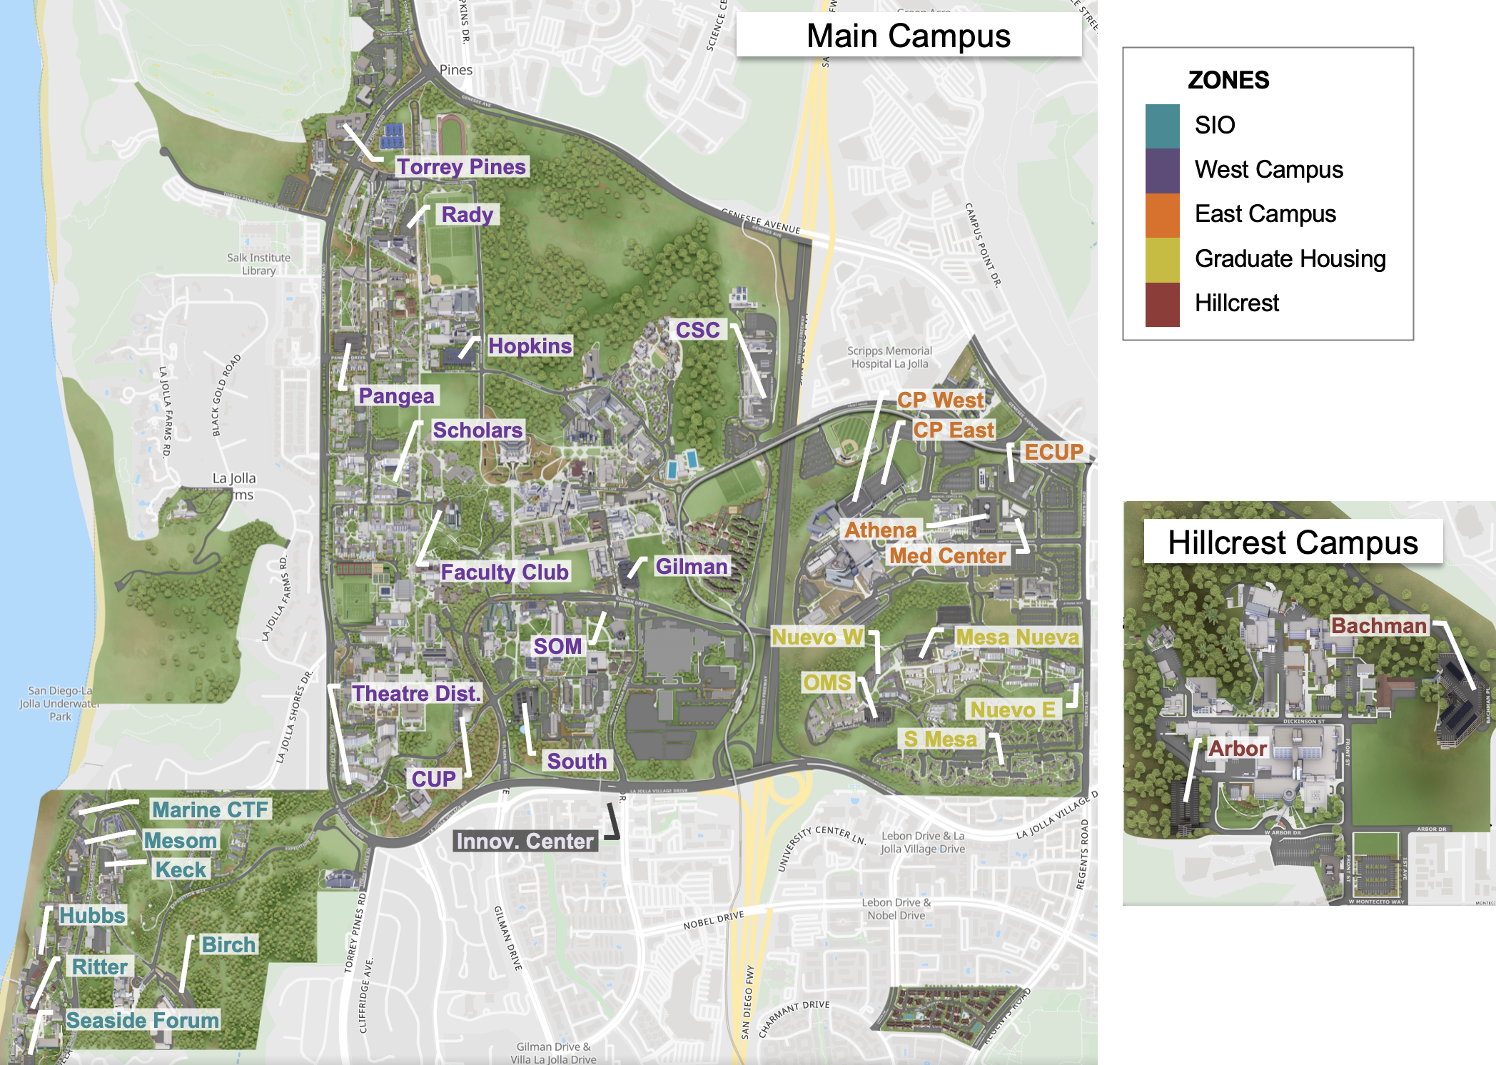
The largest campus EV network in North America
36 EV lots
590 charging ports
~3,000 unique drivers
~1,000 research participants

Slide 29
Largest ever randomized control trials on EV charging
First Experiment (2023): 629 drivers
Two separate interventions:
  An informational nudge that tells drivers about the climate benefits of daytime charging.
  A financial discount—50% or 75% off the base rate—on all campus charging
Drivers’ “behavior” measured as the number, energy draw, duration, and timing of sessions
Set up “Randomized Controlled Trial” experiment
Randomize drivers based on demographic info
Random sample is control
Random sample gets treatment
Gold-standard research design
Conduct intervention
Provide environmental information, OR
Provide financial discounts on charging
Measure drivers’ behavioral response
Share of charging done @UCSD
Number of sessions initiated
Energy consumed
Session duration
Session start time

Slide 30
Experimental Results: Mixed takeaways . . .
Informing drivers about social benefits of midday charging:
Reduced early morning plug-ins; increased late morning
However, no increase in total charging on campus
Giving large vs small discounts:
Deeper discount increased total charging
However, increased early morning and overnight charging
Doubling the chargers available for drivers:
In progress! Results expected Summer 2025
Policy Implications
Driver behavior is malleable under certain conditions, but. . .
Key to understand charging network before intervening
Future work will inform cost-effective ways to shape EV load in ways that minimize social costs and emissions while meeting drivers’ needs

Slide 31
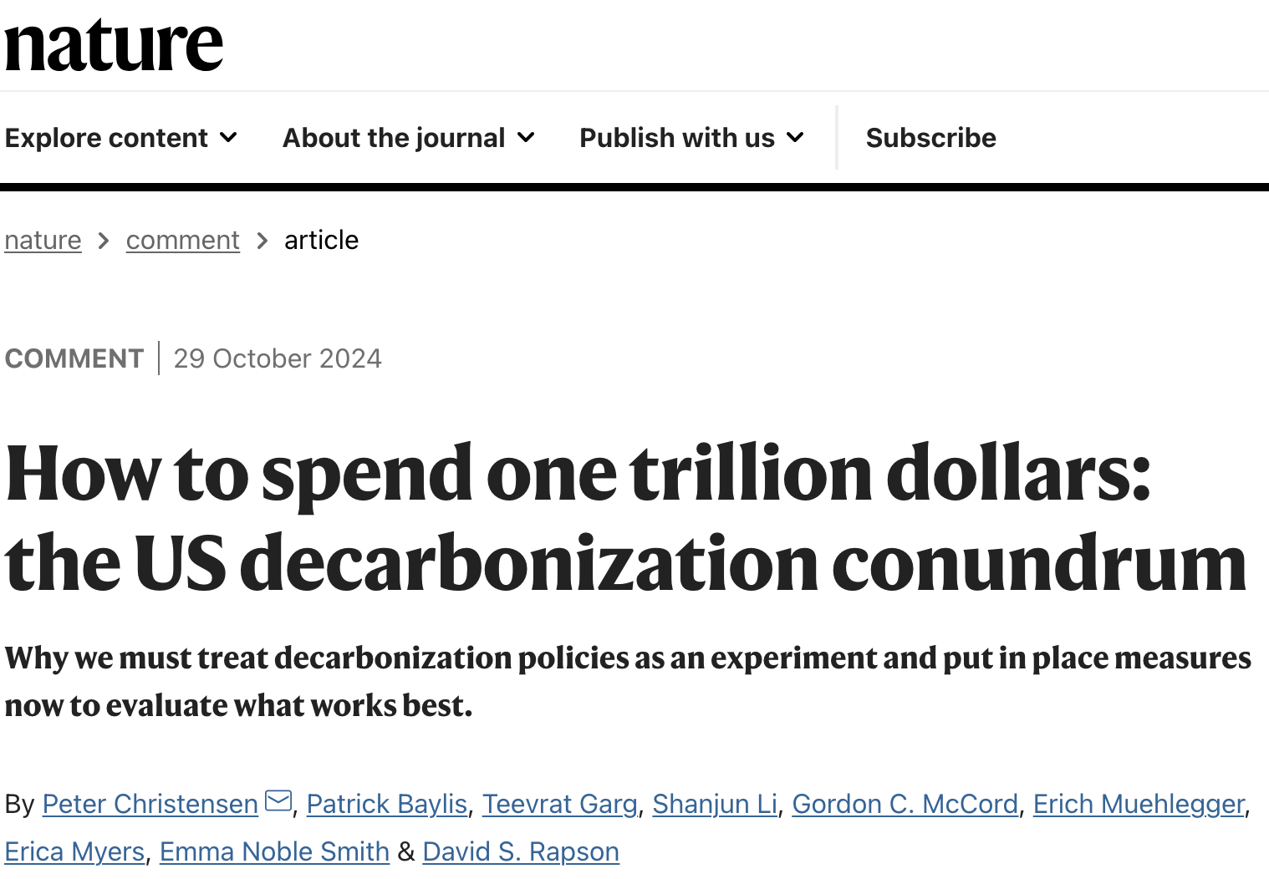
A Call To Action: Local Implementation
Invest in local experimentation and data collection
Share knowledge across jurisdictions
Maximize decarbonization impacts through better targeting and design.

Slide 32

Innovators.
Problem solvers.
Policy experts.
Thank you
EMAIL
teevrat@ucsd.edu
GPS.UCSD.EDU

