Slide 1

Building Energy Efficiency:
Taking Stock of Policy and Practice
in Asia and the Pacific
EEAP Webinar: Implementing and Evaluating Energy Efficiency Policies for Buildings in Asia-Pacific
Ms. Kimberly Roseberry
Economic Affairs Officer, Energy Division, ESCAP
3 April 2025

Slide 2

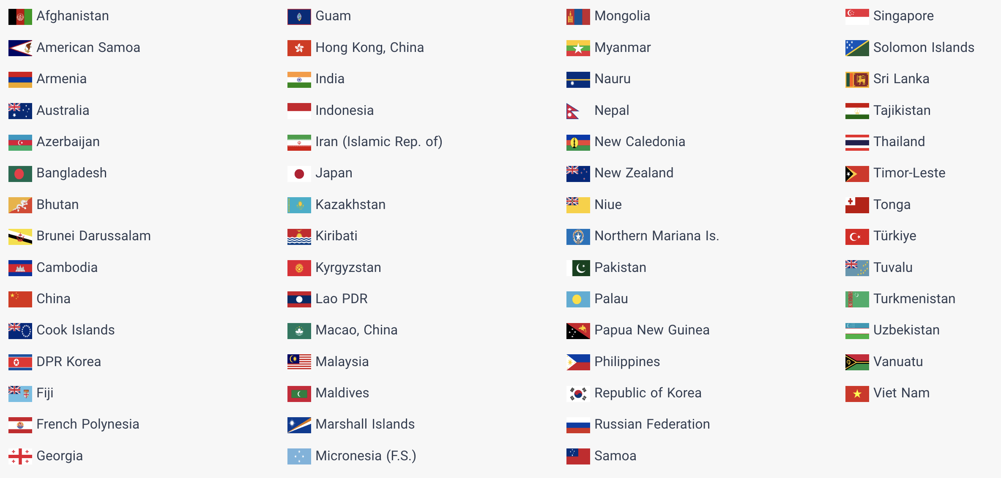
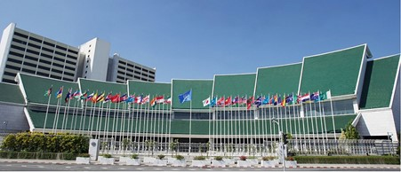
The Economic and Social Commission for Asia and the Pacific
59% of the world’s population
49% of global energy demand
57% of global fuel-related GHG emissions

Slide 3



ESCAP’s Role
Fostering regional cooperation and knowledge exchange.
Supporting evidence-based policymaking through research and analysis.
Providing technical assistance to member States.
Evaluating progress against objectives and targets under polices and commitments.
Supporting National Cooling Action Plans and building code development through strategic partnerships.

Slide 4

Building Sector Context and Relevance
Buildings account for approximately 30% of final energy use in the Asia-Pacific region.
Rapid urbanization, economic growth and rising temperatures drive growing energy demand.
Without action, emissions from buildings will continue to rise.
Energy efficiency in buildings is a critical strategy for SDG 7, NDCs, and net-zero goals.

Slide 5

Policy Tools for Energy Efficiency in Buildings
Mandatory Building Energy Codes and Standards
Voluntary Rating and Labelling Systems
(e.g., Green Building Certification)
Minimum Energy Performance Standards
Urban planning integrating passive cooling
Financial and Non-Financial Incentives
Public Procurement

Slide 6

Key Barriers to Robust Policy Frameworks
Limited technical and institutional capacity of policymakers and practitioners
Gaps in data for decision-making and evaluation
Lack of market demand for energy-efficient buildings
Lack of financing for retrofits and higher construction costs
Inadequate policy enforcement mechanisms

Slide 7


Implementation Pathways
Raise awareness on the benefits of energy efficient buildings
Build institutional capacity for policy development and enforcement
Adopt long-term roadmaps for building energy codes development with built-in MRV frameworks
Gather evidence, promote pilot projects and demonstration buildings
Enable finance mechanisms
Engage private sector, academia and construction industry

Slide 8



Evaluation
Start with (establishing) performance baselines!
(considering building typologies, usage, climatic zones, etc.)
  Energy audits and benchmarking
  Building stock modeling
  Survey evidence on user behavior and comfort
Assess policy and regulatory frameworks
  Coverage and scope across building typologies, existing/new
  Inclusion of sector-wide energy/emissions reduction targets
  Performance measures and/or prescriptive requirements
  Enforcement mechanisms
  MRV and update mechanism
Review alignment and harmonization
  Across policies for various sectors and ministries
  SDG and Paris Agreement contribution
High quality, EE design
and construction
Low energy
demand
Comfortable, safe, healthy environments for people

Slide 9




Cambodia Case
Rising building energy demand, primarily for cooling
NDC and national EE policy targets to reduce sectoral energy demand and emissions
No building energy codes, no MEPS
Lack of demonstrations and baseline performance levels validated by real-world data

Slide 10



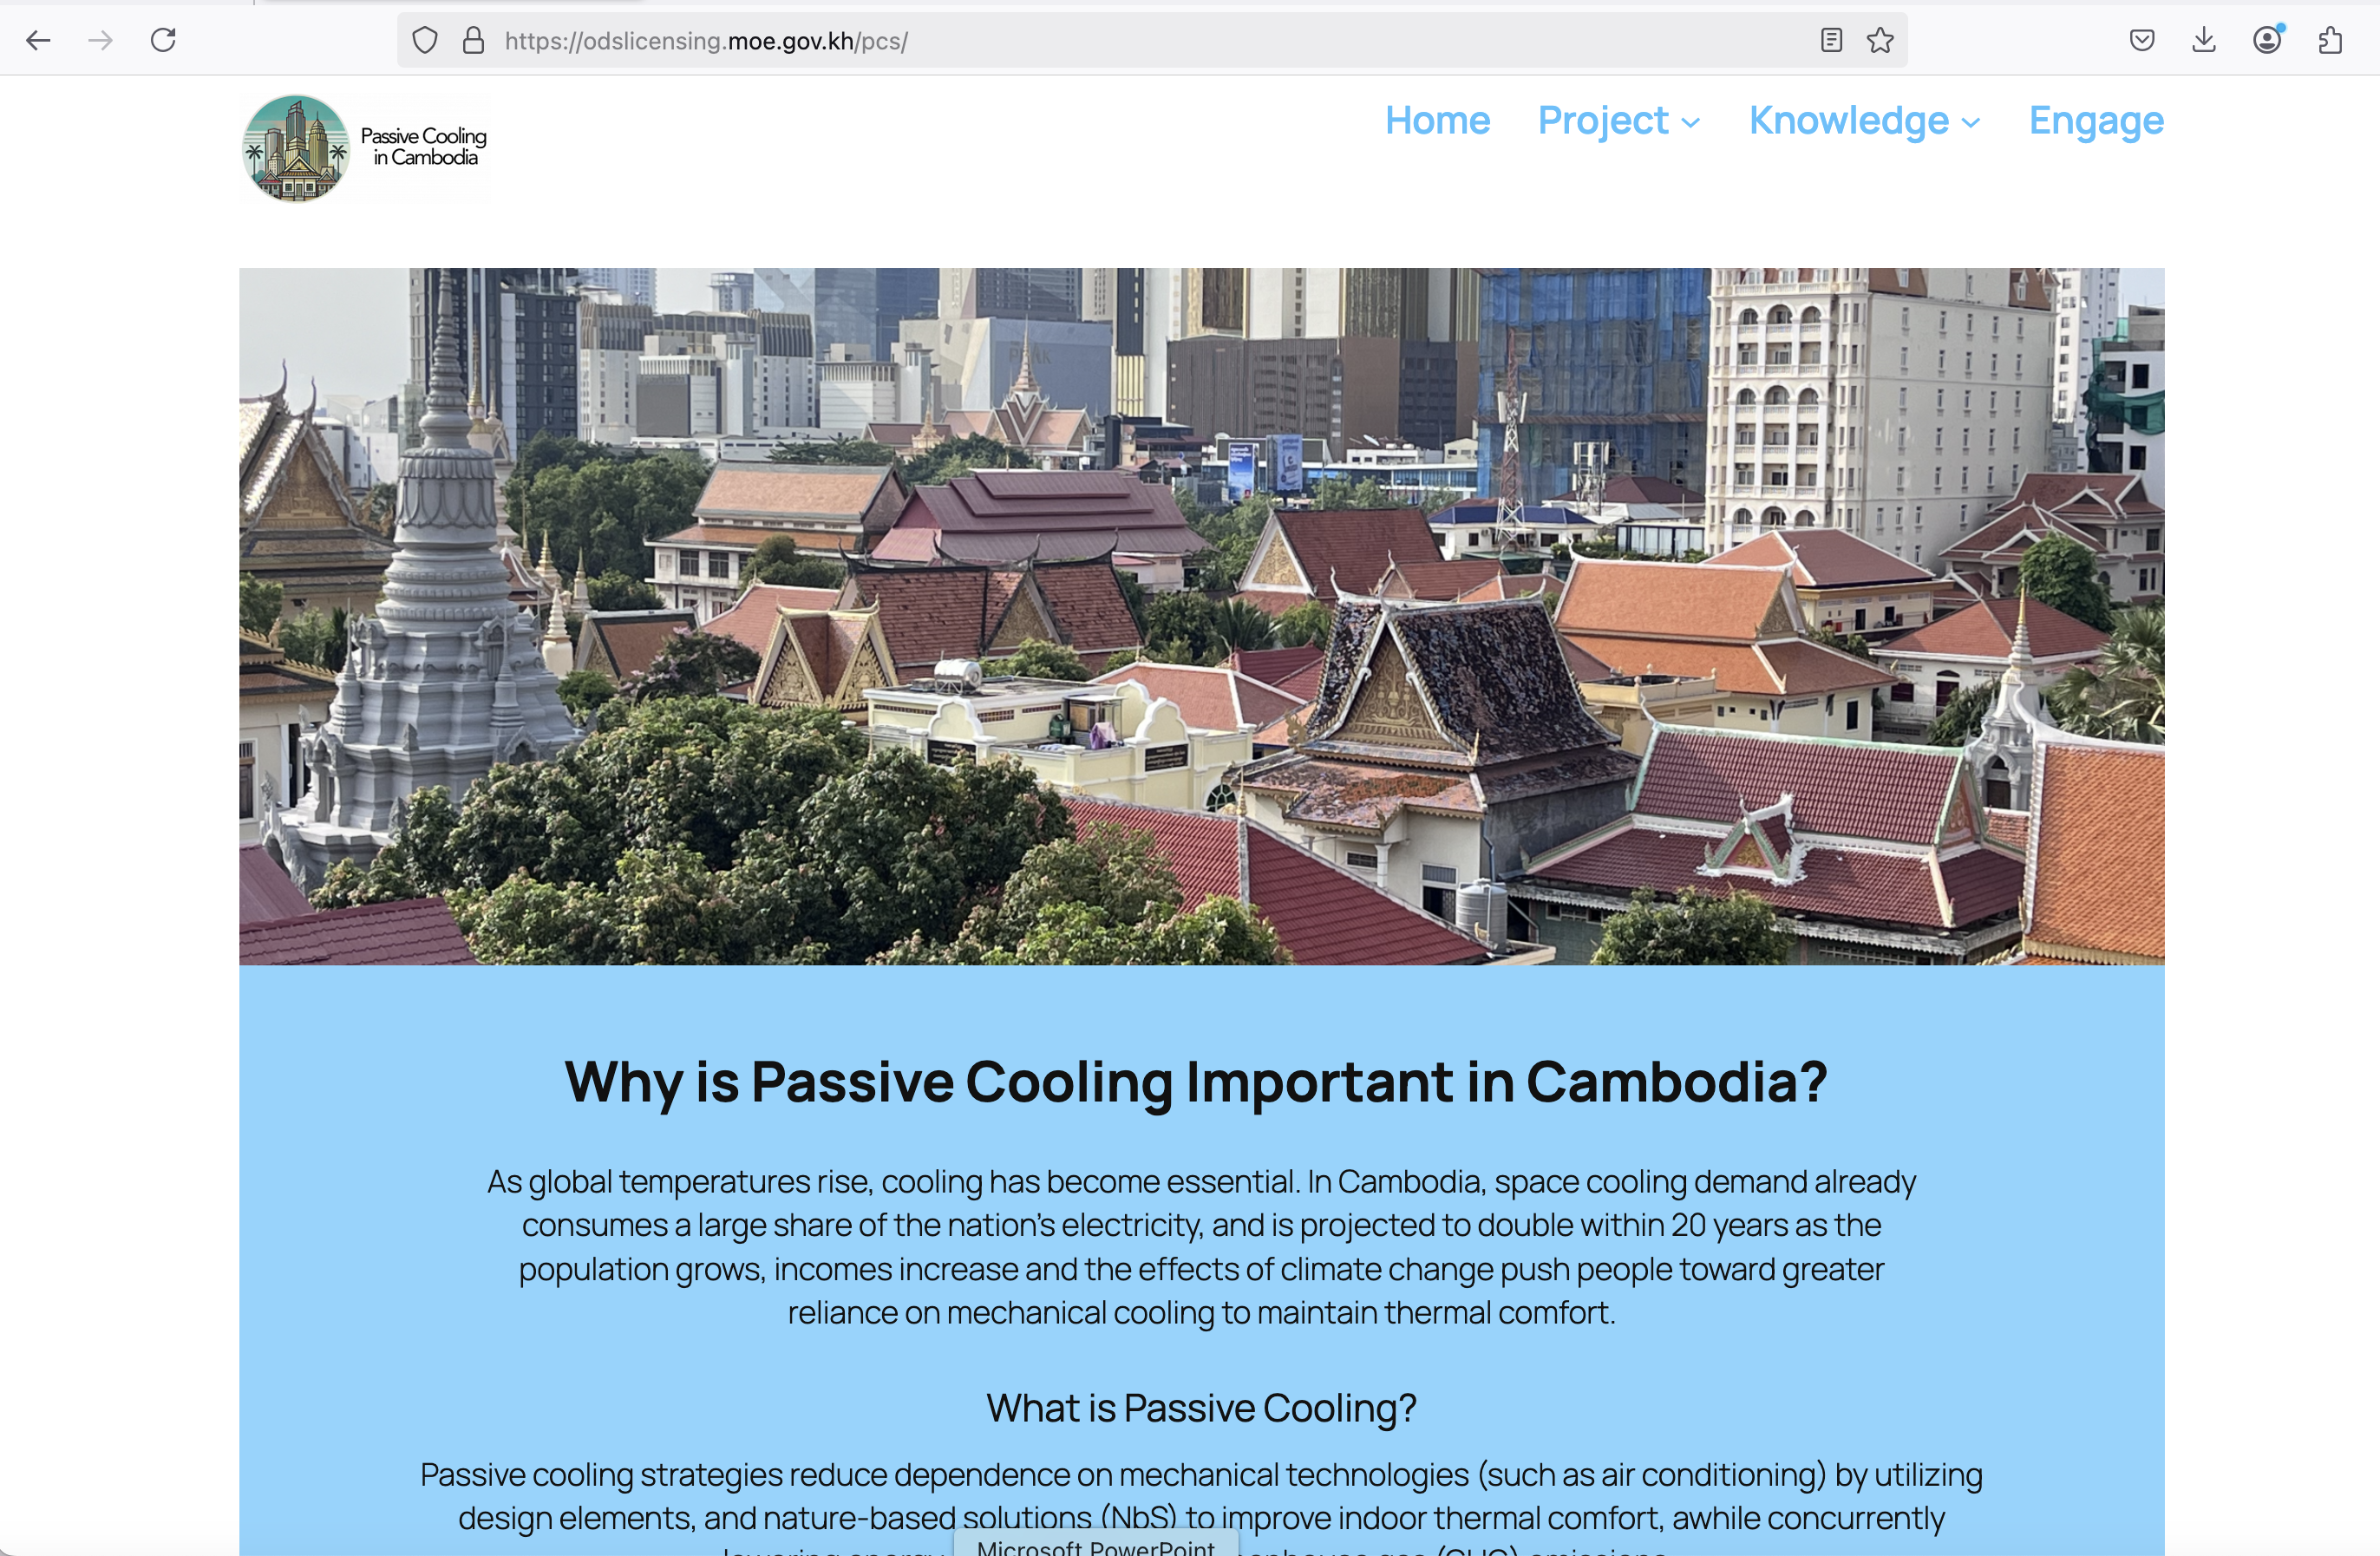
Passive Cooling Knowledge & Tools
2
Provide guidelines and tools for practitioners to enable scale-up
Support decision-makers with in-depth analysis of passive cooling’s potential to lower energy and emissions
Coming soon!
1

Slide 11

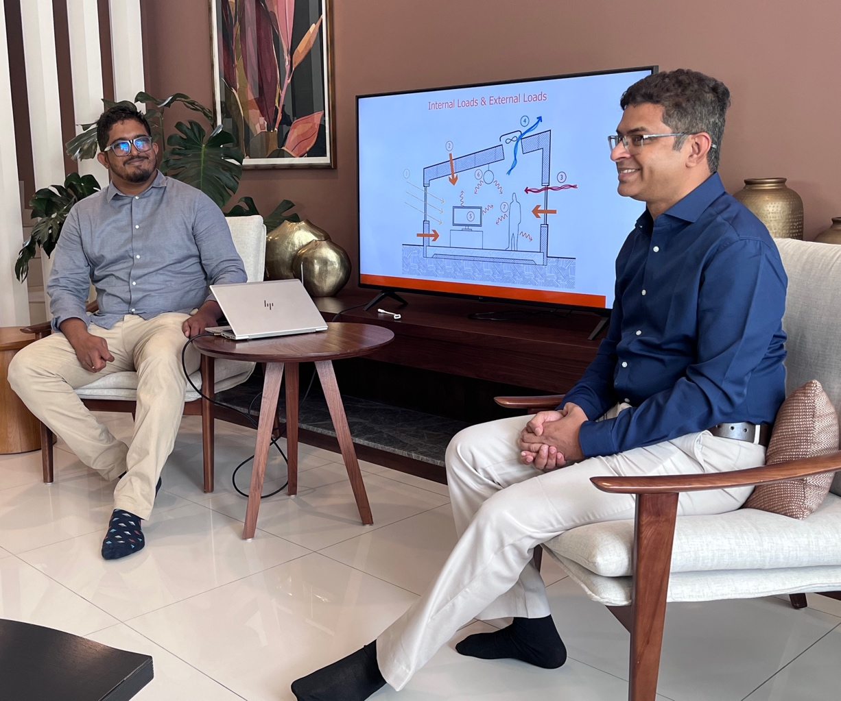


Enabling Ecosystem: Building Capacity and a Community of Practice
Engage stakeholders across the building sector to share knowledge, learn, discuss challenges and identify solutions
Build capacity for designing buildings utilizing passive cooling strategies

Slide 12
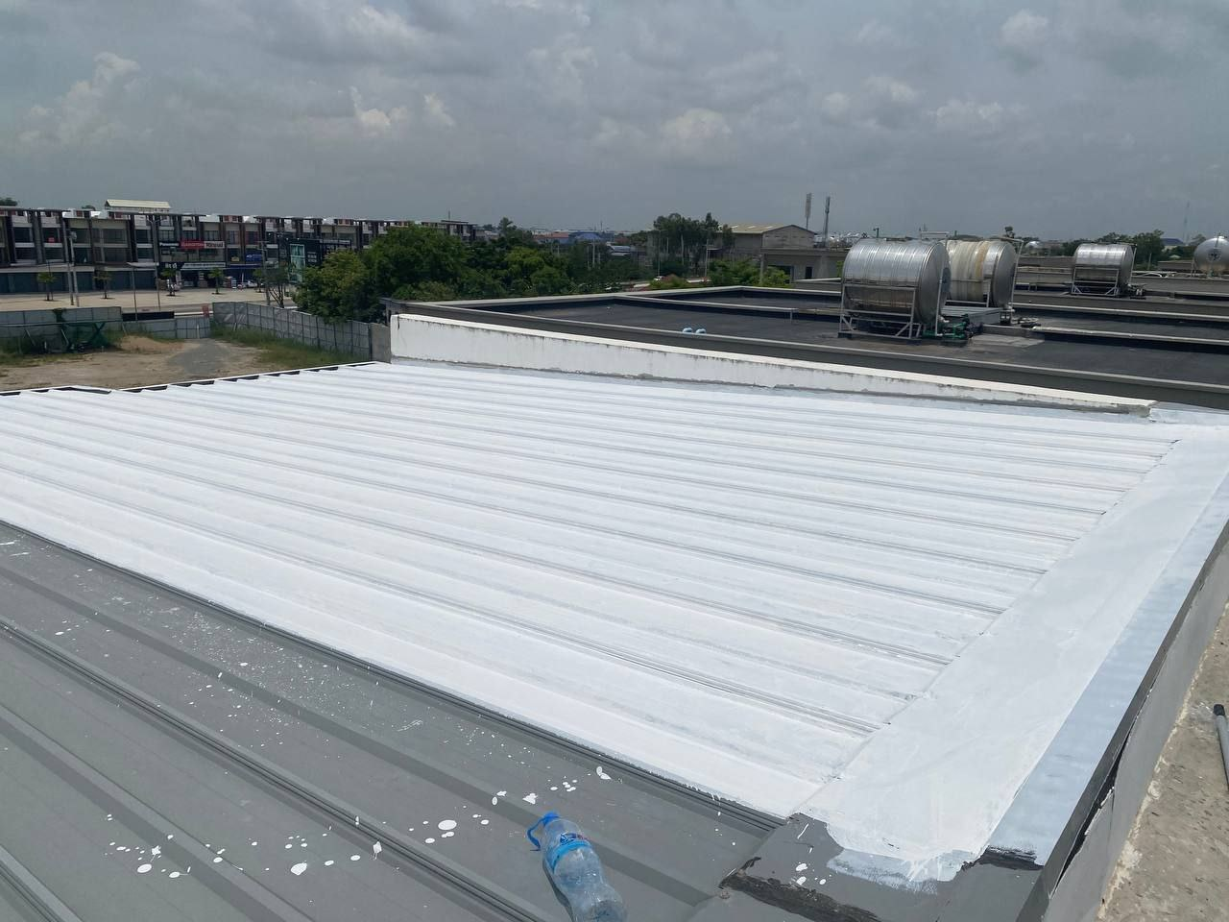
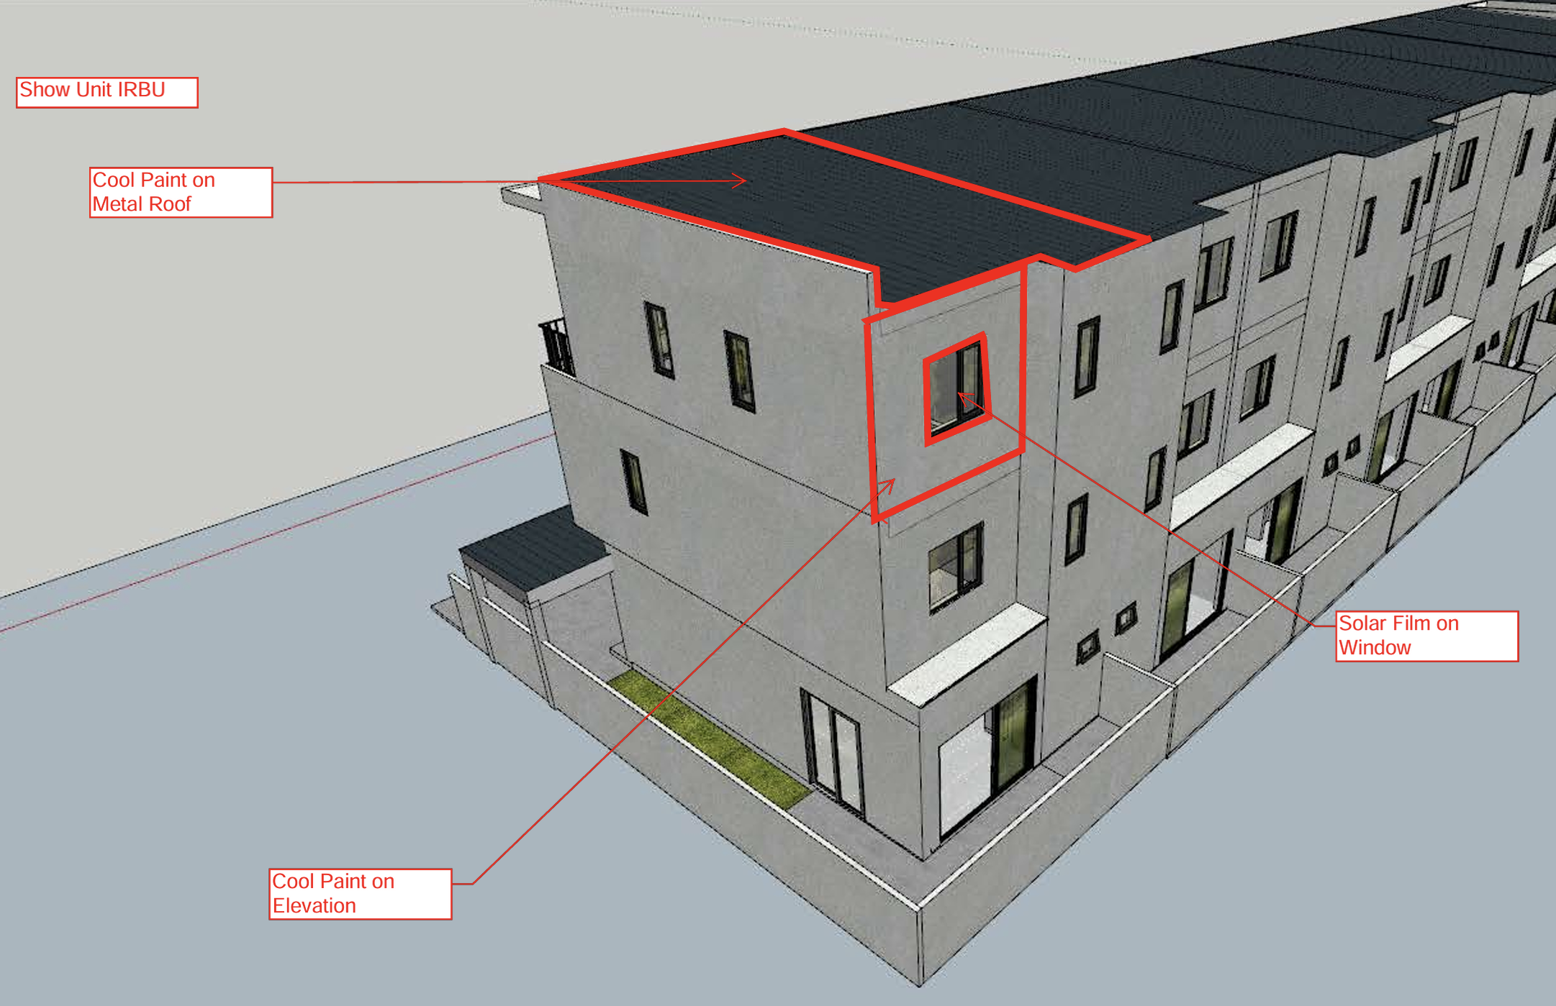

Pilot project
Cool Roof Coating – Metal roof application
3
Demonstrate passive cooling strategies’ application, costs, benefits

Slide 13
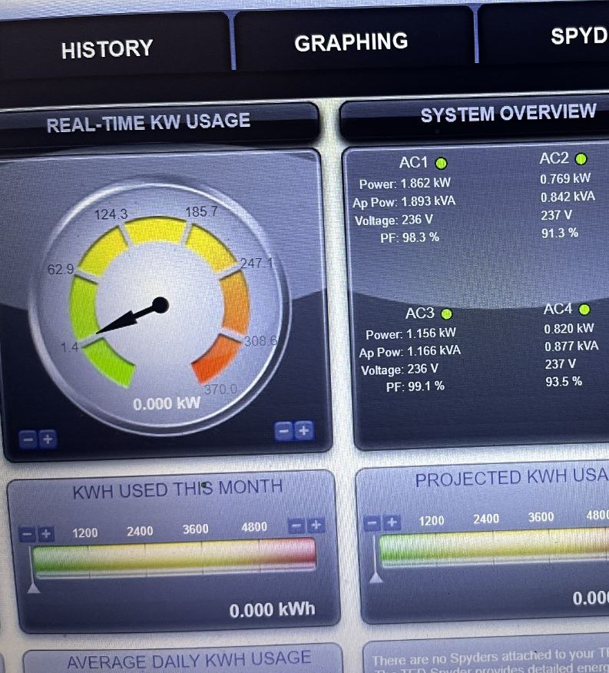


Evidence: Passive Cooling Pilot Demonstration
Establish baseline data in demo units with sensors
Pilot passive cooling strategies and measure impact
Use results to inform national level analysis on passive cooling’s potential to increase thermal comfort and reduce cooling loads (energy demand and emissions)
Contribute to development of building regulations

Slide 14
THANK YOU.

