Slide 1

Agenda 2030 for Sustainable Development:
Country-led evaluation of the SDGs: Why and Why Now?
ADA OCAMPO
IDEAS President
April 2024

Slide 2
Acknowledgments
This presentation was elaborated by Ada Ocampo, IDEAS President, building on her own experience and on the following sources:
UN Resolutions on VNRs and Evaluations
Guide: Embedding Evaluation in VNRs, by UNICEF and CLEAR Anglophone Africa.
Various resources by DEval, EVALSDGs and others
The work jointly being done by IDEAS, UNICEF, DEval and MFA-Finland on the second edition of the Guidebook: Evaluation to connect national priorities with the SDGs
These resources have been listed and hyperlinked in the last slide of this presentation.

Slide 3
Innovation occurs when current abilities are not enough to meet the challenges
The post 2015 era calls upon new ways of doing business / innovation/ revision of evaluation approaches and tools including NECD
Mihaly Csikszentmihalyi’s model of flow as related to challenge and ability
Retrieved from:
https://irinaatanasova.com/2017/02/15/the-flow-the-happiness-the-flow-of-happiness-prof-mihaly-csikszentmihalyi/
Notes:
Mihaly Csikenwnhos’ model of flow maps the relationship between the challenges we face and our capacity to respond. The quadrant of “anxiety”, where we have high challenges, but insufficient capacity to address those challenges, can be difficult – but is also the space where innovation occurs, or where we can make good use of innovations from elsewhere.

Slide 4
The current development context:
Challenges and opportunities for evaluation
2015 marks the need to review the way both development interventions and humanitarian responses, are being approached .
Among the most important milestones:
The adoption, in 2015 of the UN Resolution 2030 Agenda for Sustainable Development
The Paris Agreement on Climate Change – 2015;
The global COVID-19 pandemic and the consequent global humanitarian crisis from 2020 onwards.
Changes in global political alliances as a consequences of current regional conflicts
The recent UN Resolution A/RES/77/283 of May 2023: Strengthening Voluntary National Reviews through country-led evaluations.

Slide 5


The agenda 2030 for Sustainable Development
Formally adopted in 2015
Establishes the 17 Sustainable Development Goals (SDGs)

Slide 6
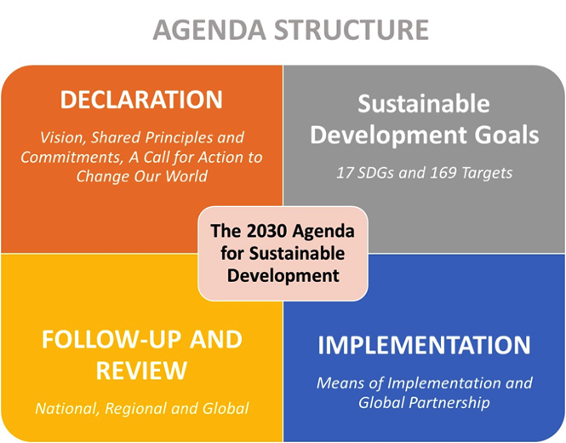
2030 Agenda for Sustainable Development

Slide 7
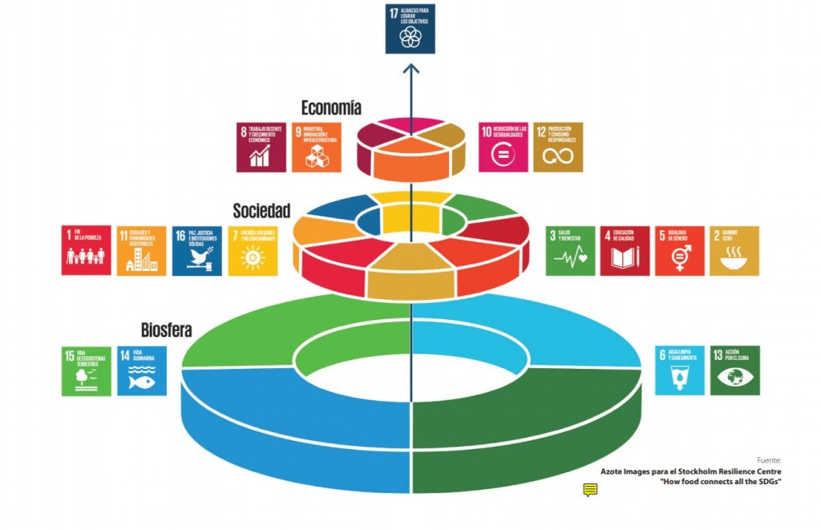
SDGs – Systems Approach: Wedding Cake

Slide 8
Agenda 2030 for Sustainable Development: Follow up and review processes
Establishes principles for follow-up and review processes
  Voluntary and country-led; open, inclusive, participatory and transparent; people-centered, gender-sensitive, respect human rights and particular focus on the poorest, most vulnerable and those furthest behind
  (g) They will be rigorous and based on evidence, informed by country-led evaluations and data which is high-quality, […]
  (h) They will require enhanced capacity-building support for developing countries, including the strengthening of national data systems and evaluation programmes, […].

Slide 9
Relevant Resolutions
69/237 – Building capacity for the evaluation of development activities at the country level (2014)
  2. Invites the entities of the United Nations development system, with the collaboration of national and international stakeholders, to support, upon request, efforts to further strengthen the capacity of Member States for evaluation, in accordance with their national policies and priorities;
70/299 – Follow-up and review of the 2030 Agenda for Sustainable Development at the global level (2016)
  Establishes the high-level political forum on sustainable development (HLPF), its themes and SDGs to be reviewed each year, the voluntary national reviews

Slide 10
2023 Resolution on
Strengthening VNRs through Country-led Evaluation
Resolution 77/283 adopted 26 April 2023 without a vote
Sponsored by Nigeria and co-sponsored by 24 other countries, including Cambodia, China, Mongolia, the Philippines, and Sri Lanka.
  Para 1. Encourages all Member States to present regular Voluntary National Reviews with a Country-led Evaluation component as deemed relevant and useful at the country level in partnership with all relevant stakeholders, in line with the principles of the 2030 Agenda, taking into consideration that follow-up and review processes at all levels will be voluntary and country-led;
  Para 3. Encourages all Member States to use evidence from evaluations of the Sustainable Development Goals implementation for decision-making and reporting on their progress towards achieving the 2030 Agenda including in their Voluntary National Reviews, as appropriate;
  Para 4. Requests the United Nations agencies, within existing mandates and resources, to provide support at the request of Member States on their efforts to undertake evaluations of the implementation of the Sustainable Development Goals and facilitate exchange of experiences and knowledge products from those evaluations.

Slide 11

EVALUATION OF AGENDA 2030 : can we afford to miss the opportunity?
Nine (9) years down the line, countries, international cooperations= and other relevant actors are still discussing whether it is worth to evaluate the Agenda 2030

Slide 12
What is an SDGs evaluation?
Determines the merit, worth, significance and sustainability of national strategies, policies and programmes that contribute to the achievement of the SDGs.
Investigates the complex interactions between the human, economic and natural systems.
Looks at the effects of laws, regulations and procedures within and beyond the geographic boundaries in which they are adopted.
Notes:
Evaluation is usually defined as a systematic determination of a merit, worth and significance of a policy of intervention. Here were will be talking in most cases about external independent evaluation done by an independent team of professional evaluators in response to the Terms of Reference established by the evaluation commissioners.
What’s special about SDGs evaluation? First, it is the object of evaluation. The SDGs evaluation determines the merit, worth, significance and sustainability of strategies, policies and programmes that contribute to the achievement of the SDGs.
Second, the sustainable development is complex and has social, economic and environmental aspect. 2030 Agenda explicitly talks about five pilars of the sustainable development: people, planet, peace, prosperity and partnership. So the SDGs evaluation has to look at complex interactions between the human, economic and natural systems.
In addition, as national policies, e.g. related to climate change, may have effects that span national boundaries, the SDGs evaluation often has to look at the effects of laws, regulations and procedures within and beyond the geographic boundaries in which they are adopted.

Slide 13
SDGs evaluations: are not regular evaluations
COMPLEX EVALUTIONS: multi-linear rather than linear causality (social, political, environmental dimensions, legal frameworks, etc.).
MULTIDIMENSIONAL: multidimensional
MULTISTAKEHOLDER and MULTI-METHOD APPROACH: involve several actors (in line with the 2030 Agenda)
UNIT OF ANALYSIS: public policies or national plans or strategies .
CRITERIA AND PRINCIPLES (BOTH: based upon internationally agreed criteria and standards as well as by the principles of the 2030 Agenda: equity, no one left behind (NOLB), environmental sustainability; shared accountability, etc.
The principles of the 2030 Agenda guide both the design, the management arrangements, and the evaluation approach. The participatory approach is "non-negotiable".
USE OF EVALUATION: linked to good governance and to better and more equitable public policies. Learning (triangular, south-south) is also relevant.
Notes:
La evaluación suele ser definida como la determinación sistemática de la relevancia, el valor y la trascendencia de una política o intervención. Aquí estaremos hablando en la mayoría de los casos de la evaluación externa independiente que realiza un equipo de evaluadores independiente en respuesta a los términos de referencia establecidos por los responsables de encargar la evaluación.
¿Qué tiene de especial la evaluación de los ODS? En primer lugar, el objeto de evaluación. La evaluación de los ODS establece la valía, el valor, la trascendencia y la sostenibilidad de las estrategias, políticas y programas que contribuyen al logro de los ODS.
En segundo lugar, el desarrollo sostenible es un tema complejo y tiene una dimensión social, económica y ambiental. La Agenda 2030 menciona explícitamente cinco pilares del desarrollo sostenible: personas, planeta, paz, prosperidad y alianzas. En consecuencia, la evaluación de los ODS tiene que examinar las interacciones complejas entre los sistemas humanos, económicos y naturales.
Además, dado que las políticas nacionales, por ejemplo aquellas relacionadas con el cambio climático, pueden tener efectos que trascienden las fronteras nacionales, la evaluación de los ODS a menudo tiene que examinar los efectos de las leyes, normas y procedimientos no solo dentro de las fronteras nacionales en las cuales son adoptados sino también más allá de ellas.

Slide 14
Country-led evaluations
Evaluations that are managed and used by governments with the participation of broad sectors of society; and with the cooperation of development agencies. Although they are led and managed by governments, these evaluations should be conducted in an inclusive process, open to all national stakeholders, in line with the principles underlying the 2030 Agenda. Considering that the SDGs are led, managed, and monitored at the national levels, their evaluations must also be country-led to ensure that countries are at the helm of their own development.

Slide 15
What to consider when initiating an SDGs evaluation?
Political decision: High level decision-making is required for the evaluation.
  The political decision to evaluate the SDGs will trigger technical consequences. Policy dialogues are an important first steps to initiate the evaluation.
  The decision to evaluate would lead to:
  Allocation of financial resources
  Designation and negotiation of responsibilities: in line with the 2030 Agenda, engagement of various actors/ stakeholder
  Commitments and expectations on the use of the evaluation
Notes:
nacionales

Slide 16
The evaluation should be tailored to the specific needs and context of the country and structured around existing national policy and evaluation systems.
This guide is the main resource on which this workshop is based. It draws on practical experiences from Finland, Nigeria and Costa Rica.
It provides guidelines, concepts, and examples that countries can leverage to design and conduct their own SDG evaluation.
Additionally, the contents of the workshop take as a complementary pillar, the lessons learned and other resources now available on Evaluation and the SDGs.
Notes:
El presente taller se sustenta, principalmente en la publicación “Evaluación para conectar las prioridades nacionales con los ODS. Una guía para responsables de comisionar y gestionar evaluaciones”. La guía fue inspirada por un taller internacional celebrado en Helsinki en marzo de 2019, que congregó a 33 representantes gubernamentales y especialistas en evaluación de 22 países.
El taller de Helsinki promovió el aprendizaje transnacional y permitió identificar desafíos comunes en el uso de la evaluación para impulsar la alineación de los planes nacionales con las expectativas de los ODS. Una de las lecciones que emergieron de este evento es que, si la evaluación ha de ayudar a alinear las políticas nacionales con la Agenda 2030, debe estar diseñada para evaluar las necesidades y el contexto específicos del país en cuestión y basarse en los sistemas nacionales políticos y de evaluación existentes.
La guía ofrece lineamientos, conceptos iy ejemplos que los países pueden aprovechar para diseñar y llevar a cabo su propia evaluación de los ODS. Adicionalmente el taller se basa en las lecciones aprendidas por los países luego de haber concluido evaluaciones de ODS así como en información complementaria ahora disponible.

Slide 17
Main steps to plan SDGs evaluation
Notes:
Figure from page 10 in the Guidebook.
The workshop focuses on the preparatory phase of the evaluation. During this stage evaluation commissioners have to make decisions about the overall purpose/ objective of the evaluation, decide what stakeholders shall be involved in the evaluation management and support, define focus and scope of the evaluation, decide on the evaluation criteria and questions. Commissioners also have to decided on approaches to the reconstruction of the logic of the evaluated policies and interventions. The last but not lease task is to develop a communication plan for dissemination of the evaluation results.

Slide 18


Be realistic - policy is not simply derived from evidence
Pragmatics &
Contingencies
Lobbyists and Pressure Groups
Experience & Expertise
Evidence
Habit and
Tradition
Judgement
Values
Resources

Slide 19
Final messages. - Why country-led evaluations of the SDGs and Why now?
  Countries at the driver’s seat: an aim since Paris Declaration 2005. Is there evidence that is is actually happening.
  Good governance: countries need to demonstrate accountability towards international commitments and to report in a Evaluation of Agenda 2030 Agenda is an excellent opportunity to demonstrate results
  Agenda 2030 is transformative in nature. I evaluation of 2030 Agenda: an opportunity to evaluate transformational change at various levels.
  Evaluation of the SDGs (as any other evaluation) poses challenges: challenges are political and technical and not only the latter:
  he decision to evaluate the SDGs is a political decision with technical implications and not the other way around.
  As stakeholders/agents for change, we, EVALUATORS, need to ensure contribution to trigger the decision to evaluate the SDGs. This is the Number 1 challenge.
    PROMOTE the involvement of different stakeholder in policy dialogues leading to the decision to evaluate.
    In line with the Agenda 2030, work to be done in partnerships
  There are already a number of countries that are paving the way and various others about to start. Let’s learn from them.
  There is limited time: 2030 is fast approaching: countries should not miss the opportunity.

Slide 20

Resources
Guide on: Embedding Evaluation in Voluntary National Reviews
Strengthening Voluntary National Reviews trough Country Led – Evaluations – UN Resolution April 2023
VNRs and SDGs evaluations in Anglophone Africa and in Latin America

