Slide 1
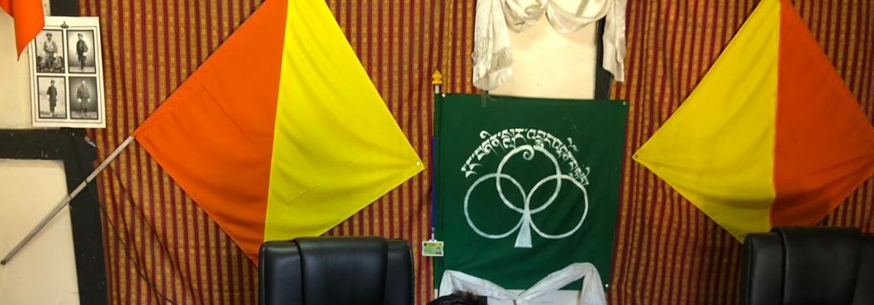
Chhimi dorji
Bhutan
www.chhimidconsulting.com
EVALUATION ASSOCIATION OF BHUTAN
https://evalbhutan.org/
IEECCE 2021!
ENERGY EVALUATION IN BHUTAN

Slide 2
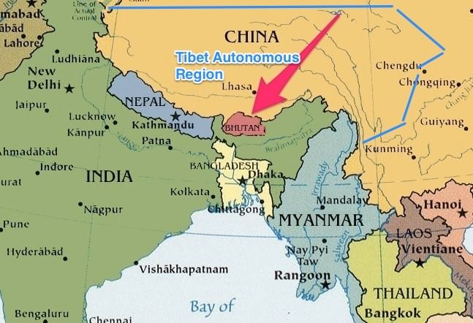
38,395 Sq.km. ~ 800,000 people

Slide 3

ENERGY IN BHUTAN
HYDROPOWER IS THE MAIN SOURCE OF ELECTRICITY
80% IS EXPORTED
Electricity to GDP ~ 20%
70+ Forest Coverage
Carbon negative
In a 2016 Ted Talk titled, “This country isn’t just carbon neutral – it’s carbon negative”, Tshering Tobgay – former Prime Minister of Bhutan – highlighted the country’s innovative strategies.
https://www.youtube.com/watch?v=7Lc_dlVrg5M

Slide 4
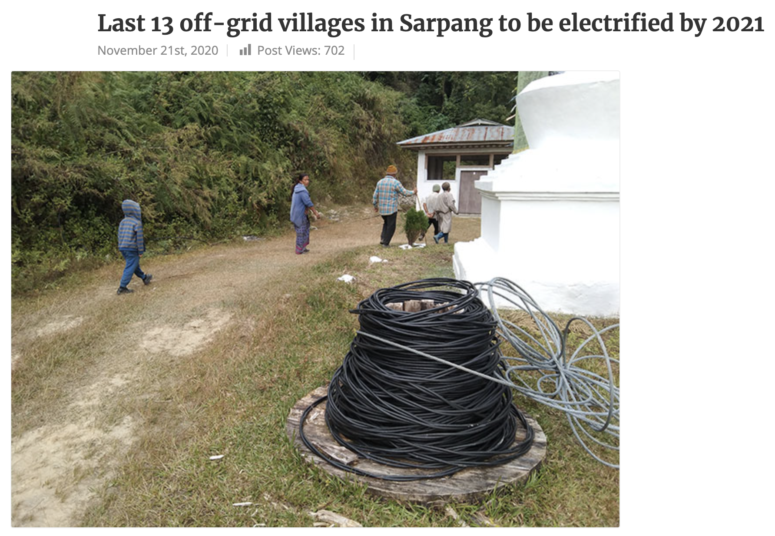
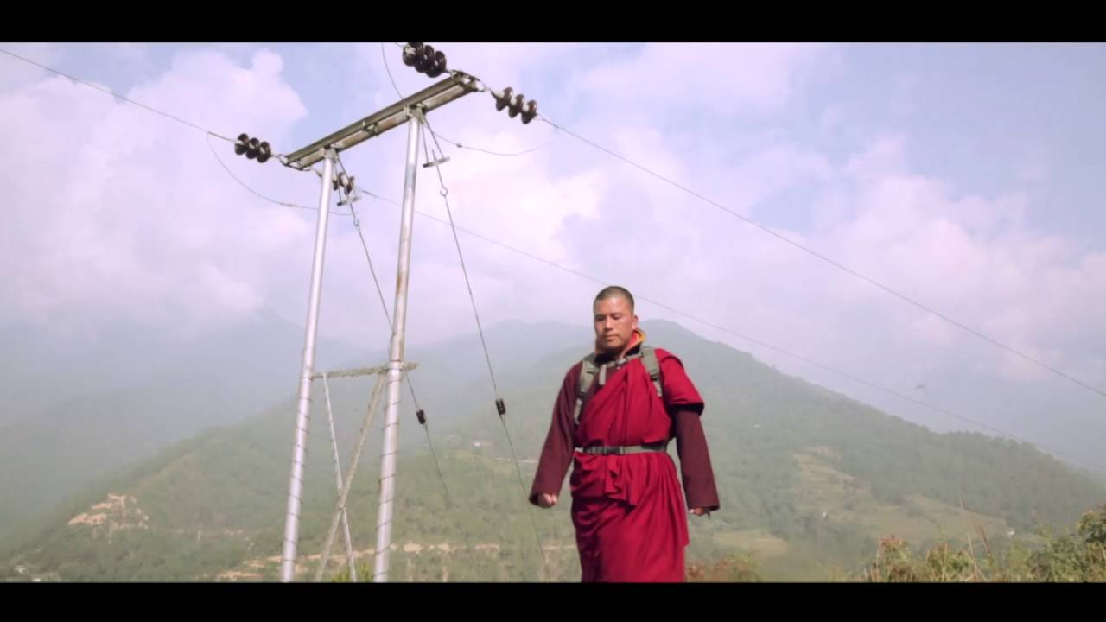
Rural electrification given importance and successful

Slide 5
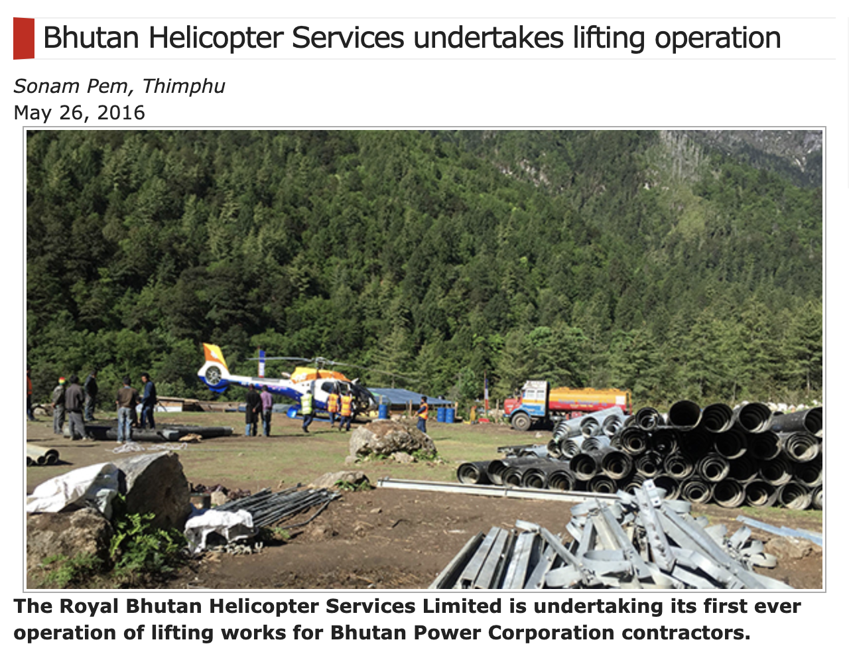

Slide 6
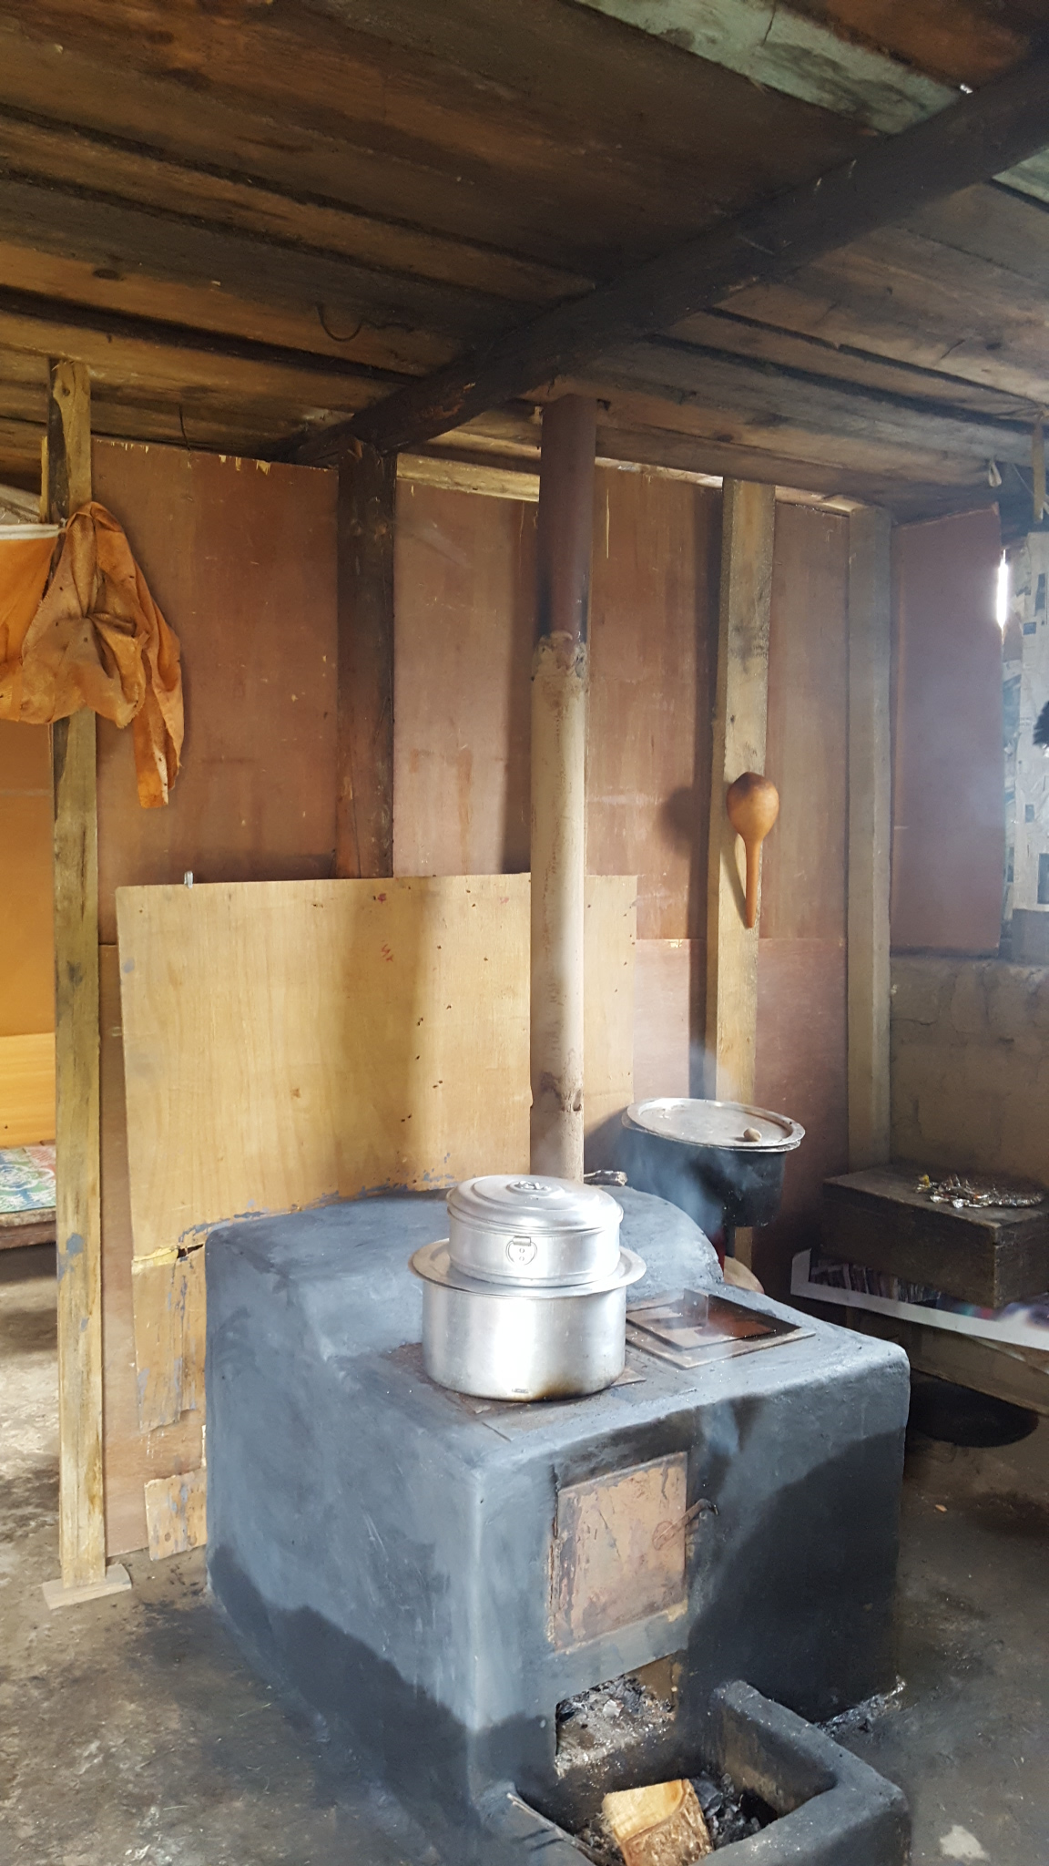
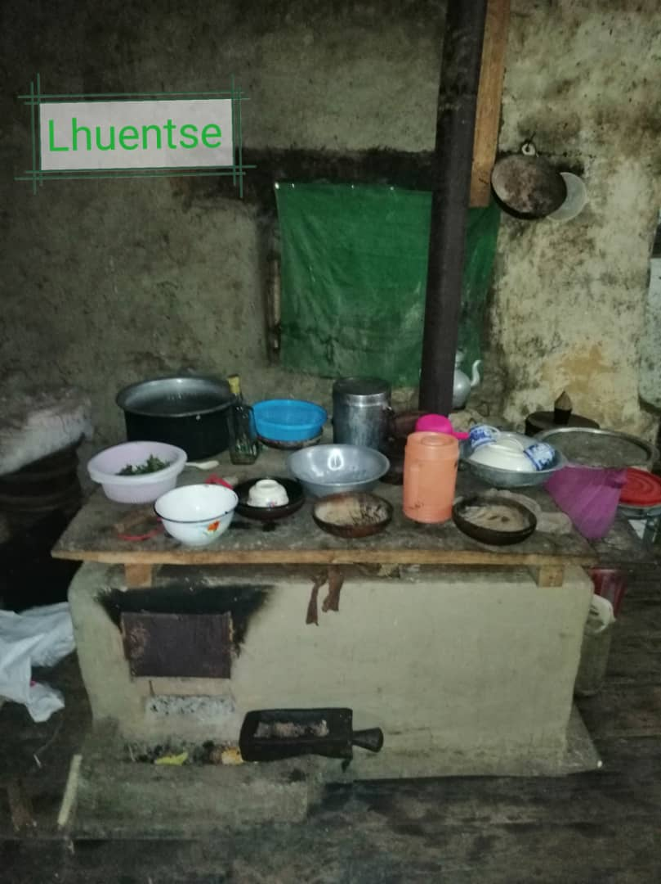
Cooking stoves

Slide 7
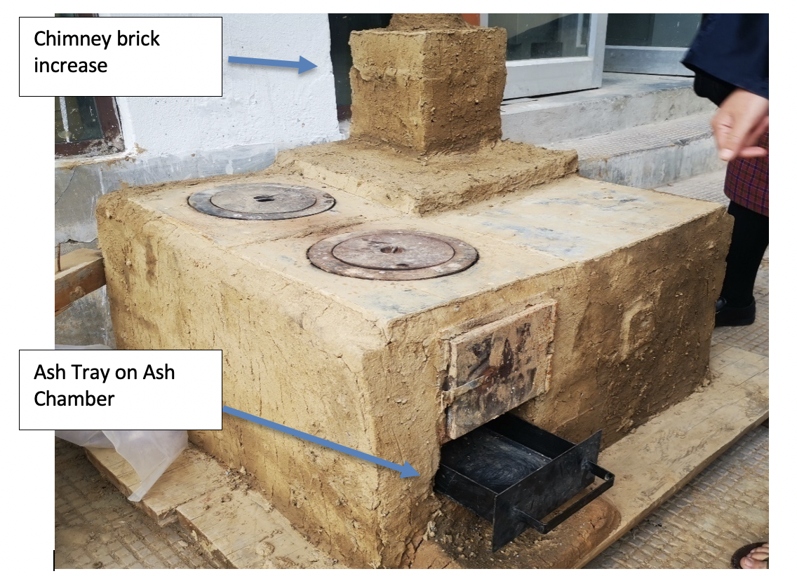
Multi-purpose stoves – re-design

Slide 8
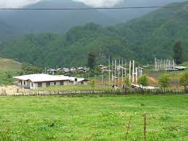
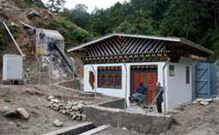
Community Micro Hydro for Sustainable Livelihoods

Slide 9

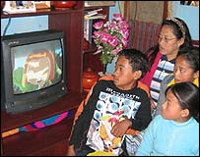
Electrification project
GOAL
CLEAN HOMES
SUSTAINABLE ENERGY
MORE TIME FOR ECONOMIC ACTIVITIES
But we also found surprises

Slide 10
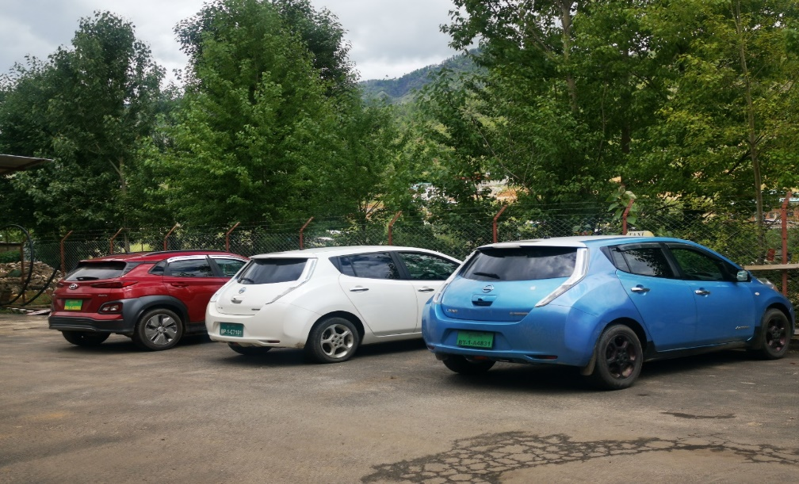
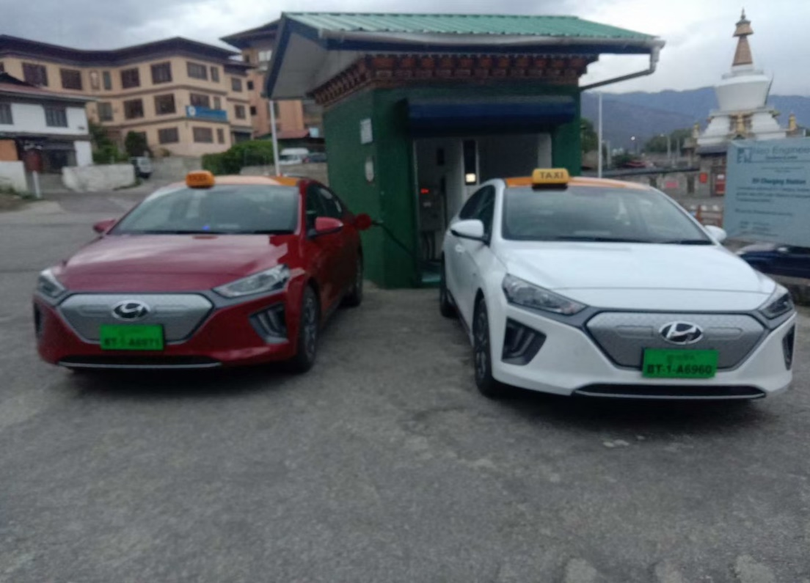
EV Technology

Slide 11
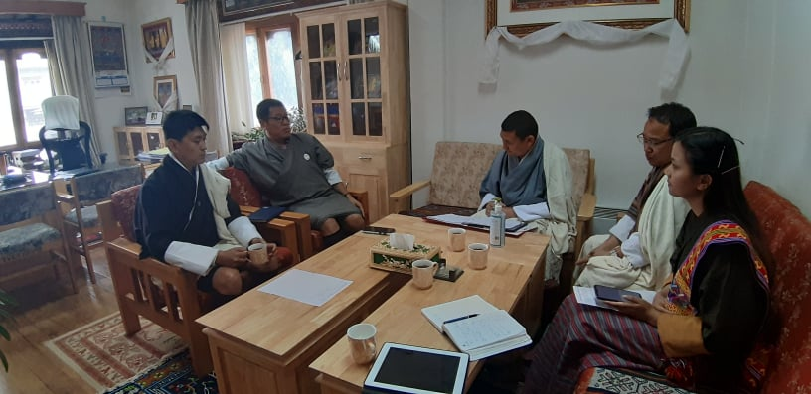
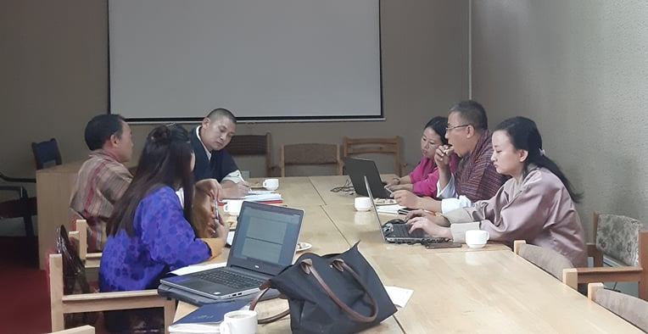
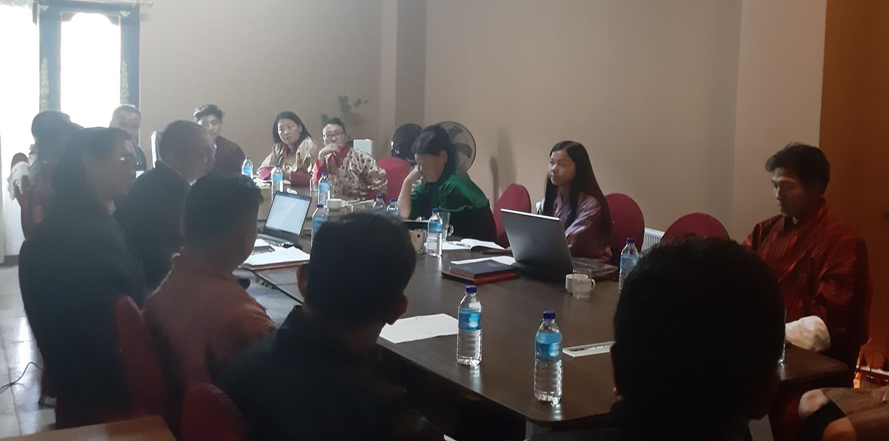
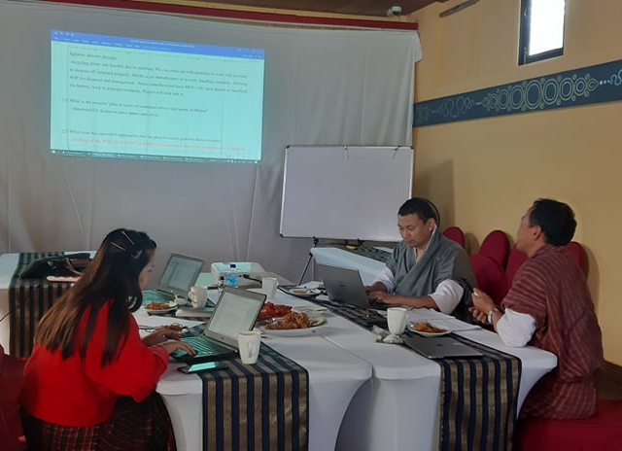
FGD: TVET, MoLHR
FGD: RSTA
FGD: Car Dealers
FGD: PMU
SOME PICTURES TAKEN DURING THE FOCUS GROUP DISCUSSIONS

Slide 12
Notable Achievements
Banks provide 70% loan for procurement of EVs. Loan tenure increased from 5 years to 7 years.
Cost Subsidy for capital cost
Zero Tax
Charging stations network underway – PPP model
Curriculum for training and operation
Makes the country self reliant and carbon negative

Slide 13
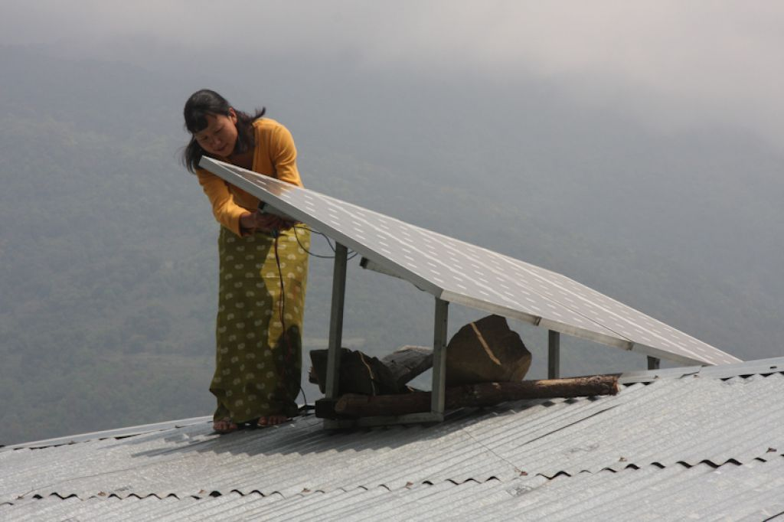
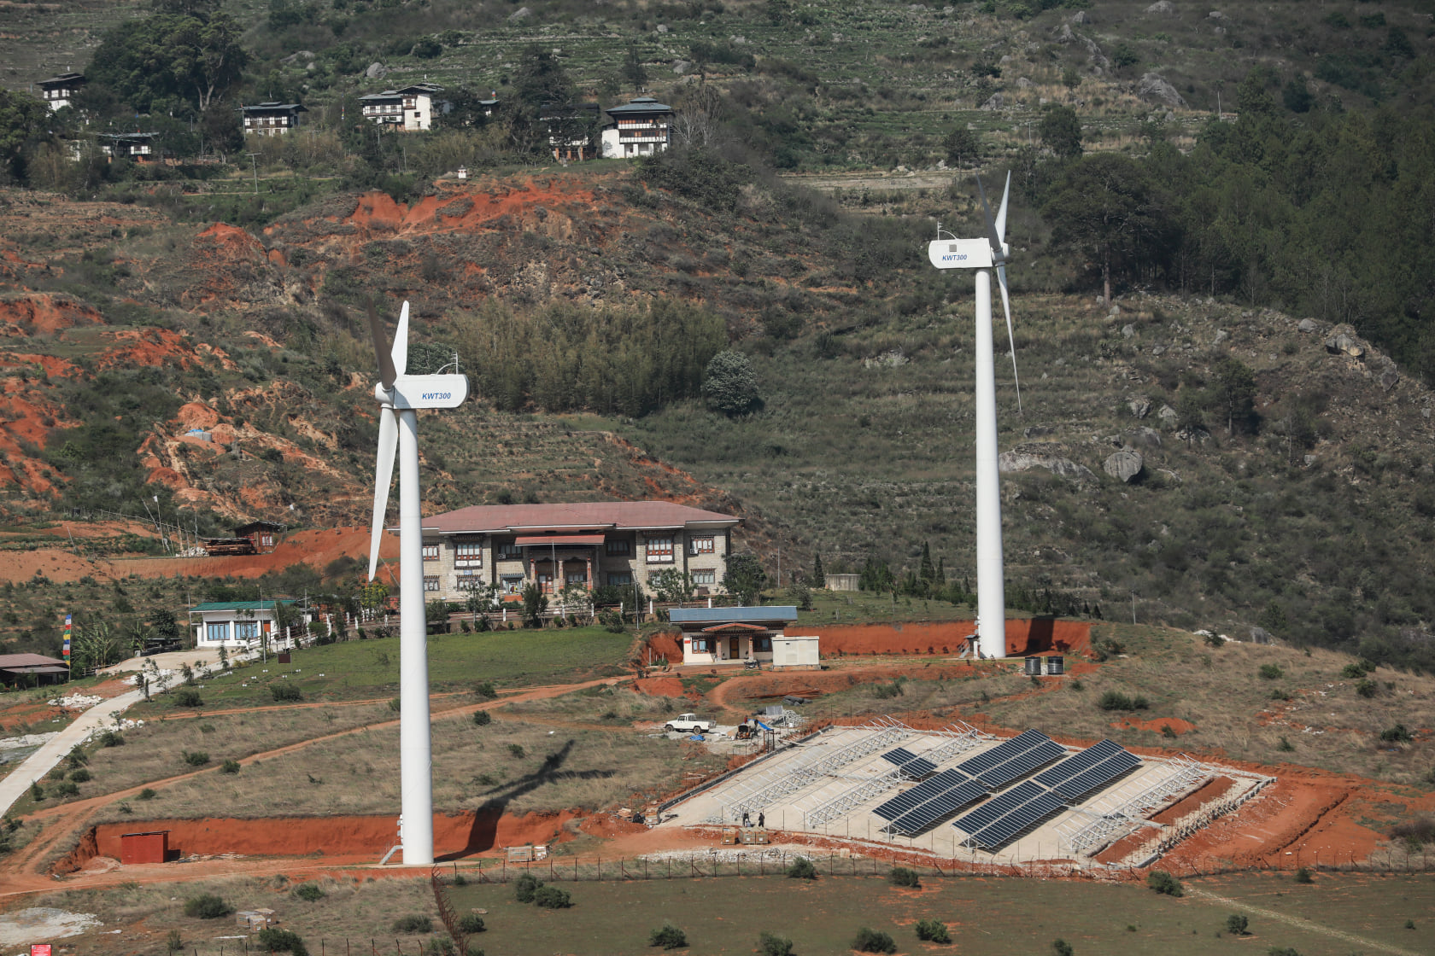
Alternative renewable Energy- new initiatives

Slide 14
Thank you
chimi6@gmail.com
www.Chhimidconsulting.com

